Slide 1
Business and Development Update
October 2018

Slide 2
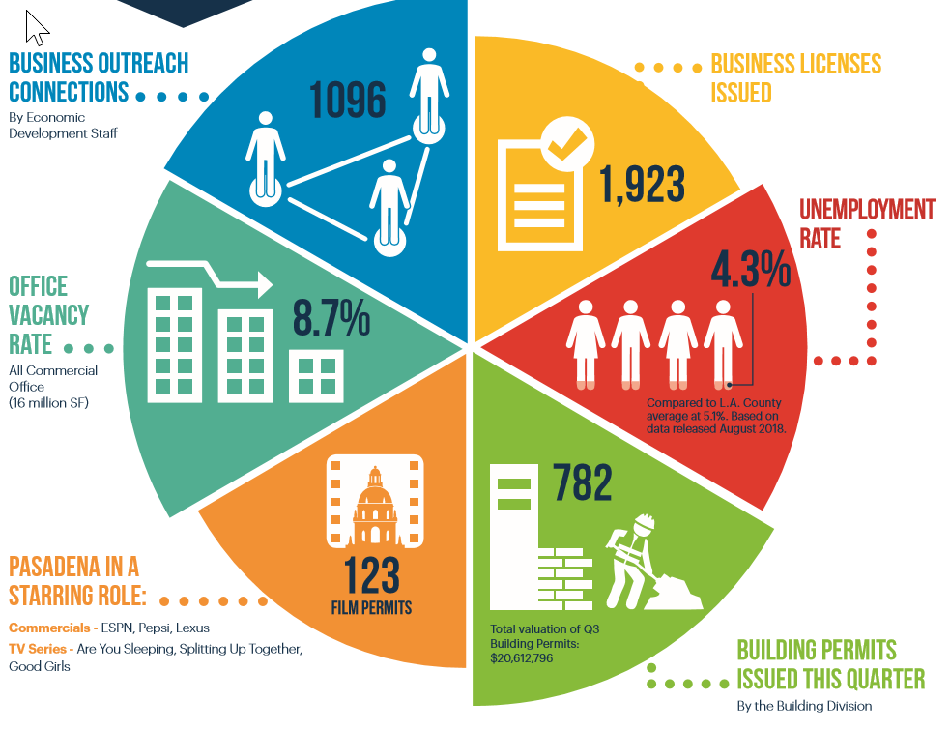
PASADENA - Q3 - 2018

Slide 3
Presentation Outline
Growing Pasadena Companies …
New Development Activity

Slide 4
GM CRUISE – OE Waves
From Pasadena’s OE Waves company, this new group uses a pulsed laser sensor to measure the distance between objects and is a crucial component of autonomous vehicles' navigation systems.

Slide 5
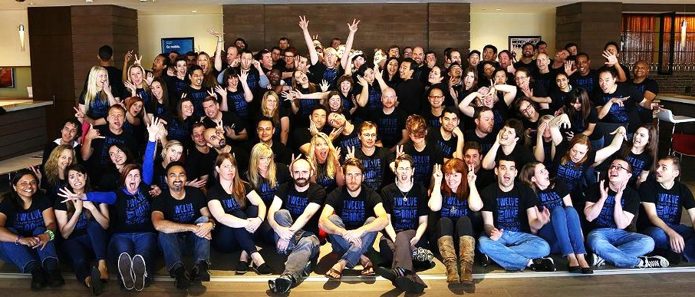
Bluebeam
Bluebeam develops smart, simple PDF creation, markup and editing software for paperless workflows. Products are used by the world’s top architecture, engineering and construction firms, as well as government agencies.
55 S Lake Ave

Slide 6
Open X
Creates programmatic marketplaces where premium publishers and app developers can best monetize their content by connecting with leading advertisers.
888 E. Walnut Street

Slide 7
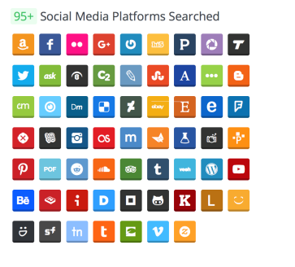
Spokeo
Public Records
Spokeo uses proprietary merge technology to process over 12 billion records in less than 18 hours. They offer consumer and law enforcement services.
Self-Portrayed Social Media
199 S. Los Robles

Slide 8
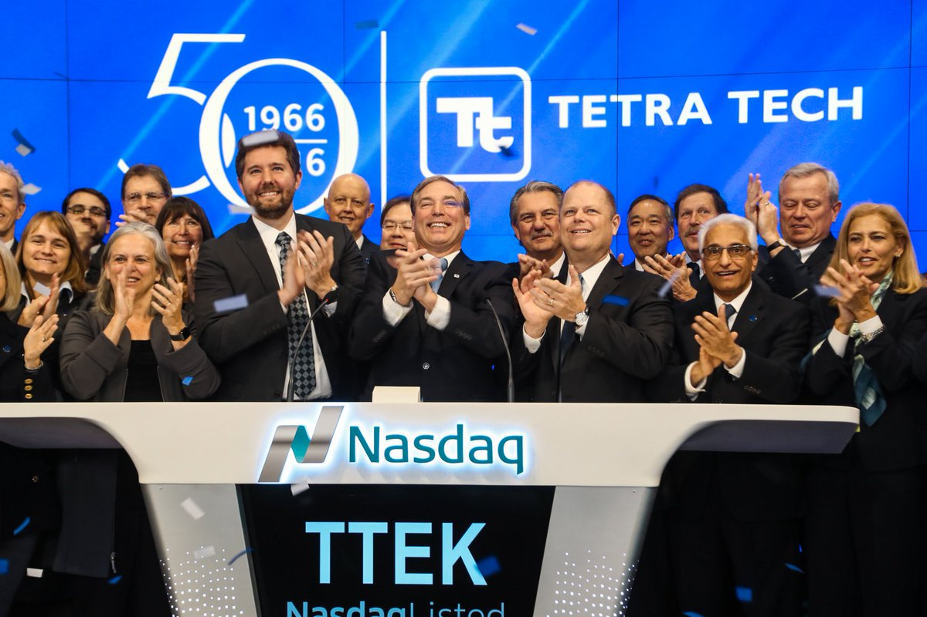
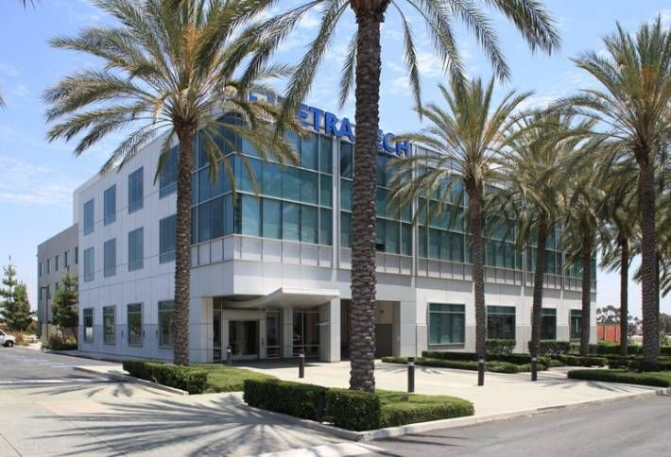
Tetra Tech
Tetra Tech is a leading provider of consulting, engineering, and technical services worldwide. Home to leading experts in water, environment, infrastructure, resource management, energy, and international development.
3475 E. Foothill Blvd

Slide 9
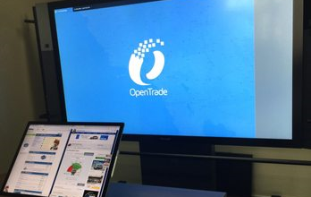
OpenTrade
OpenTrade partners with an expansive network of franchise dealerships Patented auction systems are the fastest, most efficient way to find and get what you are looking for.
Fox Dealer
Fox specializes in custom Websites and Design, effective Search Marketing and advanced conversion methods such as Video Retargeting

Slide 10
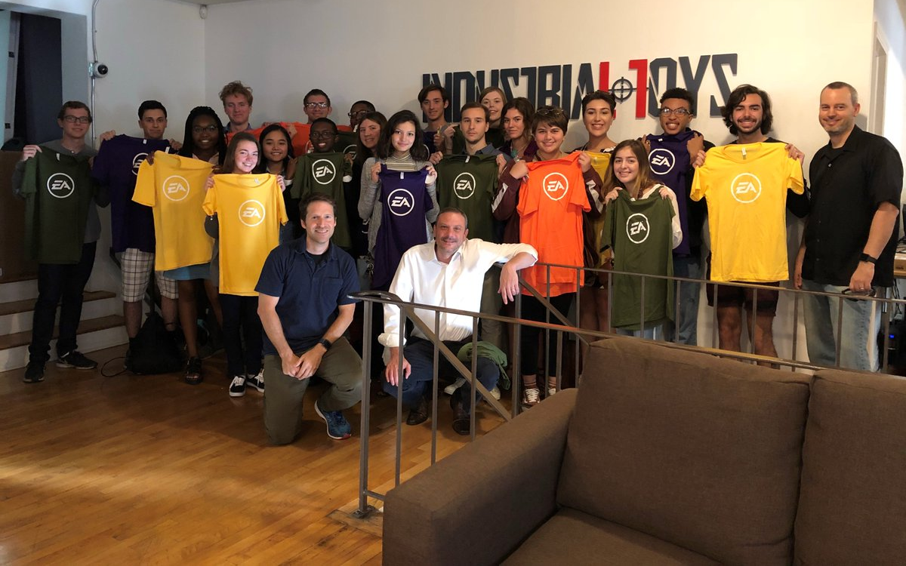
ELECTRONIC ARTS
Pasadena’s Industrial Toys was recently acquired by EA (Electronic Arts) The strategy is intended to expand EA’s mobile device gaming business.
201 E. Colorado Blvd

