Slide 1
Minimum Wage Information
Presented by
Chamber of Commerce and Civic Association of Pasadena

Slide 2
Pasadena Employment Information
Who works here?
Residents (2014 Census estimate) | Resident Workers (Those who live in Pasadena and work in Pasadena.) | Home Based Resident Workers | Estimated Resident Minimum Wage Workers (at 2.5x national average of 3.7%) | Total Employment (jobs) in Pasadena (City of Pasadena) | Minimum wage workers in Pasadena
140,888 | 13,700 | 2372 | 1048 | 100,000 | 15,000

Slide 3
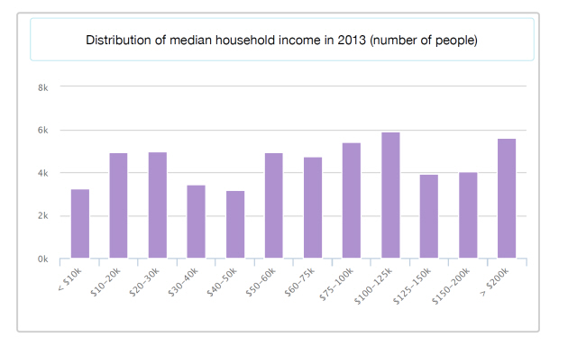
Income distribution for Pasadena residents

Slide 4
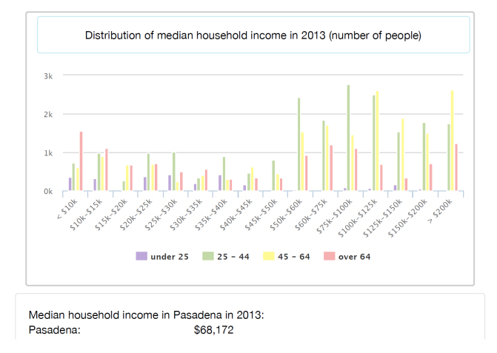
Income distribution by age – Pasadena residents

Slide 5
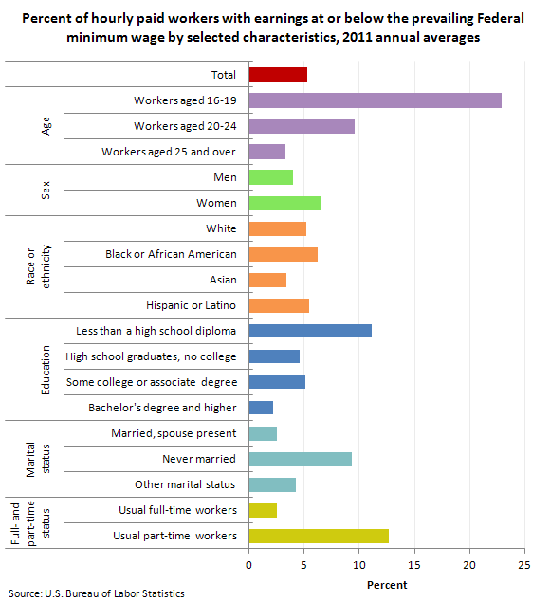
Who makes minimum wage?

Slide 6
Pasadena Business Profile
Total Businesses (Census Bureau 2010) | Small locally and owned business | Non-profits (local) – estimate from Pasadena Community Report Card 2012
18,133 | 16,048 | 1050

Slide 7
Chamber member response to Los Angeles minimum wage increase

Slide 8
How will it impact your business?

Slide 9
How will you adjust your business should the minimum wage increase?
Note, multiple responses total to more than 100%

Slide 10
Possible mitigations from City
Note, multiple responses total to more than 100%

Slide 11
Industries most impacted
HOME HEALTH CARE – set insurance and medical reimbursements for services – could leave clients without providers.
CHILD CARE AND EARLY CHILDHOOD EDUCATION– student to caregiver ratios force wages down, can’t raise costs to meet higher wages and state requirements – could make care unaffordable for working families.
SENIOR LIVING – fixed income residents, costs rise significantly when wages rise. Estimates from providers are the increase would mean $1250 more per month per unit – could force seniors to lower cost options.
RESTAURANTS – tipped employees can make between $25 and $65 per hour now – can’t raise prices enough to cover additional costs – will seek other options.
NON-PROFITS – those dependent on state funds have seen drops in funding levels, fundraising has remained static – could result in diminished services to clients.
LOCAL RETAILERS – dependent on part-time minimum wage employees and seasonal employees. Can’t raise prices by the amounts that would be required to cover additional costs – would likely mean fewer employment opportunities.

Slide 12
Who is at risk?

Slide 13
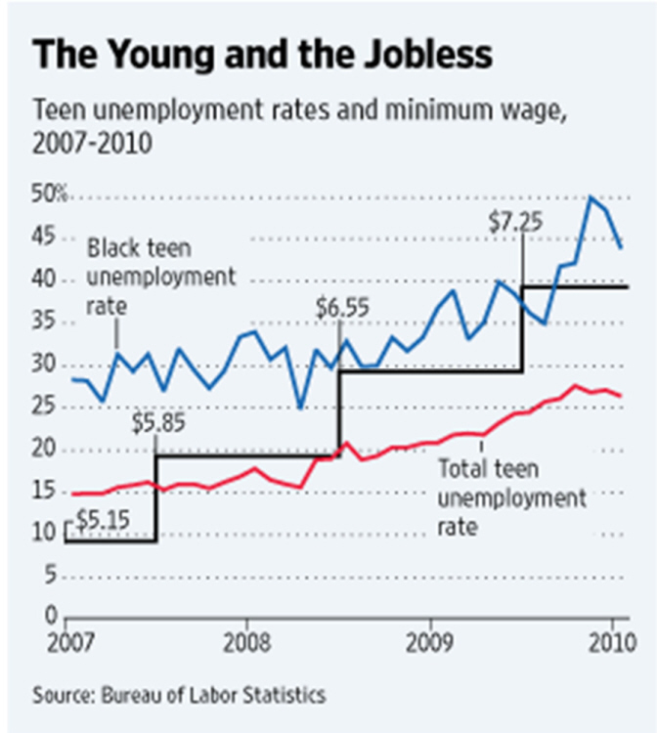
Young people, especially minorites

Slide 14
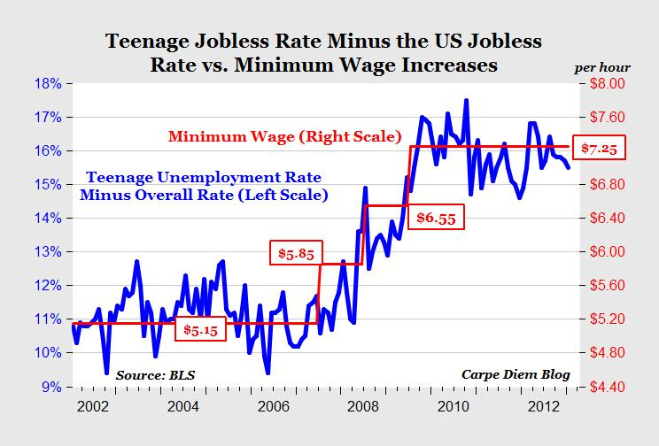
Ten year comparison

Slide 15
Those with barriers to employment
Formerly homeless
Recently released felons
Those with disabilities
Former gang members

Slide 16
Mark Loranger, president of Chrysalis, whose nonprofit helped 1600 poor or formerly homeless people find jobs in LA last year says, “They (clients) have difficulty in raising their budgets quickly enough to adapt to the rising costs of our services, which of course would be driven by the wages,” Loranger told KPCC. "They have a fixed budget, and we’ll work within that budget, but inevitably, that means fewer of our clients will be employed.”
"I was a gang member for over 20 years, I’ve been in prison. I was an addict," said Jermaine Smith, a "trainee" at Homeboy Industries. He'd just watched the full City Council cast a vote on raising the minimum wage. Part of his rehabilitation program at Homeboy Industries is working for minimum wage in the merchandising department. He says that’s changed his life. "So I would be willing to cut my check in half to let the next man get the same opportunity."

Slide 17
Pasadena Chamber recommendations
DO AN ECONOMIC STUDY particular to Pasadena. We are not Los Angeles and you need real information on Pasadena to inform any decision you may make.
FORM A WORKING GROUP OF STAKEHOLDERS to research the issue and come forward with a recommendation for Pasadena.
NO CPI INCREASE, saddling business with unfettered cost increases is an invitation to economic disaster.
EXEMPT THOSE EMPLOYEES WHO WILL BE HARMED, such as youth, difficult to employ populations (felons, formerly homeless, etc.) so hey have a fair chance at finding work as they transition back into the workforce.
CONSIDER THE TOTAL COMPENSATION MODEL - exempt employees who make taxable earnings more than $15 per hour through pay by the hour, piece rate, commissions, tips or other means.
IF YOU WON’T EXEMPT, FIND CONSIDERATION FOR SMALL, LOCALLY OWNED BUSINESSES AND NON-PROFITS – UUT rebate, discounted utilities, general fund rebate of utility transfer, free business licenses.
WAIT FOR NOVEMBER BALLOT MEASURE - The small increase in July, 2016, will have little impact. If measure passes then the state voters have dictated what minimum wage will be. If not, you can see if it would have passed in Pasadena and act accordingly.
IF YOU FEEL YOU MUST DO SOMETHING:
TAKE IT ONE STEP AT A TIME - Take it one step at a time – pass the first increase, then assess impacts before you do the next.
CONSIDER AN ALTERNATIVE MINIMUM WAGE - $15 per hour by 2020 could harm local businesses, employment opportunities and our economy, consider an increase to $12.50 per hour by 2020 as an alternative that have less of a negative impact here.

Slide 18

Thank you
For your time.

