Slide 1
California housing market UPDATE
October 23, 2014
Selma Hepp, PhD, Senior Economist
California Association of Realtors®

Slide 2
Where are we today? Housing Fundamentals are positive
Mortgage rates are low & lending is loosening up a bit
Affordability is still good and price gains are slowing
Foreclosure & delinquency rates are low & distressed sales are less than 10% of the market
Investors are leaving creating more opportunity for buyers needing financing
Overall homeownership rate has stabilized
International demand for housing in CA still strong
Construction is up – residential and non-residential

Slide 3
Economic Fundamentals are better
Economic growth is accelerating
Unemployment rate 5.9%
248,000 new jobs in Sept, 2014 best year for job growth since 1995
Construction jobs +230,000 in last 12 months

Slide 4
But...Demographics as Destiny?
Affordability is worsening
Homeownership rate for 18-34 - year-olds still falling
Household formation is VERY slow
Census: US added 476,000 HH v. 1.3 m HH prior 2 years
Majority of new households rent: “Renter Nation”
Millennials delaying “adulthood”: Getting married later or not at all; Student loans; dim job prospects
Baby boomers delaying “retirement” and staying put longer; they will love their loans when rates do rise
Inventory is better but still well below “normal”
Lower mobility rates

Slide 5
And… first time buyers Face Many Obstacles
Lot’s of competition for existing housing stock
Affordability constraints
Lack of a down-payment
Lack of information about the home-buying process
Fear of financing: “I can’t qualify”
Job prospects/security still dim for many
Lack of income growth
Many who have jobs are under-employed

Slide 6
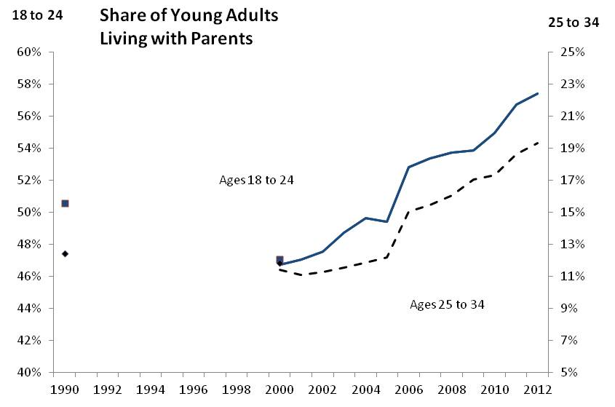
Share of young Adults Living with Parents
SERIES: Share of Young Adults Living Parents
SOURCE: U.S, Census, PUMS, ACS, NAHB Estimates.
Notes:
Another new trend resulting from recession are young adults living with parents, though trend started before recession
The share of young adults ages 18 to 34 living with parents or parents-in-law increased sharply in the late 2000s.
Rising college enrollment among younger adults ages 18 to 24 helps explain their increased preferences for not leaving parental homes. The majority of adults in this age group, 52 percent, attended school or college in 2012, compared to 45 percent in 2000 and 43 percent in 1990. College attendance plays a less important role in the decision of older adults, ages 25 to 34, to stay at parents’ home. Less than 14 percent of adults in this older cohort were still in college or school in 2012, the comparable share in 1990 and 2000 was just slightly below, close to 12 percent.
For older, more experienced and better educated adults ages 25 to 34, the ability to find stable, higher-paying jobs plays an increasing role. As unemployment rates kept increasing in the late 2000s so did the shares of young adults living with parents. In 2000, the shares of unemployed in this age group were 7 percent among young adults living with parents and 4 percent among those living independently. By 2012, these shares reached 14 percent among adults living with parents and 6 percent among same age adults living independently.
Even though unemployment rates started to decline in most states in 2011, shares of young adults living with parents remain stubbornly high and even increased in some states, suggesting that it takes longer for young adults to overcome the overall sense of economic instability, gain confidence and financial independence before leaving parents’ homes. This is particularly true for states hardest hit by the housing boom and bust, such as California and Florida, where percent of young adults living with parents continued to rise through 2012 despite improving job markets. California and Florida – two of the states hardest hit by the housing boom and bust - follow with their shares just slightly under 40 percent.

Slide 7
Student Loan Debt
Question: Do you have any outstanding debt from student loans? How much is the outstanding student loan debt?
SERIES: 2014 C.A.R. Home Buyers Survey
SOURCE: CALIFORNIA ASSOCIATION OF REALTORS®
Notes:
Much discussion around student debt and the impact
Based on our survey, ¾ of renters have no debt and majority has less than $10K
Recent expert discussion concluded that lack of interest in homeownership is a factor delayed decisions to marry and have children

Slide 8
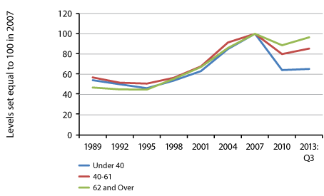
Evolution of Average Real Housing Assets Relative to 2007 Level
those under 40 years old only recovered about 1/3 of the wealth lost
the home-price gains helped older families rebuild equity, but offset by younger families’ retreat from homeownership.
Gen X-ers have higher NE and causing a gridlock in the market - baby boomers don’t have move-up buyers for their homes, but also no inventory of startup homes and affordable for the first-time buyers, i.e. millenials
SERIES: Survey of Consumer Finances
SOURCE: Federal Reserve Board
Notes:
I believe the issue inlies more in the fact that Families led by those under 40 years old have only recovered about a third of the wealth they lost during the financial crisis, according to a study released by the St. Louis Fed’s Center for Household Financial Stability.
That’s not the case for the average middle-age or older family, which have nearly recovered to precrisis levels, the report said.
The main factor is that the home-price gains that have helped mainly older families rebuild equity has been more than offset by younger families’ retreat from homeownership.
A recent analysis also showed that Gen X-ers have higher negative equity and thus are causing a gridlock in the market. Due to their NE, baby boomers don’t have move-up buyers for their homes, but also no inventory of startup homes and affordable for the first-time buyers, i.e. millenials
“The homeownership rate among younger households has plunged in recent years, reflecting both the loss of many homes through foreclosure or other distressed sales, plus delayed entry into homeownership among newly formed households. The house-price gains that have helped mainly older families to rebuild homeowners’ equity have been overshadowed among younger families by their ongoing retreat from homeownership as they struggle with excessive mortgage debt,” the report said.
The homeownership rate for the under-40s has dropped to 42.2% in 2013 from 50.1% in 2005. Middle-aged families (those led by someone 40-61) have seen their homeownership rate drop to 72.1% from 76.9% in 2005.
More depressingly, the report says the homeownership rate may never return to its peak level. While “at some point” it should stabilize for individual age groups and the population as a whole, the 2004 to 2006 levels may never reappear.

Slide 9
California housing market

Slide 10
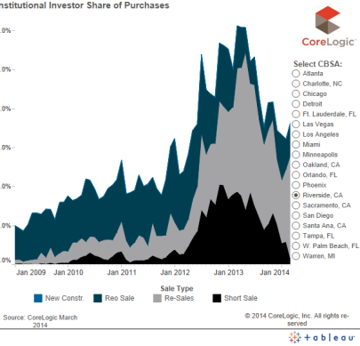
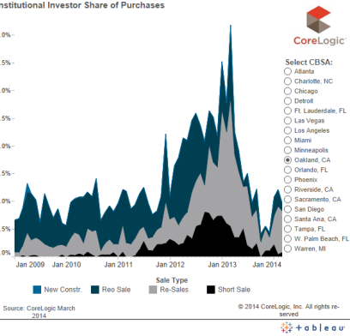
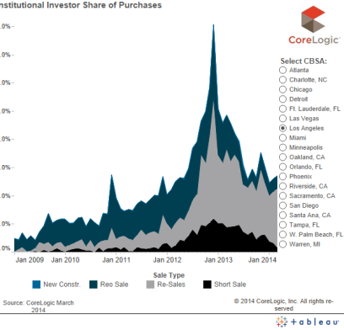
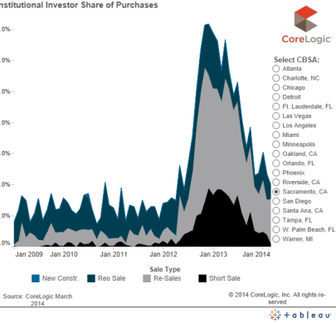

Slide 11
Sales of Existing Detached Homes
California, Sep. 2014 Sales: 396,440 Units, -9.5% YTD, -4.2% YTY
Aug-13:
434,910
Aug-14:
394,280
SERIES: Sales of Existing Single Family Homes
SOURCE: CALIFORNIA ASSOCIATION OF REALTORS®
*Sales are seasonally adjusted and annualized
Notes:
Peak:624,957 units in 2005
Valley:189,345 units in 1982
2012 annual sales up 4.3% from 2011
2011 annual sales up 1.4% from 2010
2010 annual sales down 12.3% from 2009
2009 annual sales up 24.5% from 2008
2008 annual sales up 30.4% from 2007
2007 annual sales down 33.4% from 2006
2006 annual sales down 23.8% from 2005
2005 annual sales up 0.8% from 2004
2004 annual sales up 3.8% from 2003
2003 annual sales up 7.6% from 2002
2002 annual sales up 14.1% from 2001
2001 annual sales down 4.7% from 2000 YTD
2000 annual sales up 1.4 from 1999
1999 sales up 7.3% over 1998
10/93: 41.0
Consumer Confidence
01/00: 148.6
03/03: 63.0
5/07: 128.4
2/09: 23.9

Slide 12
California vs. U.S. Median Prices
1970-2014
SERIES: Median Price of Existing Single Family Homes
SOURCE: CALIFORNIA ASSOCIATION OF REALTORS®
SOURCE: CALIFORNIA ASSOCIATION OF REALTORS®

Slide 13
Trough vs. Current Price
Bay Area, August 2014
SERIES: Median Price of Existing Detached Homes
SOURCE: CALIFORNIA ASSOCIATION OF REALTORS®

Slide 14
We’ve Come a Long Way: Equity Sales Now 9 out of 10 Transactions
SERIES: Distressed Sales, Not Seasonally Adjusted
SOURCE: CALIFORNIA ASSOCIATION OF REALTORS®
Notes:
14

Slide 15
Where are distressed sales located? (Percent of the statewide total distressed sales)
SERIES: Distressed Sales, Not Seasonally Adjusted
SOURCE: CALIFORNIA ASSOCIATION OF REALTORS®

Slide 16
Distressed Sales
Percent of Total Sales: Southern CA, Aug. 2014
SERIES: Distressed Sales, Not Seasonally Adjusted
SOURCE: CALIFORNIA ASSOCIATION OF REALTORS®

Slide 17
Price Plateau Ahead; Annual Gains Slowing
California, Sep. 2014: $460,940, Up 7.6% YTY
Aug-13:
$441,010
Aug-14:
$480,280
SERIES: Median Price of Existing Single Family Homes
SOURCE: CALIFORNIA ASSOCIATION OF REALTORS®
Notes:
Now up 8.7% from trough in Feb-09
Peak: $560,270 in 2007
Valley: $177,270 in 1996
High: May 2007: $594,530
2000 annual median price up 11.0% over 1999
2001 annual median price up 8.7% from 2000
2002 annual median price up 20.5% from 2001
2003 annual median price up 17.5% from 2002
2004 annual median price up 21.3% from 2003
2005 annual median price up 16.0% from 2004
2006 annual median price up 6.5% from 2005
2007 annual median price up 0.7% from 2006
2008 annual median price down 37.8% from 2007
2009 annual median price down 21.1% from 2008
2010 annual median price up 10.2% from 2009
2011 annual median price down 6.2% from 2010
2012 annual median price up 11.6% from 2011

Slide 18
Inventory Improving From Last Year
August 2013: 3.0 Months; August 2014: 4.0 Months
Note: “Unsold Inventory Index” represents the number of months it would take to sell the remaining inventory for the month in question. The remaining inventory for the month is defined as the number of properties that were “Active”, “Pending”, and “Contingent” (when available) and divide the sum by the number of “Sold” properties for the month in question.
SERIES: Unsold Inventory Index of Existing Single Family Homes
SOURCE: CALIFORNIA ASSOCIATION OF REALTORS®
Notes:
Range since 1988:
Low: 1.3 months in April 2004
High: 18.8 months in Feb 1991
Long-run average: 6.9 months

Slide 19
Inventory higher at upper Price Ranges
Note: “Unsold Inventory Index” represents the number of months it would take to sell the remaining inventory for the month in question. The remaining inventory for the month is defined as the number of properties that were “Active”, “Pending”, and “Contingent” (when available) and divide the sum by the number of “Sold” properties for the month in question.
SERIES: Unsold Inventory Index of Existing Single Family Homes
SOURCE: CALIFORNIA ASSOCIATION OF REALTORS®

Slide 20
Why was/is Inventory so Low?
Demand Side
Housing affordability was at historic highs
Low rates hurt investment alternatives
International buyers
Supply Side
Little new construction for last 5 years
Underwater homeowners are stuck
Mortgage Lock-In Effect
No inventory to move up
Foreclosure pipeline drying up
Investors are renting instead of flipping
Off-market (aka “pocket’) listings

Slide 21
CA Permits UP but more units needed
2013: 57,496 Units, Up 43.0% from 2012
Household Growth: 220,000-250,000/yr
SERIES: New Housing Permits
SOURCE: Construction Industry Research Board
Notes:
Red line represents approximate number of new households per year (estimated range: 220 to 250 thousand per year)

Slide 22
CA Underwater Mortgages Reverse Wealth Effect v. Squatter Economy
SERIES: Underwater Mortgages
SOURCE: CoreLogic
Notes:
22
Note: Data is for CA Properties with a Mortgage Near Negative Equity is defined as properties in negative equity or within 5% of being in a negative equity position
Corelogic Equity Report = http://www.corelogic.com/about-us/news.aspx
high negative equity among Gen-X homeowners is causing gridlock in the U.S. housing market.
Nearly 43 percent of homeowners between 35 and 49 are underwater on their mortgages. In contrast, only 15 percent of millennial homeowners (those between 20 and 34 years old) and 31 percent of baby boomers (50 to 64 years old) are underwater.
baby boomers may not be able to find move-up buyers for their homes because Gen-Xers are stuck with troubled mortgages, Zillow reported. In turn, millennials can't move into the more affordable starter homes currently occupied by Gen Xers. In other words, the very types of houses young first-time buyers would be most able to afford are not hitting the market, and millennials are increasingly getting priced out.

Slide 23
Los Angeles County
Notes:
23

Slide 24
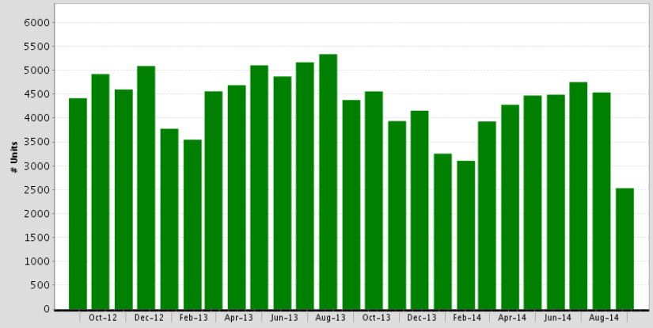
Sales of Residential Homes
Los Angeles County, September 2014: 2,532 Units
Down 44.2% MTM, Down 42.1% YTY
SOURCE: Clarus Market Metrics
Notes:
24

Slide 25
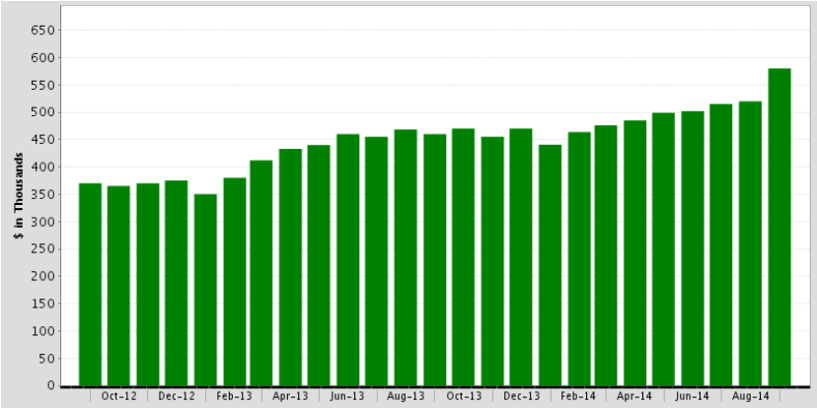
Median Price of Residential Homes
Los Angeles County, September 2014: $580,000
Up 11.5% MTM, Up 26.1% YTY
SOURCE: Clarus Market Metrics
Notes:
25

Slide 26
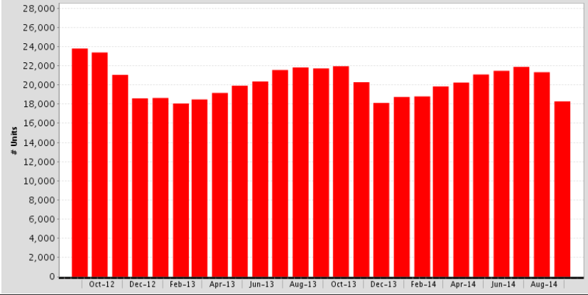
For Sale Properties
Los Angeles County, September 2014: 18,284 Units
Down 14.3% MTM, Down 15.8% YTY
Note: “For Sale Properties” represents the overall supply that exist throughout the entire month, including any listings that appear as “Active” any point in time during the month.
SOURCE: Clarus Market Metrics
Notes:
26

Slide 27
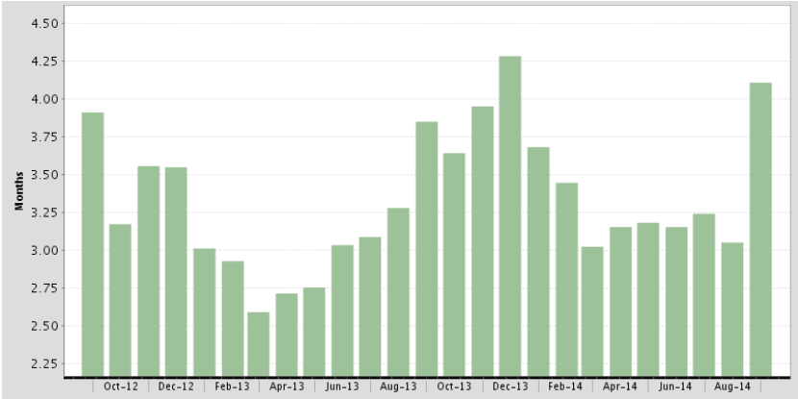
Month’s Supply of Inventory
Los Angeles County, September 2014: 4.1 Months
Note: “Month’s Supply of Inventory” represents the number of months it would take to sell the remaining inventory for the month in question. The remaining inventory for the month is defined as the number of properties that were “For Sale” on the last day of the month in question. The inventory figure is then divided by the number of properties that went Under Contract during the month.
SOURCE: Clarus Market Metrics
Notes:
27

Slide 28
Pasadena
Notes:
28

Slide 29
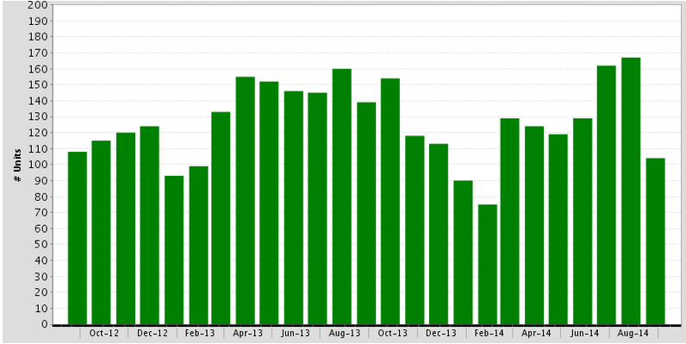
Sales of Residential Homes
Pasadena, September 2014: 104 Units
Down 37.7% MTM, Down 25.2% YTY
SOURCE: Clarus Market Metrics
Notes:
29

Slide 30
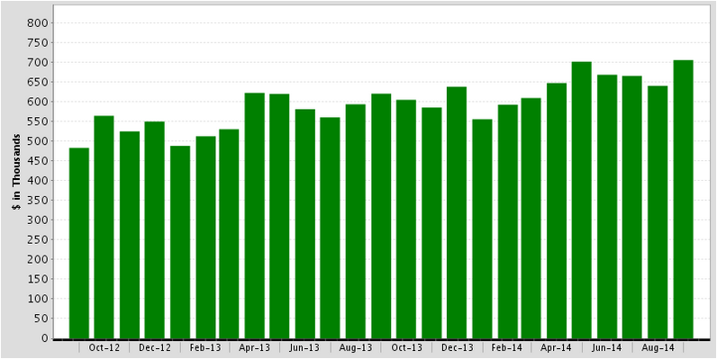
Median Price of Residential Homes
Pasadena, September 2014: $705,000
Up 10.2% MTM, Up 13.7% YTY
SOURCE: Clarus Market Metrics
Notes:
30

Slide 31
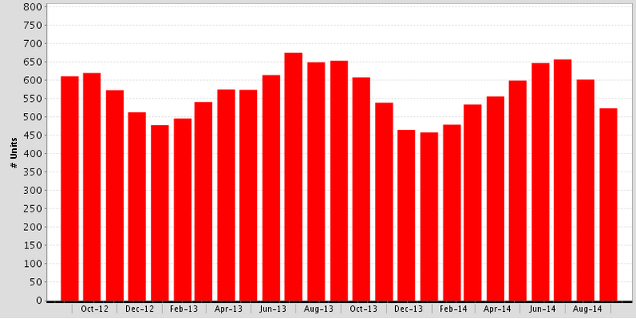
For Sale Properties
Pasadena, September 2014: 524 Units
Down 13.0% MTM, Down 19.3% YTY
Note: “For Sale Properties” represents the overall supply that exist throughout the entire month, including any listings that appear as “Active” any point in time during the month.
SOURCE: Clarus Market Metrics
Notes:
31

Slide 32
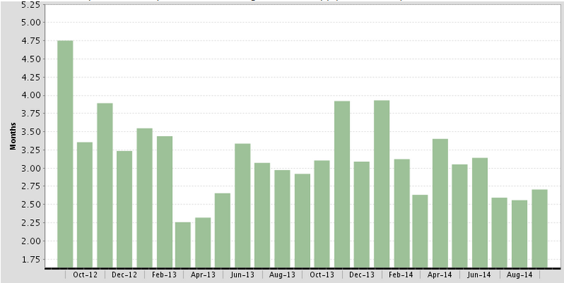
Month’s Supply of Inventory
Pasadena, September 2014: 2.7 Months
Note: “Month’s Supply of Inventory” represents the number of months it would take to sell the remaining inventory for the month in question. The remaining inventory for the month is defined as the number of properties that were “For Sale” on the last day of the month in question. The inventory figure is then divided by the number of properties that went Under Contract during the month.
SOURCE: Clarus Market Metrics
Notes:
32

Slide 33
Altadena
Notes:
33

Slide 34
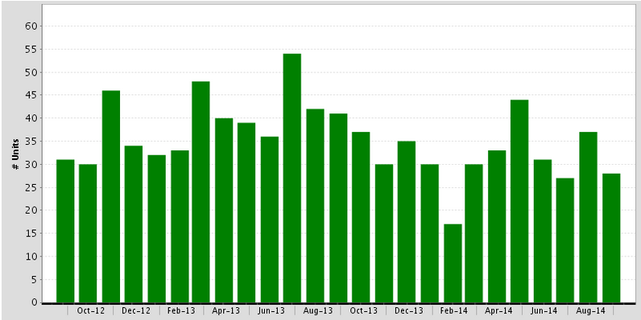
Sales of Residential Homes
Altadena, September 2014: 28 Units
Down 24.3% MTM, Down 31.7% YTY
SOURCE: Clarus Market Metrics
Notes:
34

Slide 35
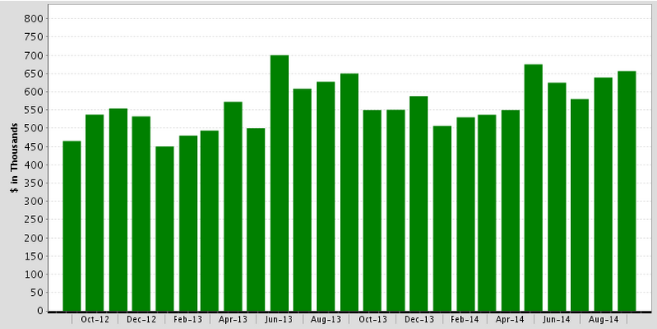
Median Price of Residential Homes
Altadena, September 2014: $656,500
Up 2.7% MTM, Up 1.0% YTY
SOURCE: Clarus Market Metrics
Notes:
35

Slide 36
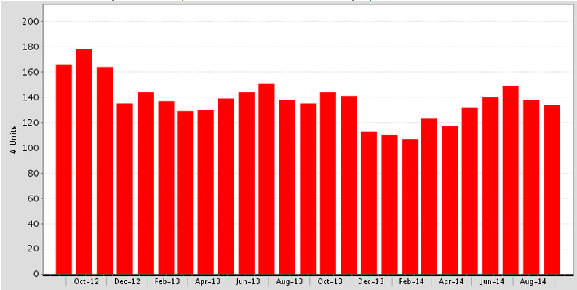
For Sale Properties
Altadena, September 2014: 134 Units
Down 2.9% MTM, Down 0.7% YTY
Note: “For Sale Properties” represents the overall supply that exist throughout the entire month, including any listings that appear as “Active” any point in time during the month.
SOURCE: Clarus Market Metrics
Notes:
36

Slide 37
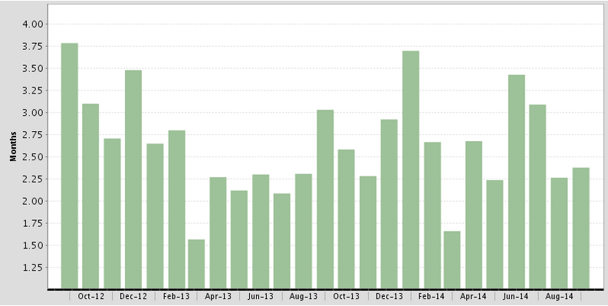
Month’s Supply of Inventory
Altadena, September 2014: 2.4 Months
Note: “Month’s Supply of Inventory” represents the number of months it would take to sell the remaining inventory for the month in question. The remaining inventory for the month is defined as the number of properties that were “For Sale” on the last day of the month in question. The inventory figure is then divided by the number of properties that went Under Contract during the month.
SOURCE: Clarus Market Metrics
Notes:
37

Slide 38
Arcadia
Notes:
38

Slide 39
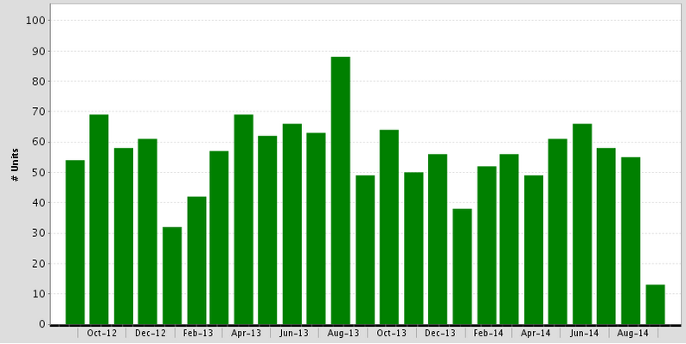
Sales of Residential Homes
Arcadia, September 2014: 13 Units
Down 76.4% MTM, Down 73.5% YTY
SOURCE: Clarus Market Metrics
Notes:
39

Slide 40
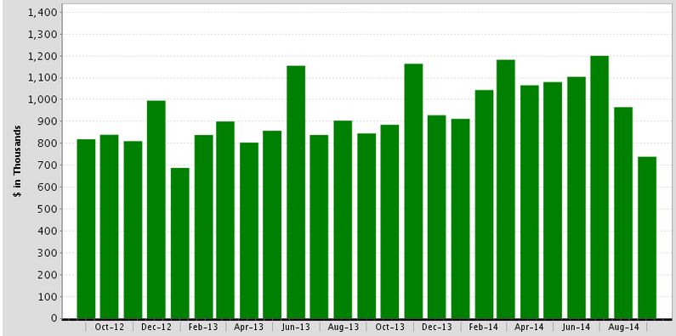
Median Price of Residential Homes
Arcadia, September 2014: $739,000
Down 23.4% MTM, Down 12.5% YTY
SOURCE: Clarus Market Metrics
Notes:
40

Slide 41
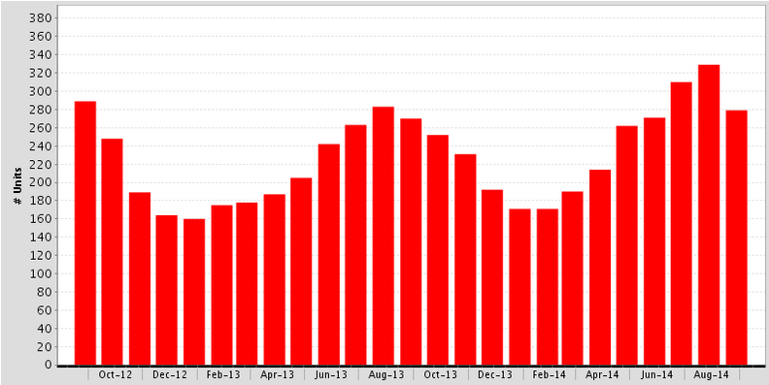
For Sale Properties
Arcadia, September 2014: 279 Units
Down 15.2% MTM, Up 3.3% YTY
Note: “For Sale Properties” represents the overall supply that exist throughout the entire month, including any listings that appear as “Active” any point in time during the month.
SOURCE: Clarus Market Metrics
Notes:
41

Slide 42
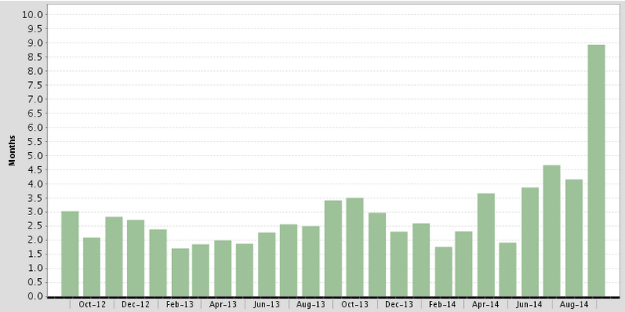
Month’s Supply of Inventory
Arcadia, September 2014: 8.9 Months
Note: “Month’s Supply of Inventory” represents the number of months it would take to sell the remaining inventory for the month in question. The remaining inventory for the month is defined as the number of properties that were “For Sale” on the last day of the month in question. The inventory figure is then divided by the number of properties that went Under Contract during the month.
SOURCE: Clarus Market Metrics
Notes:
42

Slide 43
Los Angeles County
Preforeclosure: 5,270 • Auction: 4,855 • Bank Owned: 962
SOURCE: PropertyRadar.com as of 10/14/14

Slide 44
Los Angeles County
Preforeclosure: 5,270 • Auction: 4,855 • Bank Owned: 962
SOURCE: PropertyRadar.com as of 10/14/14

Slide 45
Los Angeles County
Preforeclosure: 5,270 • Auction: 4,855 • Bank Owned: 962
SOURCE: PropertyRadar.com as of 10/14/14

Slide 46
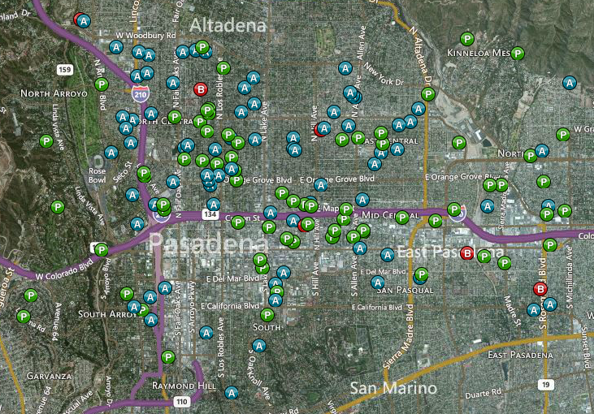
Pasadena
Preforeclosure: 73 • Auction: 77 • Bank Owned: 6
SOURCE: PropertyRadar.com as of 10/14/14

Slide 47
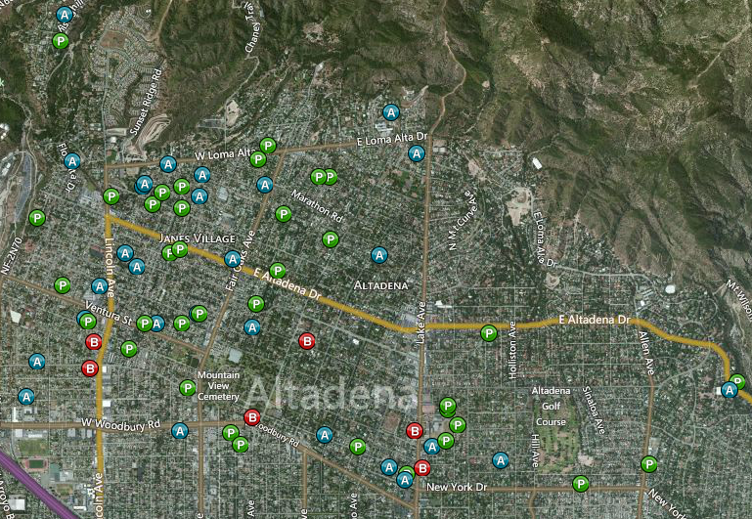
Altadena
Preforeclosure: 37 • Auction: 28 • Bank Owned: 6
SOURCE: PropertyRadar.com as of 10/14/14

Slide 48
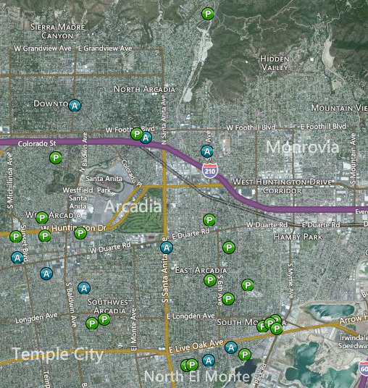
Arcadia
Preforeclosure: 22 • Auction: 9 • Bank Owned: 0
SOURCE: PropertyRadar.com as of 10/14/14

Slide 49
#1 concern: housing affordability

Slide 50
Real Enemy of the Future of California?
Housing Affordability
The Achilles Heel of the California Economy
What happens when housing costs are too high?
Impact on jobs and economic growth
Impact on neighborhoods and family stability

Slide 51
Housing Affordability Down Sharply Since q1 2012
% OF HOUSEHOLDS THAT CAN BUY
SERIES: Housing Affordability Index of Traditional Buyers
SOURCE: CALIFORNIA ASSOCIATION OF REALTORS®
Notes:
C.A.R.’s traditional Housing Affordability Index (HAI) was replaced with the First-Time Buyer Housing Affordability Index (FTB-HAI) in 2006.
Note this slide takes the average of the 3 months in each of the quarters.
C.A.R. began producing its Housing Affordability Index (HAI) in 1984. At that time, fixed-rate mortgages were the prevailing form of financing a home purchase, while the calculations used to produce the HAI reflected a 20 percent down payment. The methodology also assumed a monthly payment for principal, interest, taxes and insurance that was no more than 30 percent of a household’s income. In the more than two decades since the CALIFORNIA ASSOCIATION OF REALTORS® first conceived the HAI, the mortgage finance landscape has changed dramatically. The range of mortgage products available to buyers as well as underwriting criteria has changed. C.A.R. developed the new index measuring affordability for first-time home buyers to better reflect the realities of today’s real estate market.

Slide 52
Income Required to Buy a Median-Priced Home in CA: (Peak vs. Current)
Change in minimum required income: $37,269
Increase in income attributed to interest rate increase: $836 (2.2% of total change)
Increase in income attributed to price increase : $36,433 (97.8% of total change)
SERIES: Housing Affordability Index
SOURCE: CALIFORNIA ASSOCIATION OF REALTORS®

Slide 53
Drop in Income Contributed to the Decline in HAI
HAI declined from 56 to 30 from 2012 Q1 to 2014 Q2
Median household income slipped from $58,553 in 2012 to $58,504 in 2014
The decline in household income alone led HAI to drop by about 2 index points.
SERIES: Housing Affordability Index
SOURCE: CALIFORNIA ASSOCIATION OF REALTORS®

Slide 54
Housing Affordability: so cal
SERIES: Housing Affordability Index
SOURCE: CALIFORNIA ASSOCIATION OF REALTORS®

Slide 55
Share of First-Time Buyers Up But Still Below Long-Run Average
Long Run Average = 38%
QUESTION: Was the buyer a first-time buyer?
SERIES: 2014 Housing Market Survey
SOURCE: CALIFORNIA ASSOCIATION OF REALTORS®
Notes:
Share of FTB bounced back after dipping to the lowest since 2006. It remains below the long run average of 38 percent, and it is the second lowest in the last 7 years.
2004 – 26.0% (lowest on record)

Slide 56
Thank You!
www.car.org/marketdata
Facebook: CARResearchgroup
Twitter: CARResearchInfo
selmah@car.org

