Slide 1

JPL SMALL BUSINESS PROGRAM OVERVIEW
ACCESS: OPPORTUNITY- A PROCUREMENT FORUM AND WORKSHOP
STEVE ALFERY
MANAGER, BUSINESS OPPORTUNITIES OFFICE
JPL ACQUISITION DIVISION
MARCH 11, 2015
Notes:
MH

Slide 2
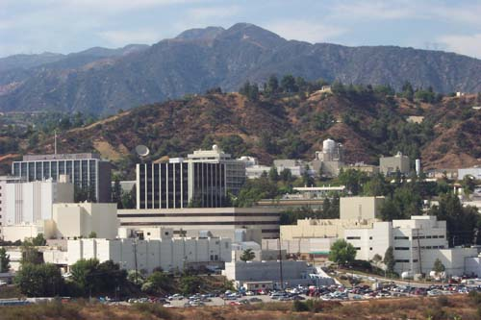
ABOUT JPL
Located in Pasadena, California
5,300 employees
$1.6 billion business base
$750 million in annual subcontract and purchase orders
177 acres
139 buildings
673,000 net square feet of office space
906,000 net square feet of non-office space (e.g., labs)
Notes:
Jaz

Slide 3

OUR MISSION: ROBOTIC SPACE EXPLORATION FOR NASA
Mars
Solar System
Exoplanets
Astrophysics
Earth Science
Interplanetary Network
Notes:
Jaz

Slide 4


ROLES: Caltech Operated-NASA FUNDED
Annual Funding
Program reporting and specific program direction
Integral ties with campus and faculty
Review of Acquisition System and selected subcontracts
Oversight reporting to Caltech management and trustees
Notes:
Jaz

Slide 5
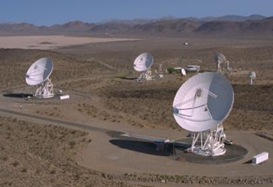
JPL FUNDING AND EXPENDITURES
Notes:
Jaz

Slide 6




FUNDING DISTRIBUTION AT A GLANCE: FY14
$757,216,745
Procurement Awards
Infrastructure
$1,600,000,000
JPL Business Base
JPL Workforce
Notes:
Jaz

Slide 7
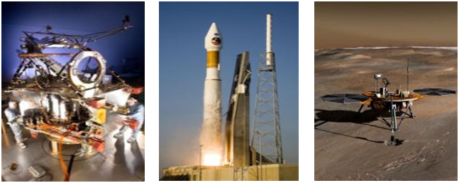
ACQUISITIONS: WHAT WE BUY AND HOW
Notes:
MH

Slide 8
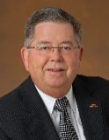
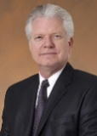
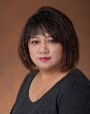
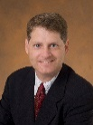

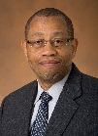
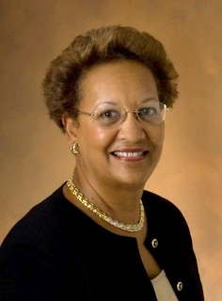
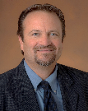
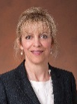





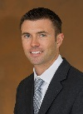

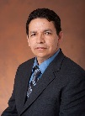


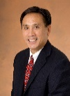

JPL ACQUISITION DIVISION
Karl Bird
Division Manager
Andre Stefanovich
Deputy Manager
Commodity
Purchasing Section
Debbie Lee
Acquisition Planning and Compliance Section
Kevin Caporicci
Acquisition
Process Improvement
Office
Martin Johnson
Service & Institutional Support Subcontracts
Section
Dale Wright
Flight Project and
Program Subcontracts Section
Janester Short
Project Acquisition
Management and Business Opportunities
Office
Steve Alfery
University
Subcontracts Section
Della Borlund
2620
2630
2640
2660
2670
2680
2690
Rapid Procurement Kathy Levy
Supervisor
262-1
Subcontracts Closeout
Ray Kong
Supervisor
263-1
Labor & Task Services
Nancy Neilan
Supervisor
266-1
Astronomy & Physics (7X) and Earth Science & Tech. (8X)
Kirk Bilby
Supervisor
267-1
Eastern States
University Subcontracts
Tom Currier
Supervisor
269-1
Fabrication, Test
Equipment & Supplies
Michael Phalen
Supervisor
262-2
Cost & Performance Analysis
Jeff Goodman
Supervisor
263-2
Construction, Facilities
and Interplanetary
Network
Martin Johnson
Supervisor
266-2
Solar System
Exploration (4x) &
Mars Exploration Directorates (6x)
Jose Medrano
Supervisor
267-2
Western States
University Subcontracts
Patrick Thompson
Supervisor
269-2
IT Hardware,
Software & Services
Shannon Grover
Supervisor
262-3
Non-Flight Research
and Development
Steve Woo
Supervisor
266-3
Base Support
and Infrastructure
Joel Esparza
Supervisor
262-4
Notes:
MH

Slide 9
JPL ACQUISITION DIVISION
Responsible for managing the process to purchase goods and services.
Comprised of six primary sections and 13 work groups
  Commodity Purchasing Section
  Acquisition Planning and Compliance
  Services and Institutional Support Subcontracts
  Flight, Project and Program Subcontracts
  Project Acquisition Management and Business Opportunities Office
  University Subcontracts
Notes:
MH

Slide 10
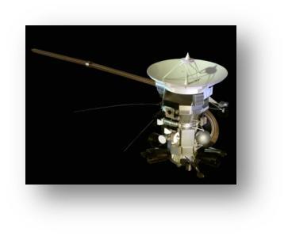

COMMON ITEMS PROCURED
COMMODITIES
ADP Systems
Building Supplies & Hand Tools
Electronic Components
Electronic Instrumentation
Electronic Supplies
Electrical Supplies
Fabrication and Processing
Furniture
Graphics Products & Services
Hardware & Software
Office & Computer Supplies
Office Equipment & Machines
Test Equipment
FLIGHT
Flight Hardware
Flight Instruments
Flight R&D Studies
Spacecraft Subsystems
Spacecraft Systems
Technology Studies
LABOR & SERVICES
Subcontract Labor
Consulting Agreements
Engineering & Technical Services
Non-Flight R&D Studies
Non-Flight Hardware
Facilities & Construction
Maintenance & Operations
Security Services
Institutional Support Services
Ground Support Equipment
Desktop & Network Services
Interplanetary Network Support & Services
RESEARCH
Scientific Investigations
Basic Research
Technical Studies
Flight Instruments & Instrumentation
Educational Outreach
Not-for-Profits
Notes:
MH

Slide 11
AWARDING WORK
Define Requirement
Identify Qualified Sources
Negotiate
Issue Solicitation
Select Source
Award Subcontract
Manage Subcontract
Closeout
Purchase Order
Purchase Card
Blanket Agreement
Subcontracts
e-Commerce
GSA Schedules
Procurement Process
Procurement Vehicles
Notes:
MH

Slide 12
JPL COMMODITY PURCHASING SUBCONTRACTS
COMMODITY | SUBCONTRACTOR | EXPIRATION
Office Supplies | Office Solutions | September 2016
Seating (Ergonomic and Conference Chairs | Tangram Interiors | March 2017
Software & Accessories | SHI International Corp | April 2019
Laboratory Supplies & Chemicals | Fisher Scientific | August 2016
UNIX | Dynamic Systems | May 2015
Cryogenics & Gases | Matheson Tri-Gas | March 2016
Unleaded diesel and Bio diesel fuel | Merrimac Energy System | July 2015
Graphic Services | Presentation Media | November 2015
Notes:
MH

Slide 13
JPL COMMODITY PURCHASING SECTION
  How best to respond to an Request for Quotation (RFQ)
    Submit bid by the due date and time
    Price out every line item
    Fully complete the RFQ
    Submit questions or concerns prior to the due date and only to the Subcontracts Manager
    Be price competitive
    Confirm receipt of the RFQ
    Note: JPL will not disclose pricing from other bidders
  JPL Supplier Database
  Submit a Supplier Profile Form to the Business Opportunities Office available on the JPL Acquisition Division Website: https://acquisition.jpl.nasa.gov/ps/
  Email the form to: business.opportunities.office@jpl.nasa.gov
Notes:
MH

Slide 14
INDUSTRY PARTNERS
Lockheed Martin Corporation, Denver, CO
  Spacecraft manufacturing
Exelis Monrovia, CA
  Deep Space Network, Operations & Maintenance
Lockheed Martin, Pasadena, CA
  IT hardware, software and services
Orbital Sciences Corporation, Germantown, MD
  Spacecraft manufacturing
Notes:
MH

Slide 15
SMALL BUSINESS INDUSTRY PARTNERS
  Mori Associates, Rockville, MD
    Information Technology Infrastructure Support Services (ITISS)
  Santa Barbara Applied Research, Ventura, CA
    Temporary Support Effort Personnel Subcontract (TSEP)
  Malin Space Science Systems
    MSSS Camera for MSL
  Dynamic Systems, Los Angeles, CA
    iProcurement Acquisition of Scientific and Engineering Workstations and Servers
  ATA Engineering, San Diego, CA
    Mechanical Analysis Support
Notes:
Jaz

Slide 16
JPL BUSINESS OPPORTUNITIES OFFICE
Notes:
MH

Slide 17
JPL PROJECT ACQUISITION MANAGEMENT & BUSINESS OPPORTUNITIES OFFICE (PAM/BOO)
As part of the Acquisition Division, the Business Opportunities Office (BOO) ensures that small businesses have the maximum opportunity to compete for contracts to provide space exploration support or support for the
day-to-day operations of the Lab.
Notes:
Jaz

Slide 18
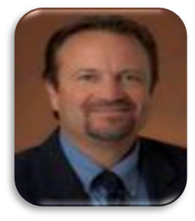
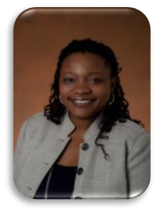
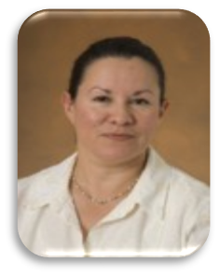
CONNECTING WITH BOO
Steve Alfery, Manager
818-354-4715
Steven.C.Alfery@jpl.nasa.gov
Jasmine Colbert
818-354-8689
Jasmine.N.Colbert@jpl.nasa.gov
Mary Helen Ruiz
818-354-7532
MaryHelen.Ruiz@jpl.nasa.gov
Notes:
Jaz

Slide 19
FY15 SMALL BUSINESS GOALS
CATEGORY | GOAL
SMALL | 25.65%
SMALL DISDAVANTAGED BUSINESS | 4.35%
WOMAN-OWNED | 2.13%
VETERAN-OWNED | 0.53%
SERVICE-DISABLED VETERAN-OWNED | 1.08%
HUBZone | 0.053%
HBCU/MI | 1.08%
Notes:
Jaz

Slide 20
SMALL BUSINESS AWARD DISTRIBUTIONS-FY14
CATEGORY | AWARDS
SMALL | $151M
SMALL DISDAVANTAGED BUSINESS | $30M
WOMAN-OWNED | $28M
VETERAN-OWNED | $5.7M
SERVICE-DISABLED VETERAN-OWNED | $9.4M
HUBZone | $709K
Notes:
Jaz

Slide 21
AWARD DISTRIBUTION BY TYPE OF SUPPLIER (FY14)
$272,268

Slide 22
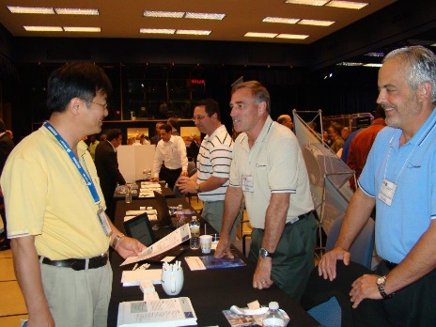
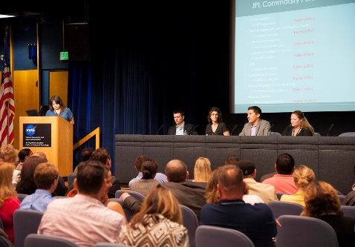
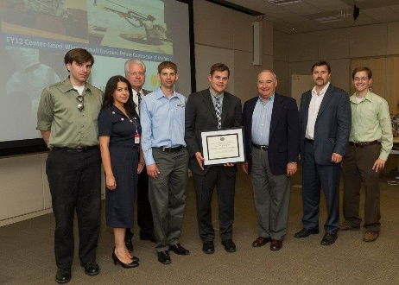
BOO SMALL BUSINESS OUTREACH EVENTS
Small Business Supplier Fair-Held annually in May, this outreach event allows 25 small business exhibitors an opportunity to demonstrate their core capabilities, products, and services.
Small Business Round Table Conference-Held annually in August, this outreach event is designed to facilitate discussion between NASA/JPL, prime contractors and the small business community regarding the NASA/JPL procurement process, small business legislation and programs, and how to do business with government agencies and prime contractor organizations.
Annual Small and Large Business Awards Ceremony- Held in May, the ceremony is an opportunity for the Lab to present our selections for the NASA Center Level Small Business Subcontractor of the Year Award, the Thomas H. May Legacy of Excellence Award, and the NASA Center-Level Large Prime Contractor of the Year Award.
Notes:
MH

Slide 23
BOO SMALL BUSINESS OUTREACH SERVICES
15-Minutes with BOO-Small Business Counseling sessions available every Thursday, 9:00a.m. – 11:00a.m. & 1:00p.m. – 3:00p.m. No appointment necessary.
Product Demonstration- An opportunity for companies with unique science and technology capabilities to present their products and services to the technical community.
.
Notes:
MH

Slide 24
KEY WEBSITES
JPL Acquisition Division (RFPs, Outreach, Subcontract Information) http://acquisition.jpl.nasa.gov/default.htm
NASA Office of Small Business Programs
http://www.osbp.nasa.gov/
NASA Vendor Database (NASA Opportunities)
https://vendors.nvdb.nasa.gov/
System of Award Management (SAM)
www.sam.gov
Notes:
MH

Slide 25
QUESTIONS
Notes:
MH

