Slide 1
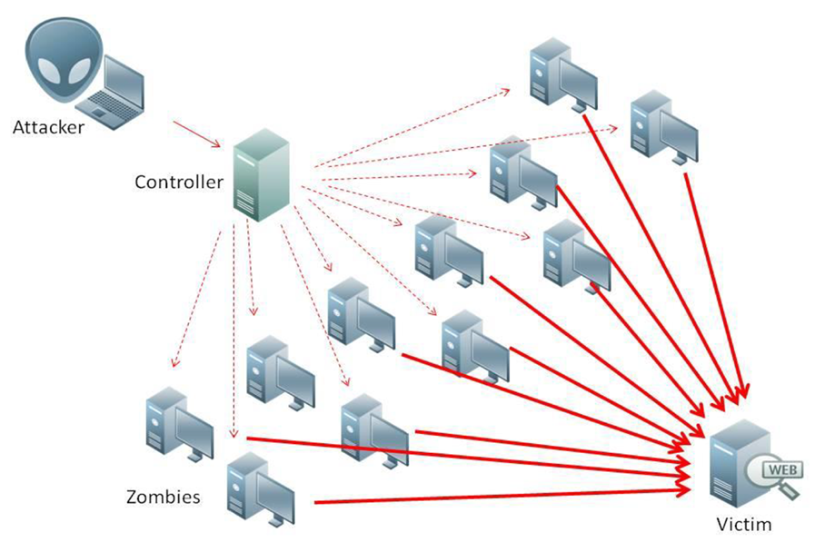
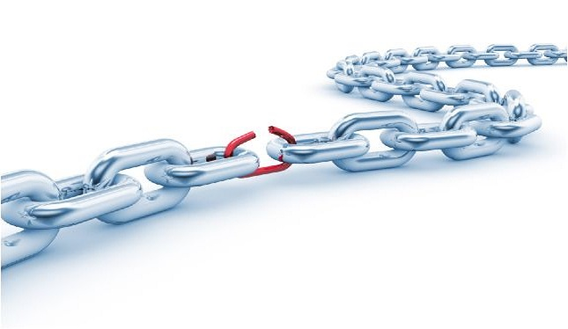
Handling cybersecurity challenges at scale requires understanding threat trends JPL Perspective
Industry Threat Trends | CY17Q2 | CY17Q3
Email Phishing
Vishing
Distributed Denial of Service attacks
Ransomware email escalations
End of Life software exploitation
Attacks on externally accessible websites
Poorly managed/configured systems
Weak security encryption deployments
Zero-Day / APT / Nation-State attacks
Dark Web Intel (TOR, Onion, Play Pen, etc.)
Insider threat
Make it easy to be secure
E.g. derived credentials test lab
E.g. AI in the background (DDOS)
E.g. BlockChain
Notes:
At JPL, we see 124 DDOS attacks a month and 9% increase per quarter.
Scale, authentication, encryption by default,
Role-based training, BlockChain

Slide 2
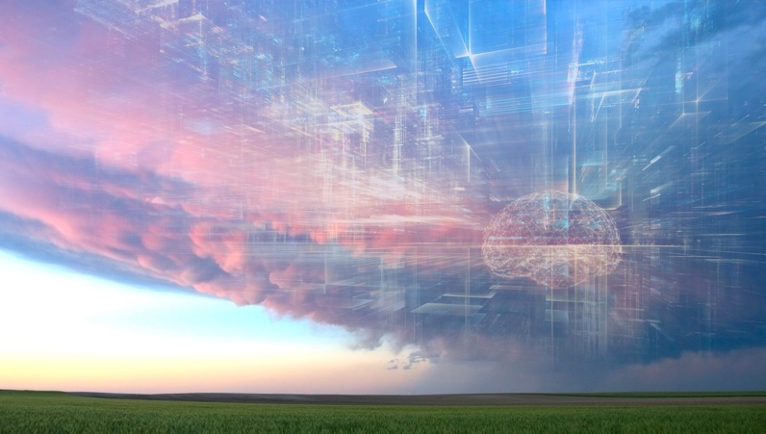
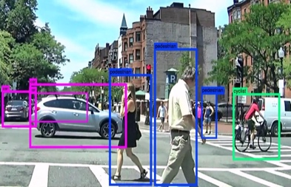
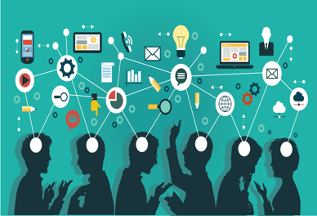
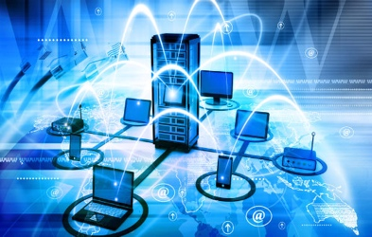
Surfing the next major technology waves – Accelerated Computing
Surfing the next major technology waves – Accelerated Computing
New Habits
Cyber Security challenges
Applied AI
Built in
intelligence
everywhere
Accelerated Computing
Serverless, edge computing, HPC, GPUs, Neuromorphic, Quantum
Ubiquitous Computing
Software Defined Everything
These waves will impact everyone
These waves will impact primarily developers
Participate at: techwaves@jpl.nasa.gov or https://goto.jpl.nasa.gov/techwaves
Notes:
Other potentials:
From IDC: Technologies covered include distributed cloud, pervasive AI, composable applications, blockchain, diversified IoT, and more.
Everything as code, Automating Cyber Security for diversity and scale, Intelligent automation
1. Preparing for Software Defined Everything
Programming, SDN, containers, DevOps, Open Software, Intelligent network, devices
2. Accelerating the computing
Cloud, Serverless, cloud edge, HPC, GPUs, Quantum
3. Living mobile in a mixed reality
Mobile, smart devices, AR, IoT, NUI, customization
4. Automating Intelligence: Measuring & Automating Everything
AI, chatbots, NLP, automation, data, APIs, analytics, combinations
5. Handling Cyber Security challenges at scale
Scale, authentication, encryption, BlockChain
6. Adjusting to changing workforce expectations and habits
Work from anywhere, gaming, sharing, open source, reduced footprint, cord-cutting

Slide 3
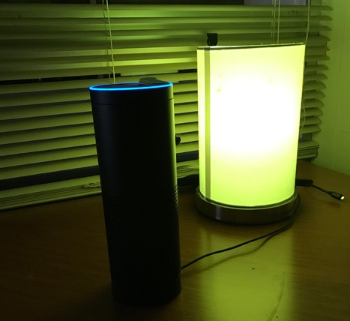
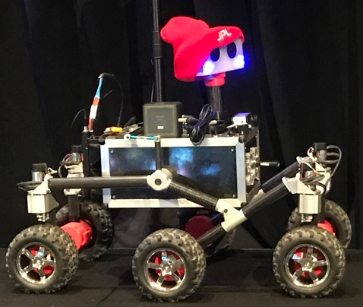
Accelerating the computing – JPL Perspective
Cloud computing - the new normal
Serverless computing - experiments saw higher scalability and 100x less cost
Edge computing - prototypes showed higher system performance and resiliency
High Performance Computing - now uses multiple sites (JPL, Ames, Texas, cloud)
GPUs – showing 10x faster with using Graphical Processing Units
Training - Holding training classes in GPU programming
Quantum Computing – experimenting now
Huge bandwidth increases – get ready for WiFi 802.11ax, 5G, and Bluetooth 5
Alexa NASA Mars uses
Serverless Computing
OSR uses Edge Computing
AI/AR processing in near realtime
Is being used already
JPL GPU test lab available now
NISAR is testing GPU computing
Notes:
Serverless application model allows you to deploy full featured applications without having to manage the underlying infrastructure. Examples include web applications, microservices, automated processing workflows, etc…
How we (can) use at jpl: Telemetry processing, Public facing outreach web sites, …
Using GPUs for science data processing and machine learning workloads we can realize speedups that are orders of magnitude more efficient that what we can achieve with traditional CPUs. This means quicker turnarounds in returning scientific results and close to real-time performance for artificial intelligence applications.

Slide 4
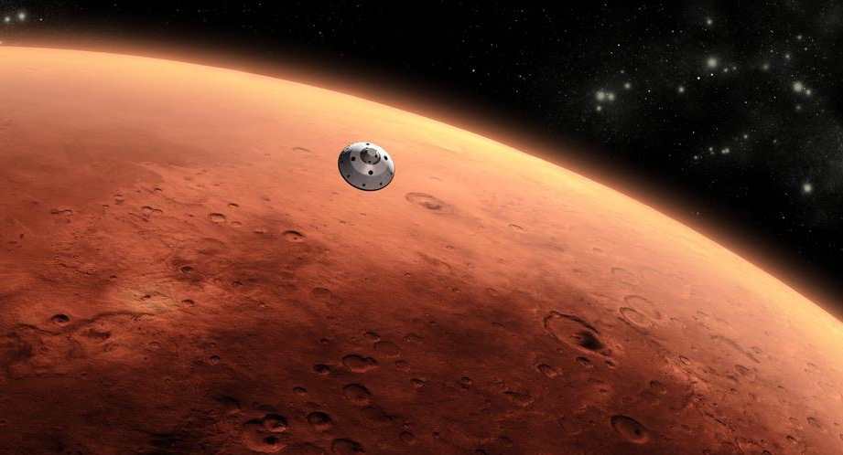
NASA MARS
NASA’s First Alexa App
Separate IoT Network
Serverless - safer and cheaper
Natural user interfaces
Using multiple senses
Handles huge scale
“Alexa, enable NASA Mars"
“How cold is Mars?”
”Can people live on Mars?”
…
Notes:
• What if you don’t have a robotic rover but want to know about Mars?
• We are happy to announce that as of today you can ask Alexa questions about Mars from the comfort of your own home.
We will go into more details in an Alexa talk tomorrow afternoon where we go into details about several JPL Alexa skills and use cases

Slide 5
Surfing the next major technology waves – Software Defined
Surfing the next major technology waves – Software Defined
New Habits
Cyber Security challenges
Applied AI
Built in
intelligence
everywhere
Accelerated Computing
Ubiquitous Computing
Software Defined Everything
Programming everything, APIs, Software Defined Networks, containers, DevOps, Open Source, self-healing, everything distributed
These waves will impact everyone
These waves will impact primarily developers
Participate at: techwaves@jpl.nasa.gov or https://goto.jpl.nasa.gov/techwaves
Notes:
Other potentials:
From IDC: Technologies covered include distributed cloud, pervasive AI, composable applications, blockchain, diversified IoT, and more.
Everything as code, Automating Cyber Security for diversity and scale, Intelligent automation
1. Preparing for Software Defined Everything
Programming, SDN, containers, DevOps, Open Software, Intelligent network, devices
2. Accelerating the computing
Cloud, Serverless, cloud edge, HPC, GPUs, Quantum
3. Living mobile in a mixed reality
Mobile, smart devices, AR, IoT, NUI, customization
4. Automating Intelligence: Measuring & Automating Everything
AI, chatbots, NLP, automation, data, APIs, analytics, combinations
5. Handling Cyber Security challenges at scale
Scale, authentication, encryption, BlockChain
6. Adjusting to changing workforce expectations and habits
Work from anywhere, gaming, sharing, open source, reduced footprint, cord-cutting

