Slide 1
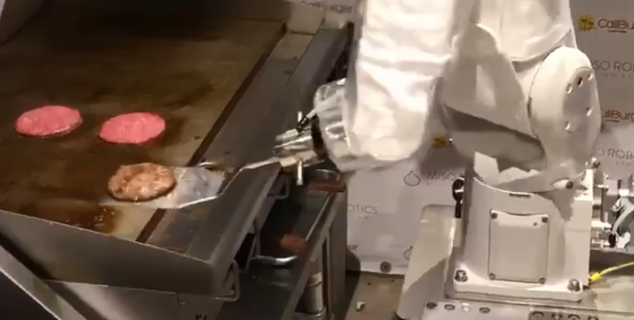
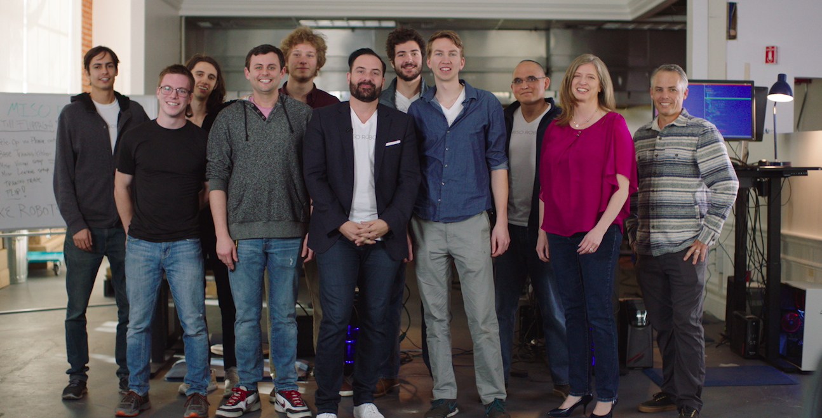
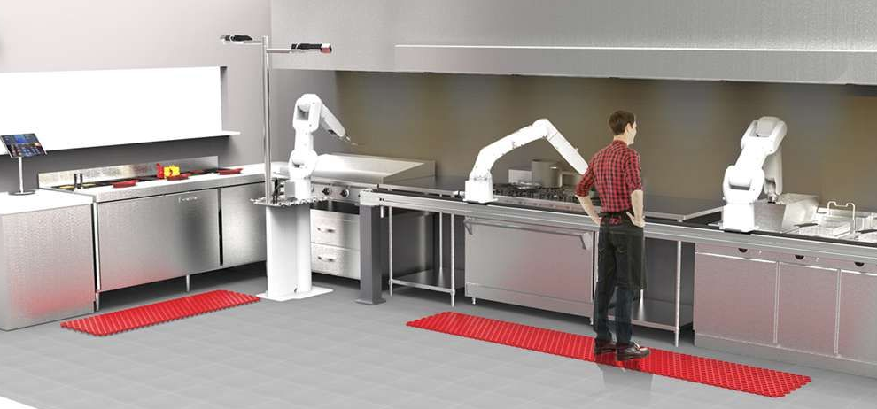
MISO Robotics
Miso AI combines 3D, thermal and regular vision to automatically detect when raw burger patties are placed on the grill and monitors each one in real-time throughout the cooking process.
“Flippy”
525 E. Green Street

Slide 2
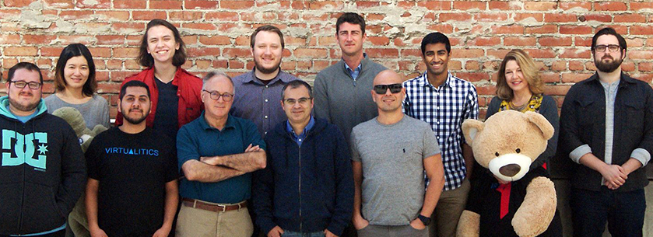
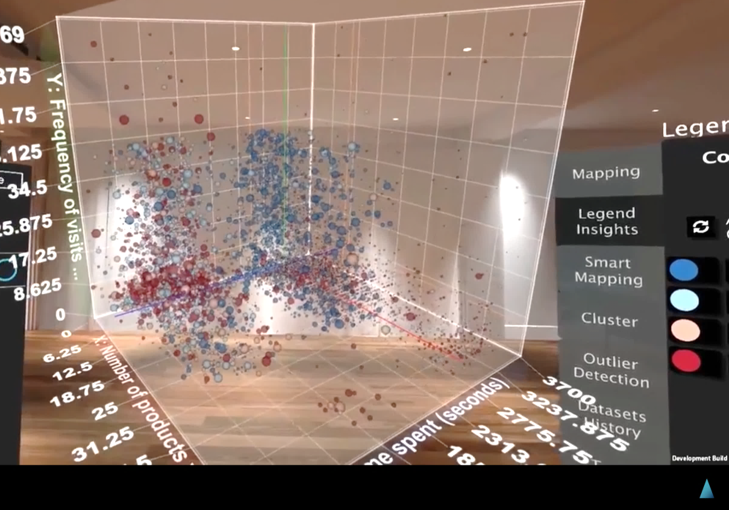
Virtualitics
Virtualitics has built the first platform to merge Artificial Intelligence, Big Data and Virtual/Augmented Reality.
600 S. Lake Ave

Slide 3
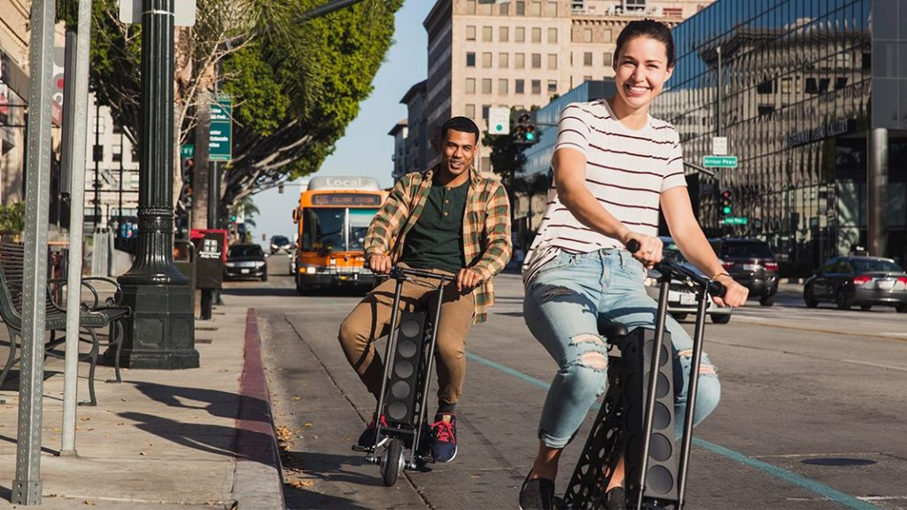
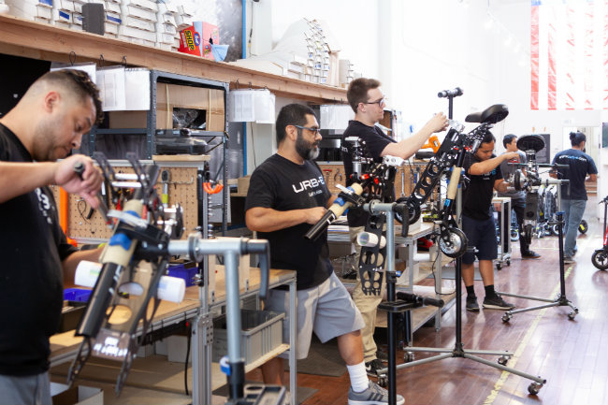
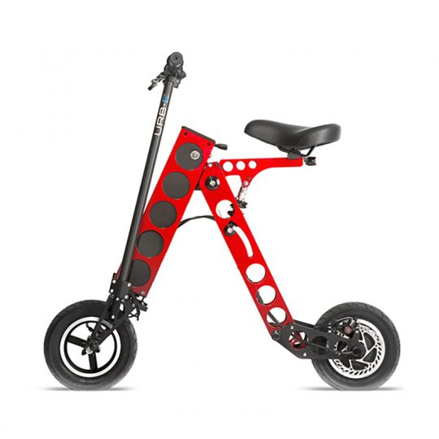
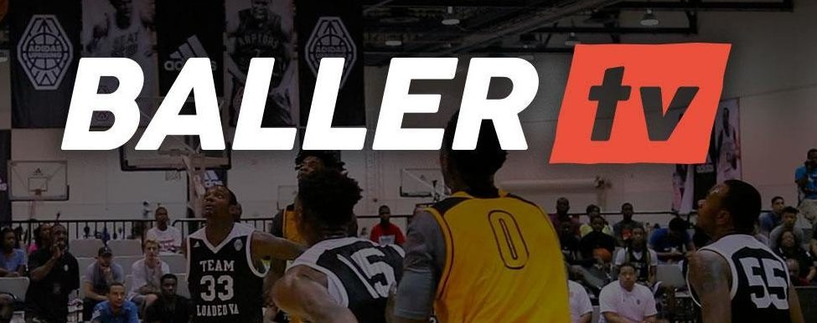
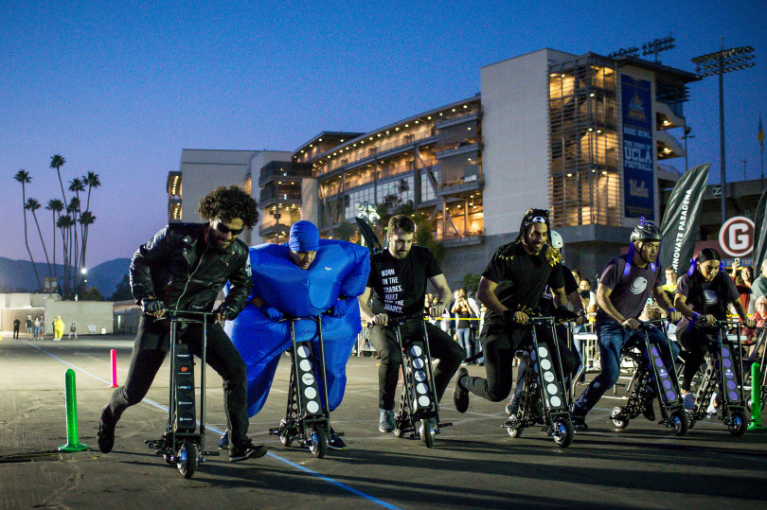
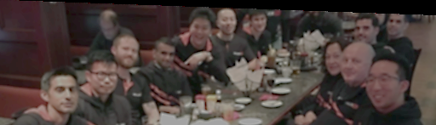
URB-E
URB-E is the global leader in lightweight foldable electric vehicles and mobile power sources
Baller tv
Provides live video coverage of amateur sports while creating sports media job opportunities in local communities. Has 20 full-time office staff and roughly 3,500 broadcasting operations staff coast-to-coast — a number that's growing every day.
3

Slide 4
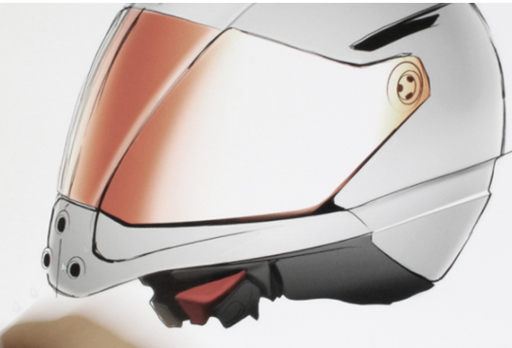

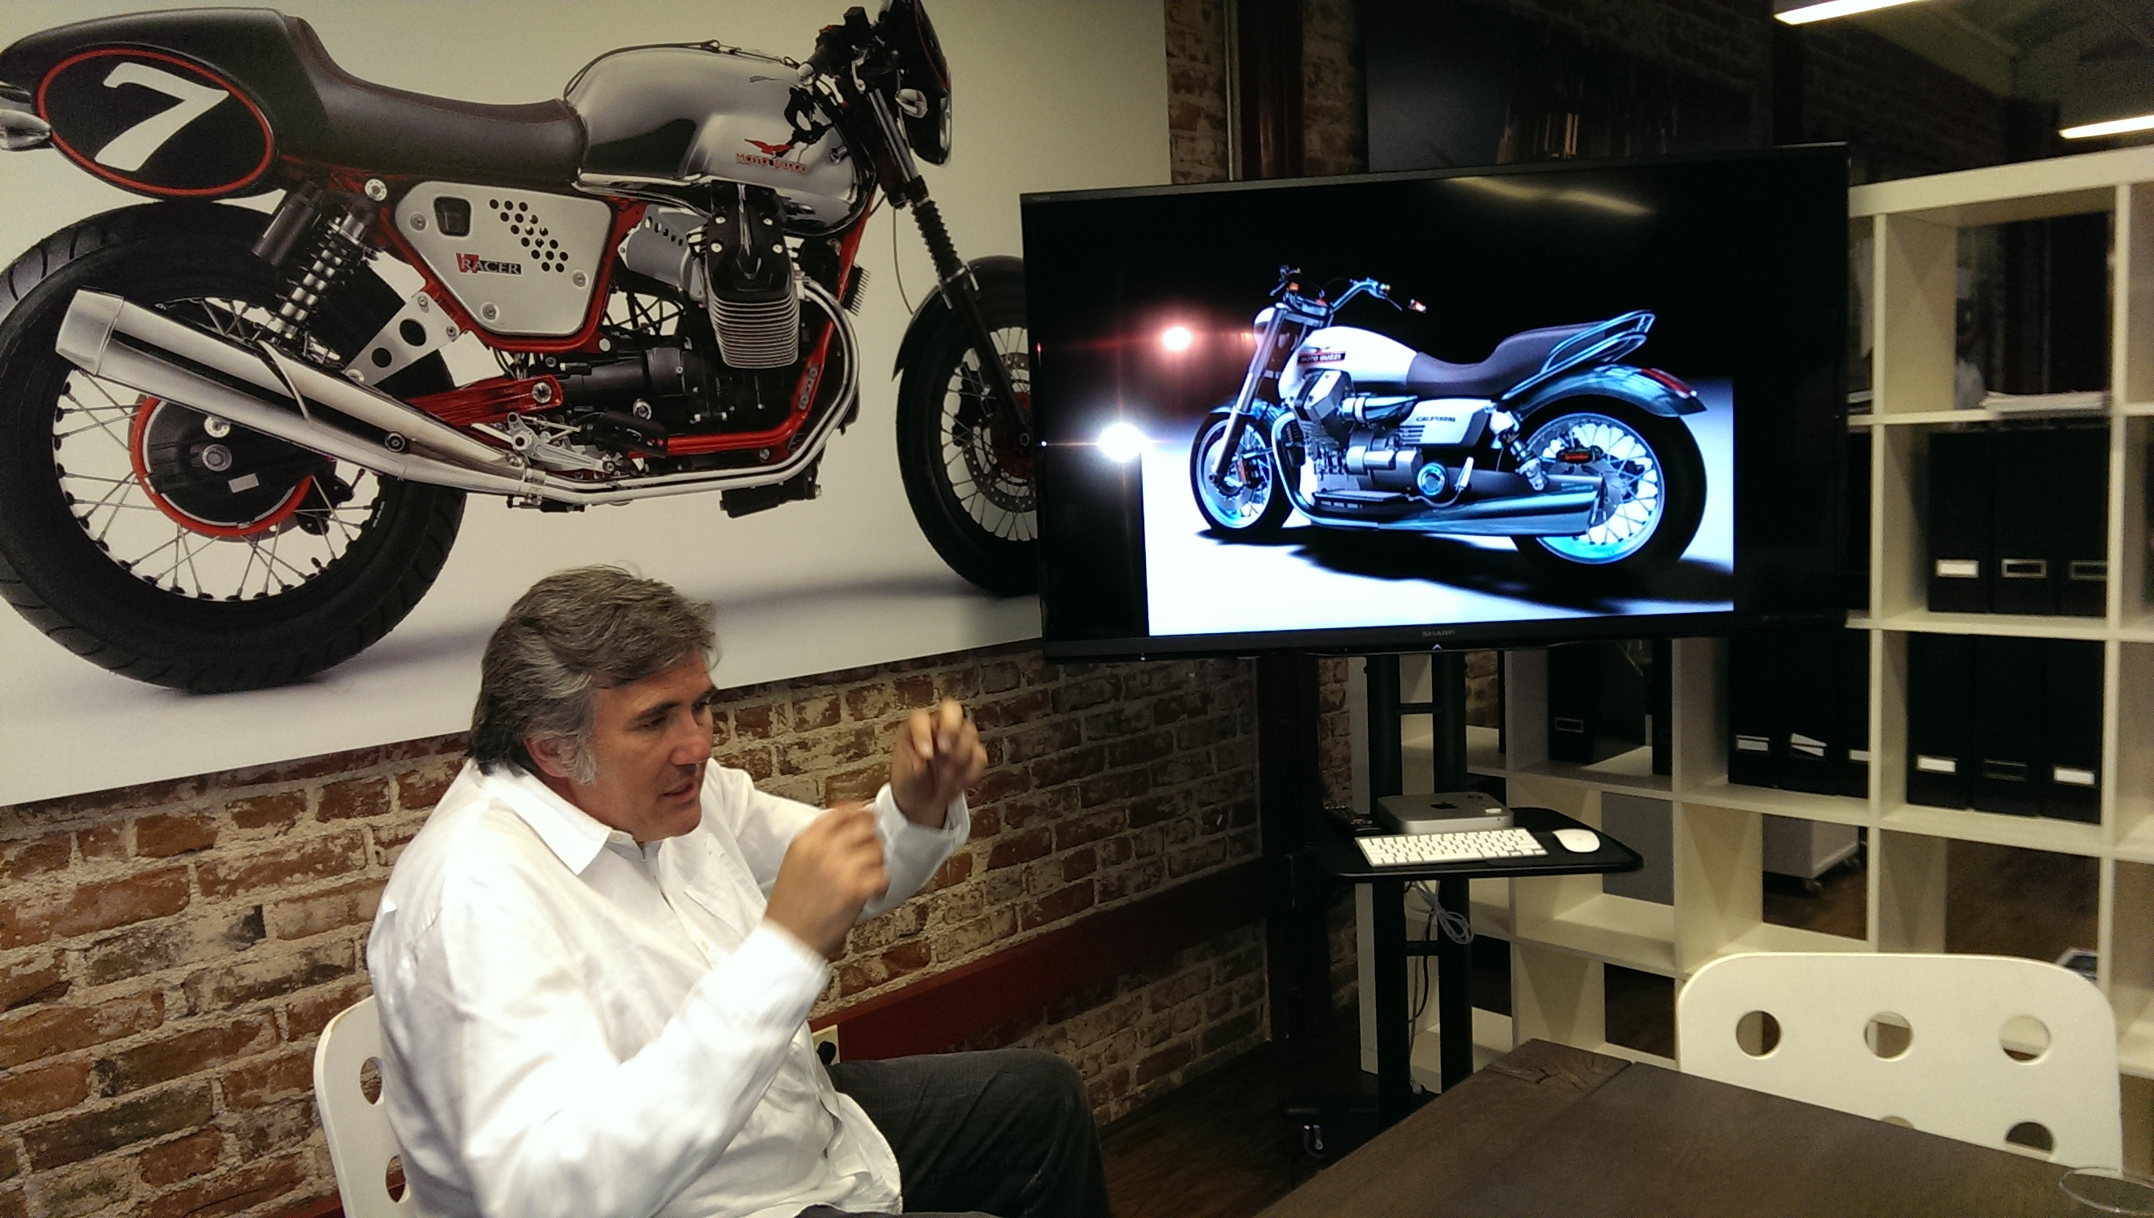
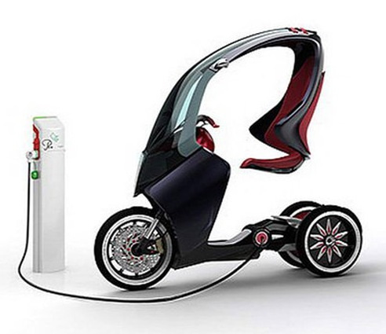
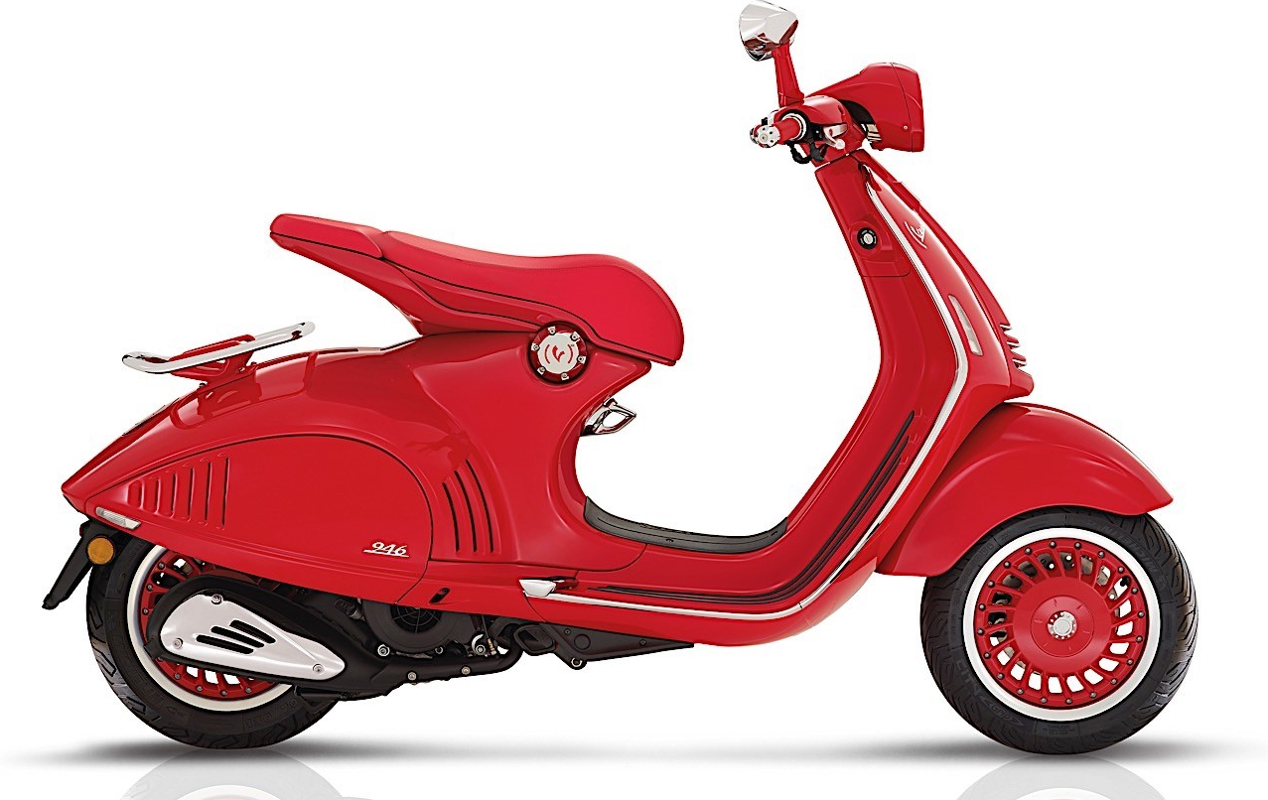
H&H Sports Protection
H&H is the second largest motorcycle helmet manufacturer in the world. headquartered in Hong Kong with offices in Pasadena, Italy & Brazil and factory in Shanghai.
PiAGGIO Advanced Design Center
Piaggio Advanced Design Center is dedicated to developing the next wave of two and three-wheeled vehicles equipped to respond to rapidly-changing, disparate and diverse transportation needs worldwide

