Slide 1
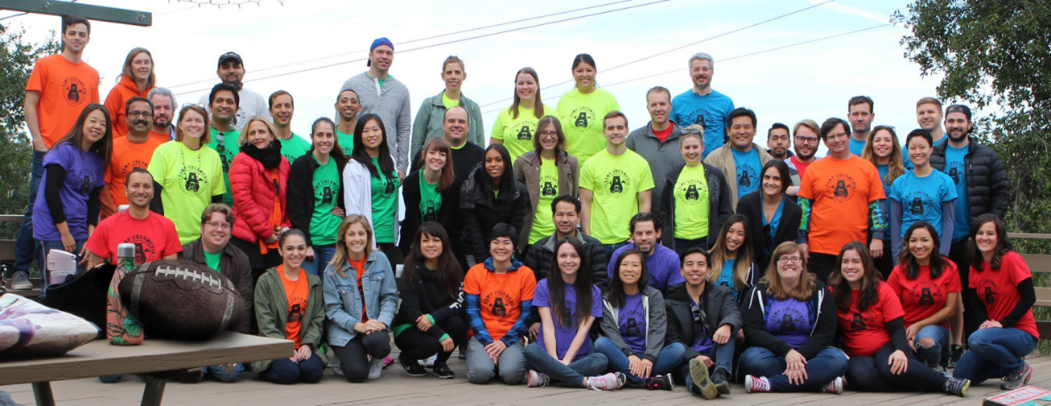
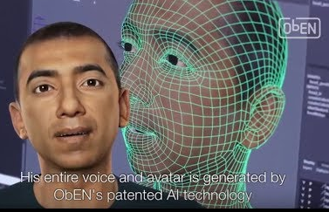
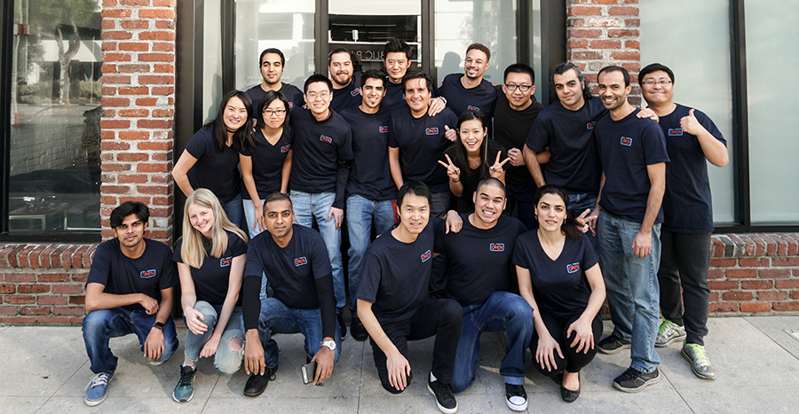
Uber media
Process billions of social, demographic, and location signals daily for Fortune 500 companies across retail, automotive, and entertainment
.
Oben
Personalized Digital Avatar
Regional Map

Slide 2
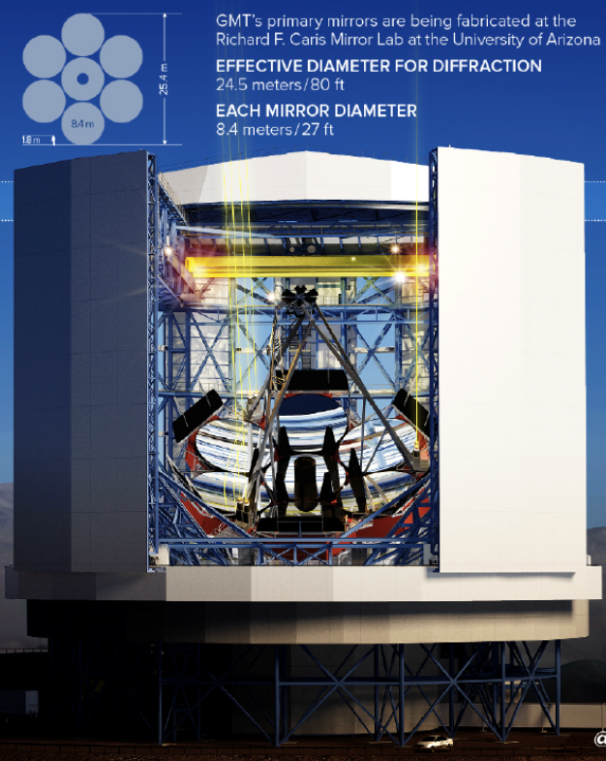
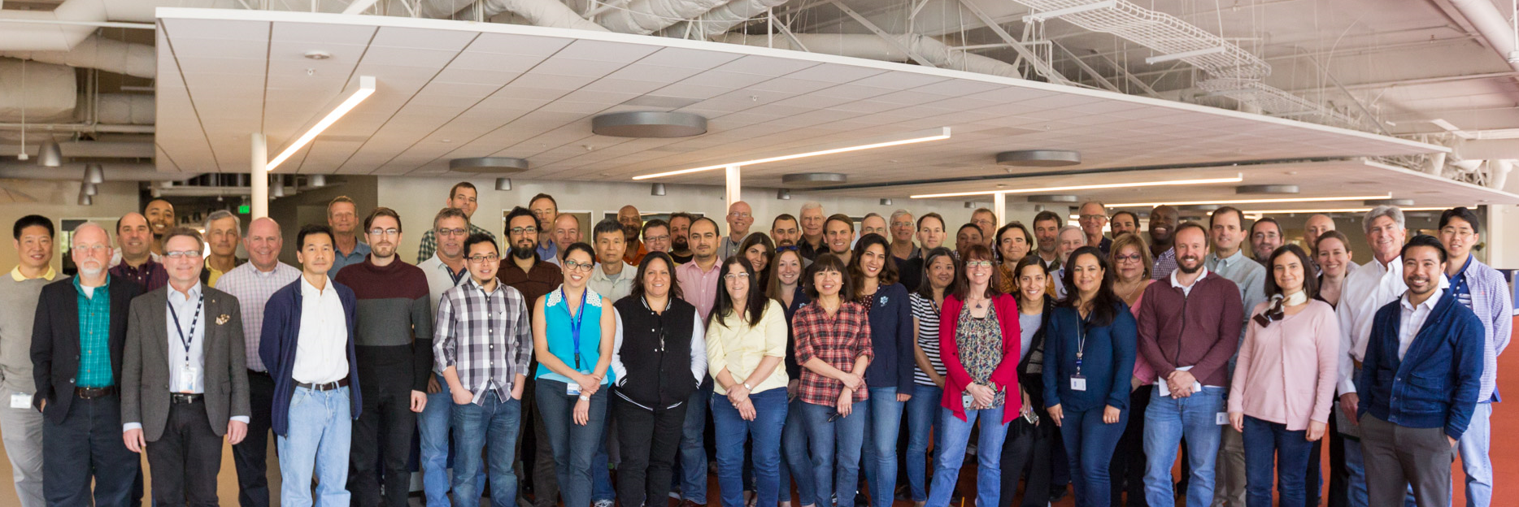
Telescope projects
Carnegie Led Team - The Giant Magellan Telescope - will be constructed in the Las Campanas Observatory in Chile. Commissioning of the telescope is scheduled to begin in 2023
465 N. Halstead
Caltech Led Team– International Team - 30 m prime mirror diameter, TMT will be three times as wide, with nine times more area, than the largest currently existing visible-light telescope in the world. This will provide unparalleled resolution with TMT images more than 12 times sharper than those from the Hubble Space Telescope.
100 W. Walnut

Slide 3
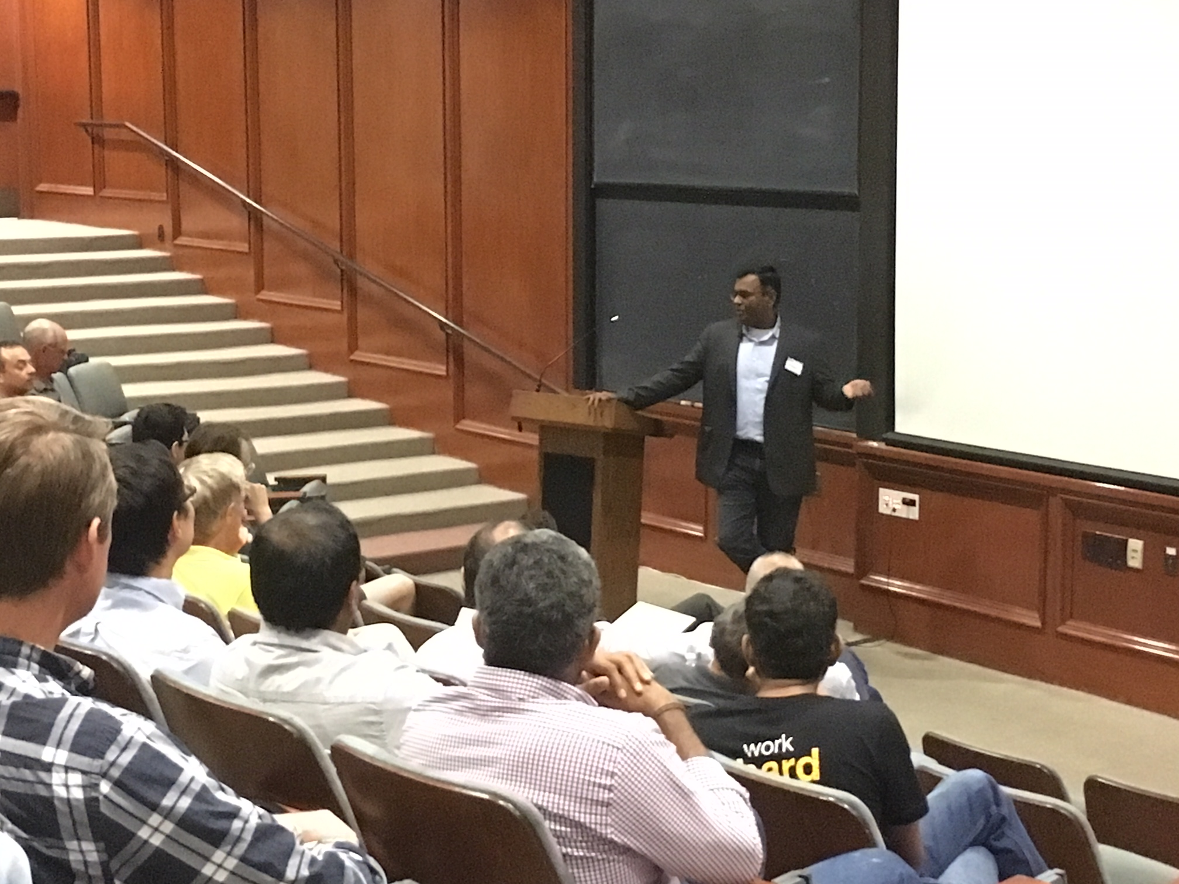
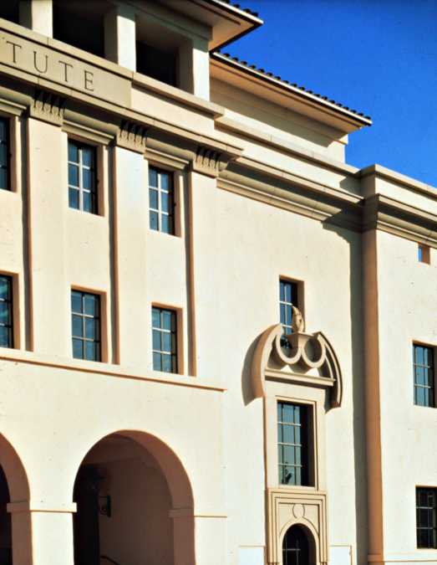
AMAZON WEB SERVICES
AWS Pasadena-based staff researchers, some of whom are temporarily being hosted on the Caltech campus, are working to improve the AI and machine-learning cloud services offered by AWS. They will move off campus by the end of the academic year but remain in Pasadena.
Also, Pasadena City College, as part of the California Cloud Workforce Project, will soon begin offering a regionally recognized cloud computing certificate program to its students, in collaboration with Amazon Web Services (AWS) and its AWS Educate program

