Slide 1
Presentation Outline
Pasadena Companies
New Development Activity

Slide 2
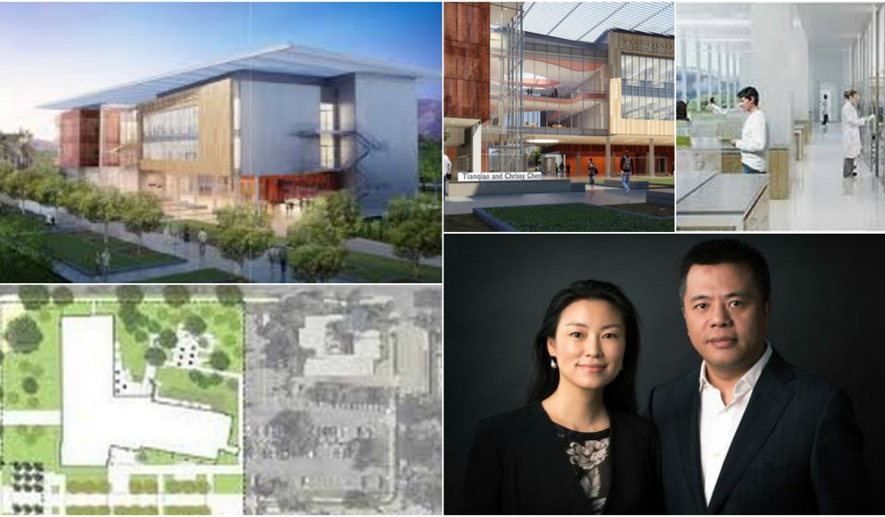
Academic and institutional
Chen neuroscience center
caltech - del mar near wilson.
Under Construction

Slide 3
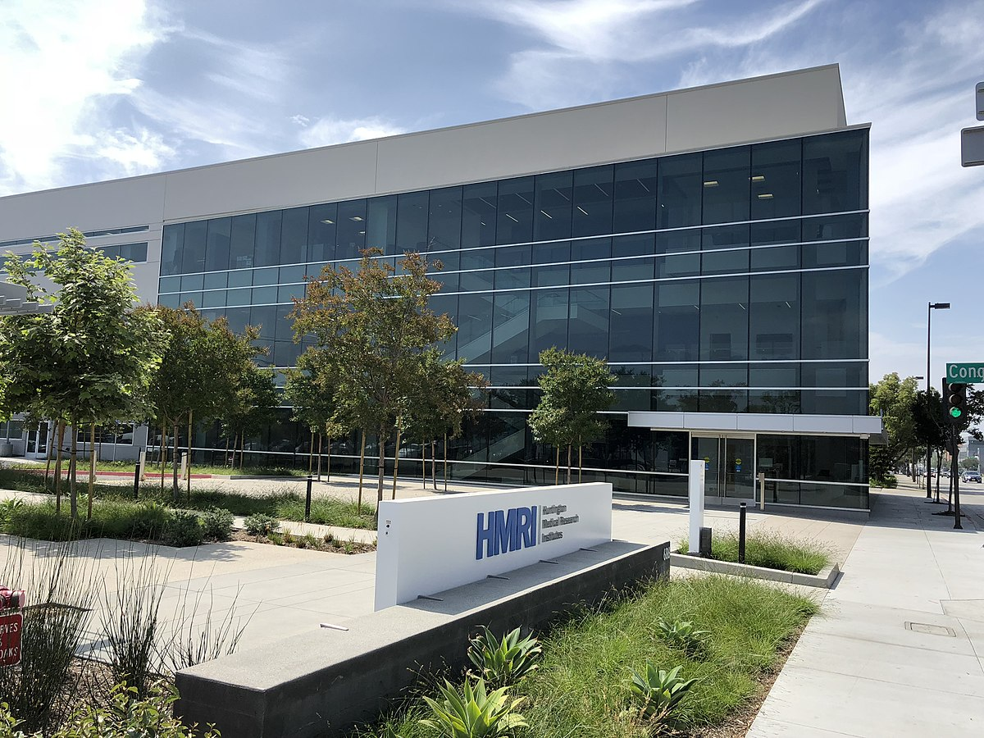
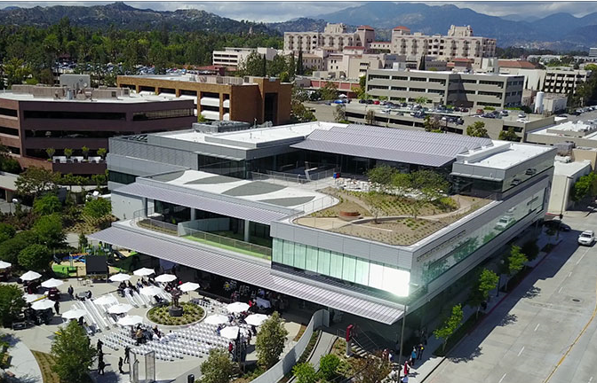
Academic and institutional
Huntington Medical
Research Institutes
Laboratory
Recently Completed
Shriners
Hospital

Slide 4
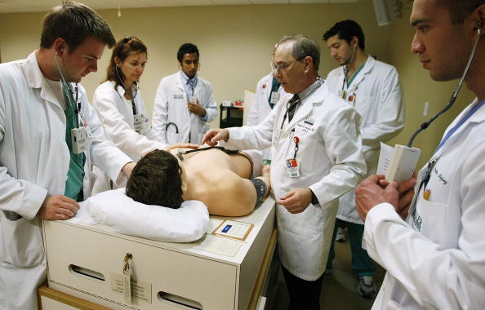
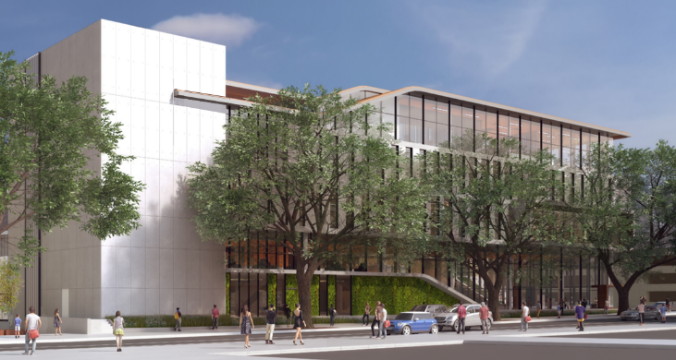
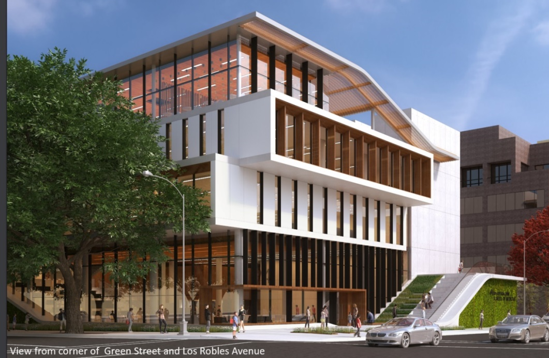
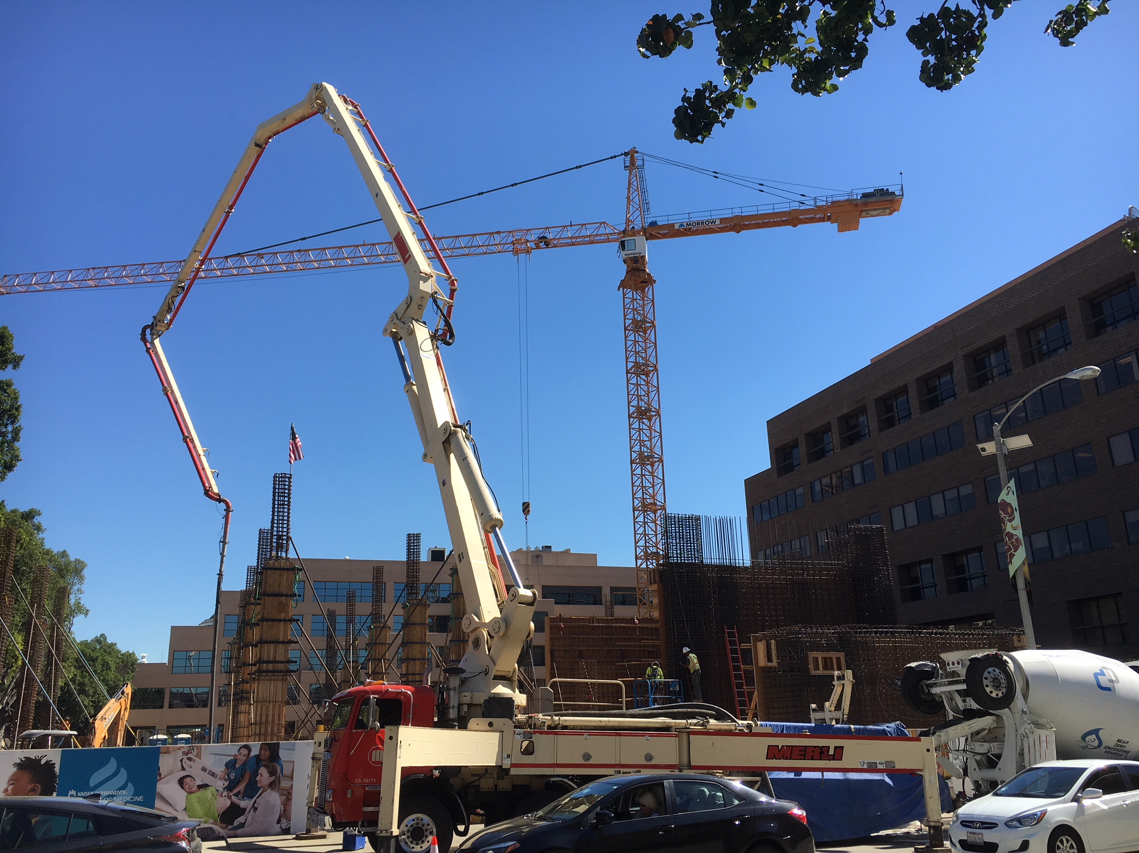
ACADEMIC AND INSTITIONAL
Kaiser Permanente School of Medicine
SE corner of Los Robles and Green.
Under Construction

Slide 5

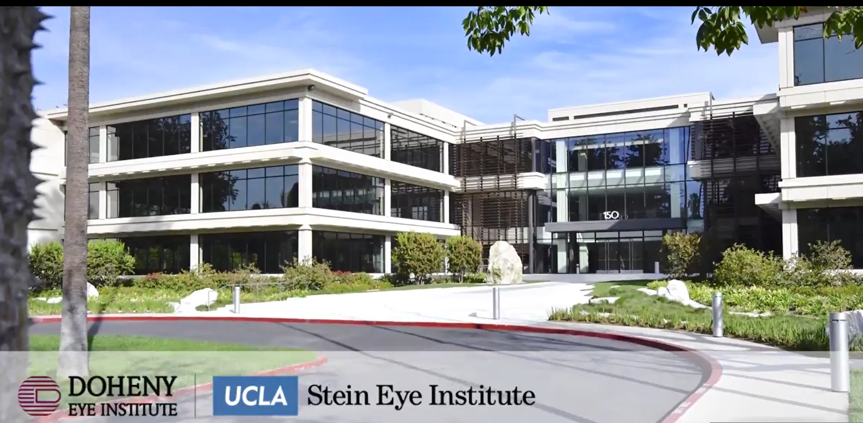
Doheny – UCLA
Eye Institute
ACADEMIC AND INSTITIONAL
Acquired – Interior Improvements 2019

Slide 6
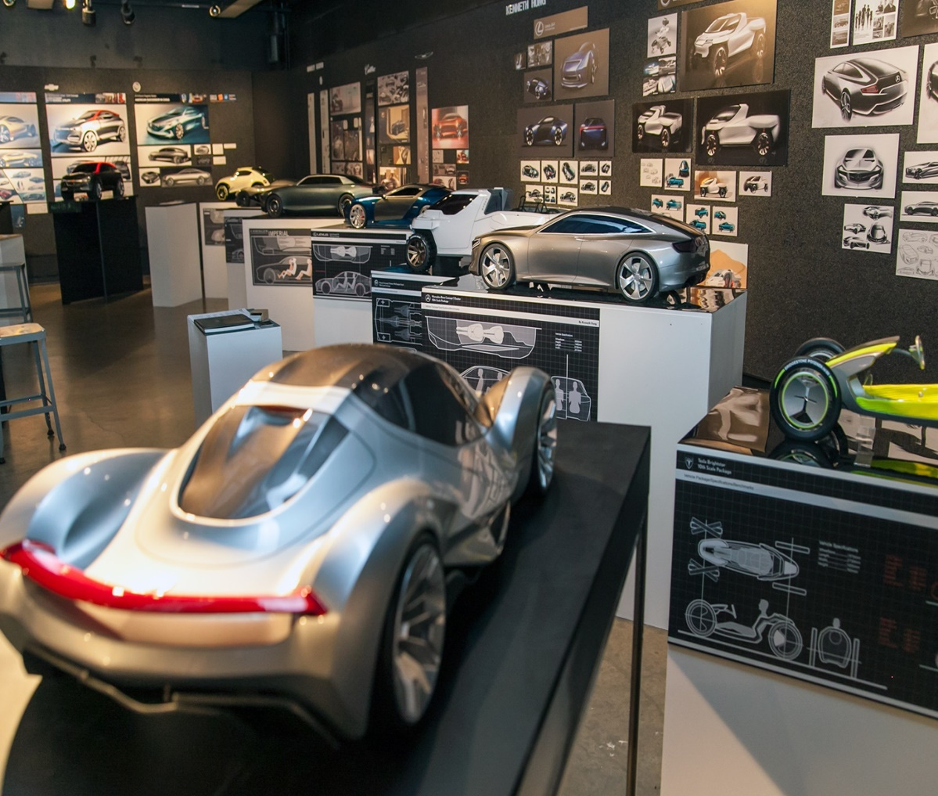
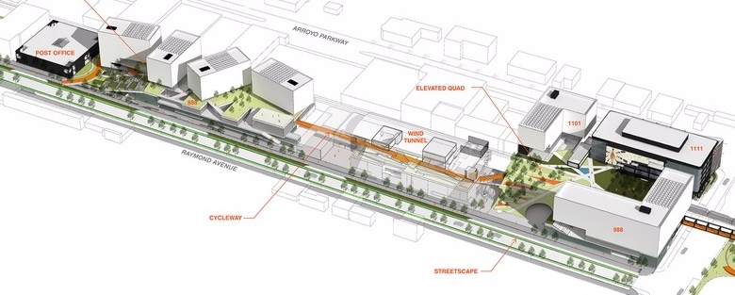
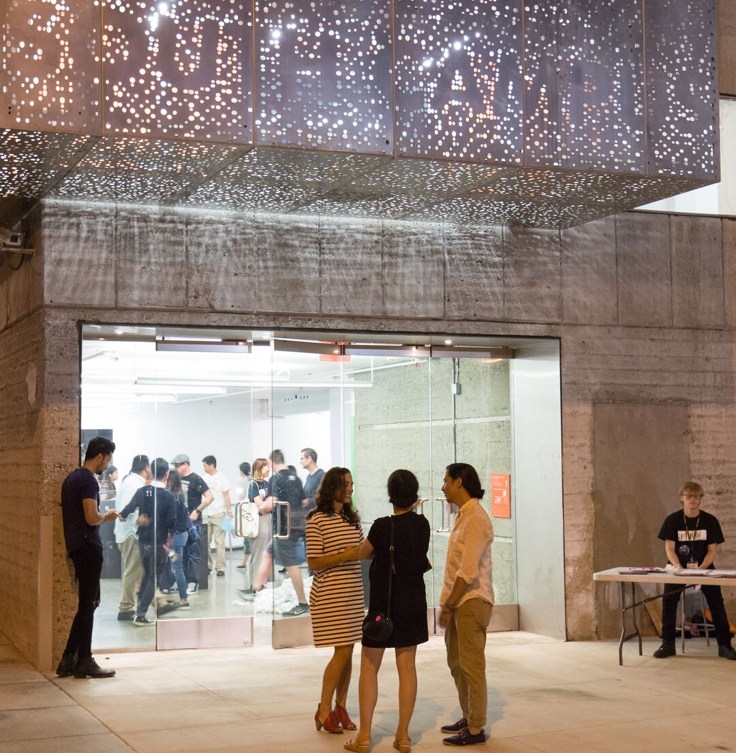
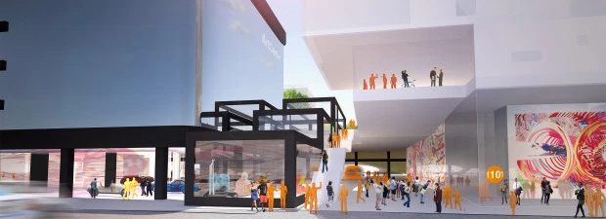
ACADEMIC AND INSTITIONAL
Master Plan Approved
Arroyo Parkway
South Raymond
Art Center
South Campus

