Slide 1
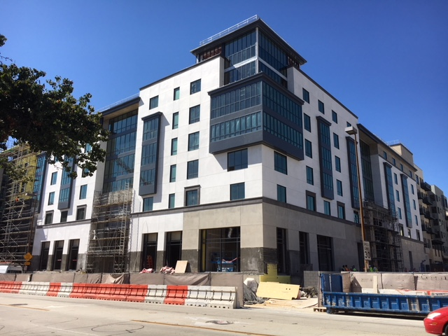
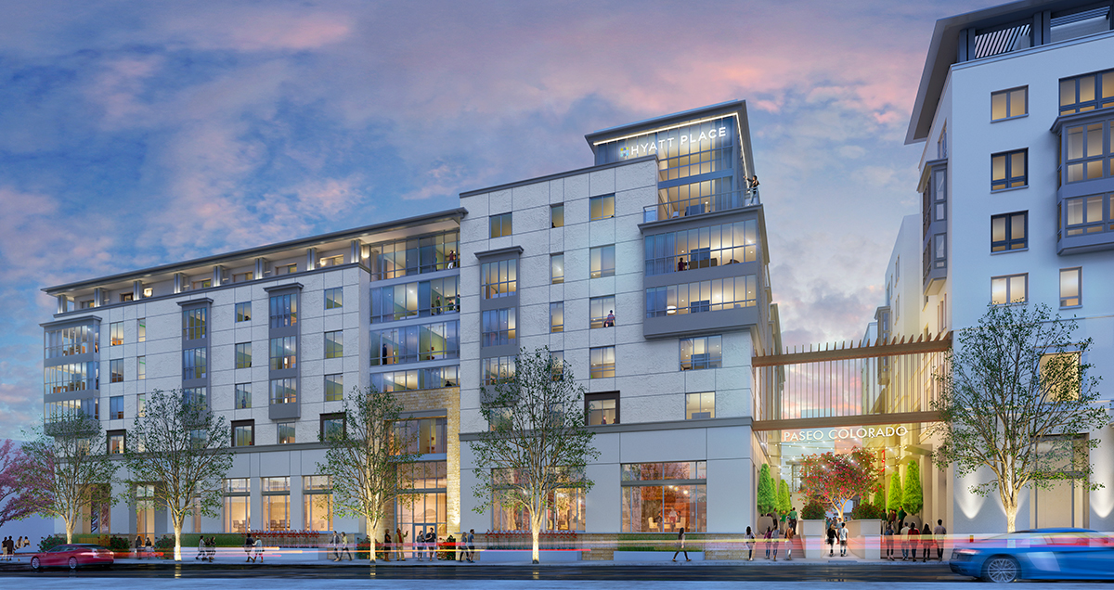
hotels
Hyatt Place
Nearing Completion

Slide 2
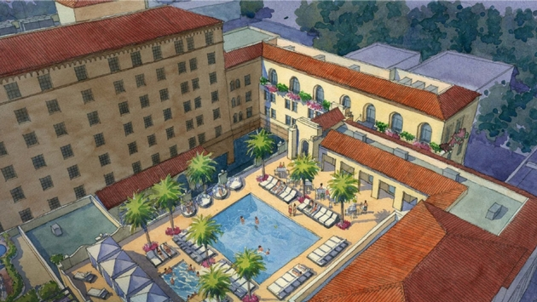

HOTELS
Dusit – D2
Third Phase
Nearing Completion

Slide 3
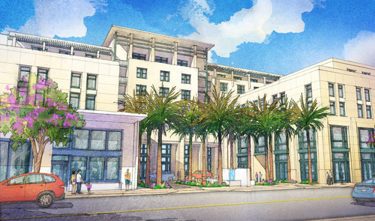
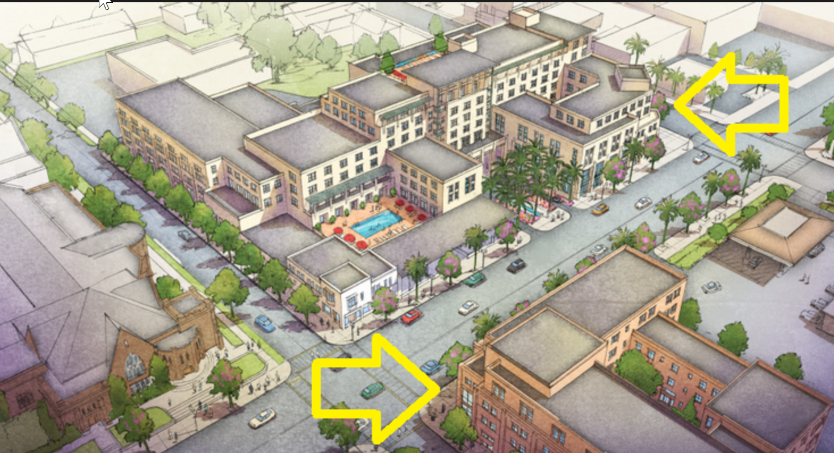
HOTELS
Colorado and Hill
– 500 + rooms in two hotels
Approved – In Design Review
Design Review

Slide 4
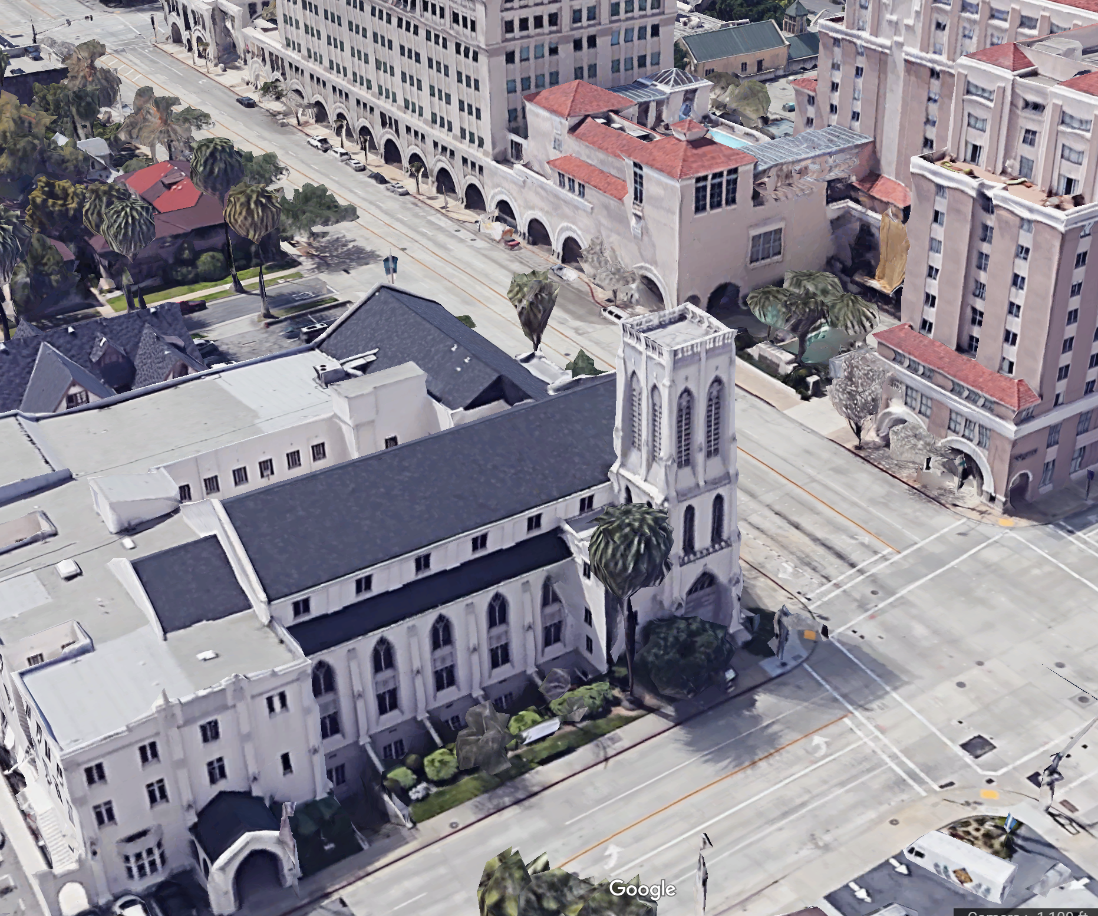
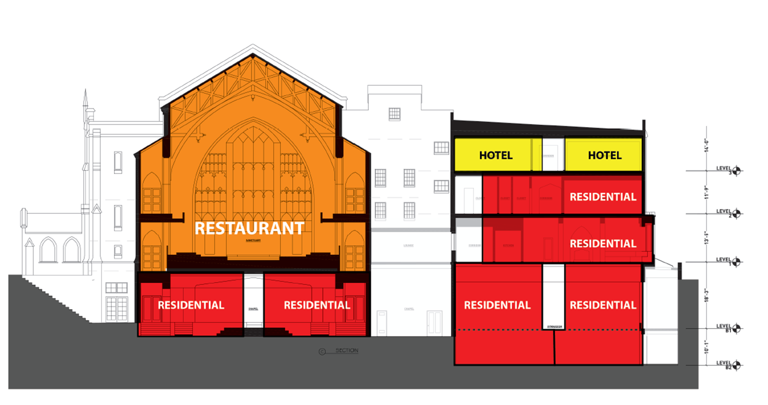
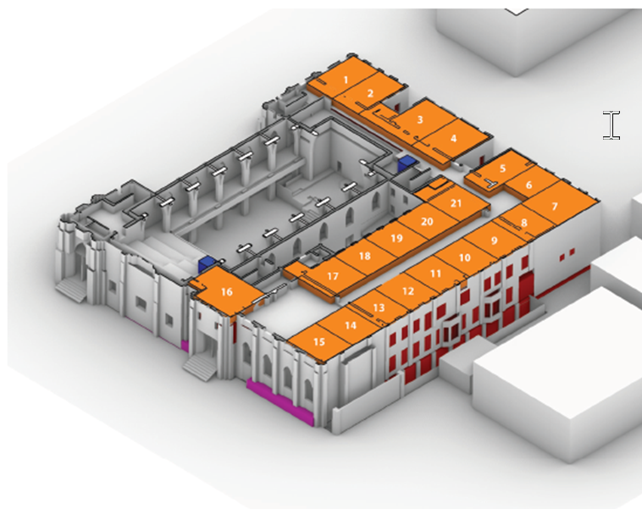
HOTEL – Mixed Use
SE Corner of Walnut and Los Robles
– Restaurant, Apartments and Hotel
Church Conversion - Preliminary Review

Slide 5
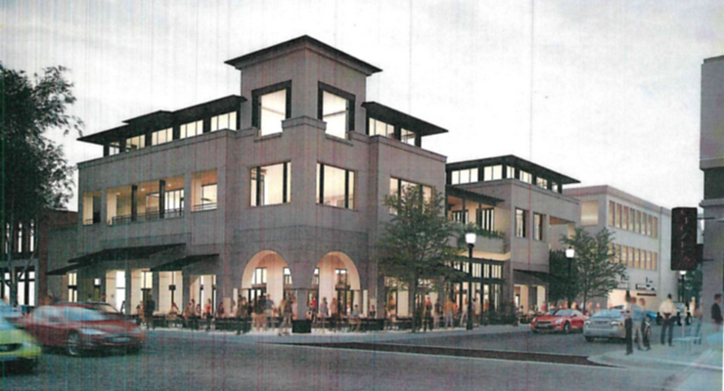
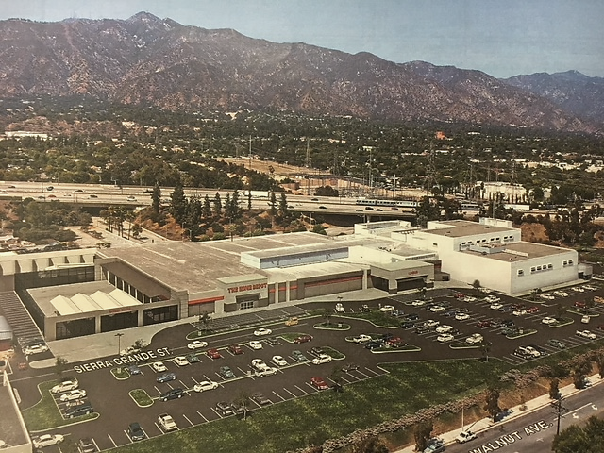
Green St. & Delacy Ave.
“Twin Palms” site
NEW COMMERCIAL
Avon site on Foothill Blvd.
Reuse to Home Depot and Office Space

