Slide 1
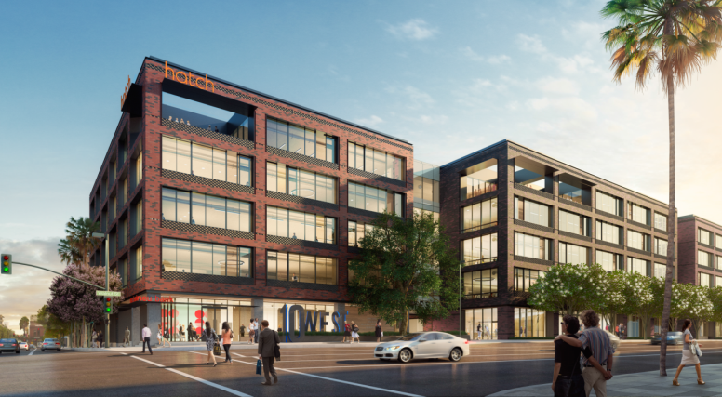
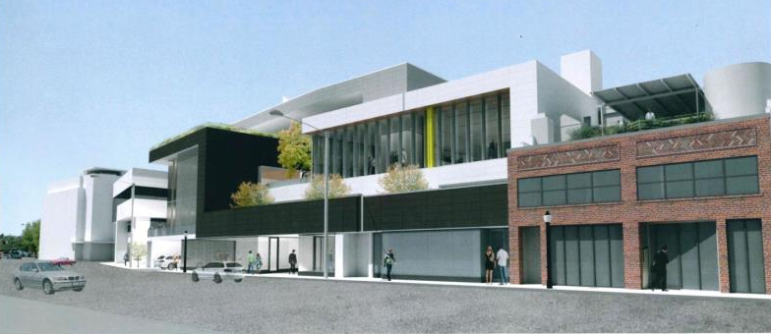
OFFICE
Lincoln Properties
(Parsons Block)
Starting Construction
Ayzenberg (on Walnut)
1

Slide 2
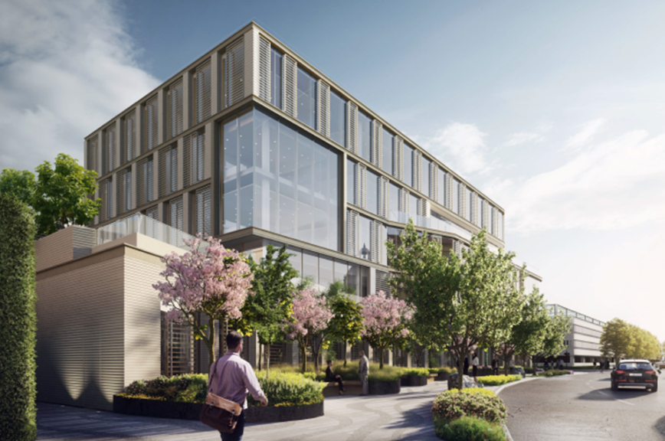
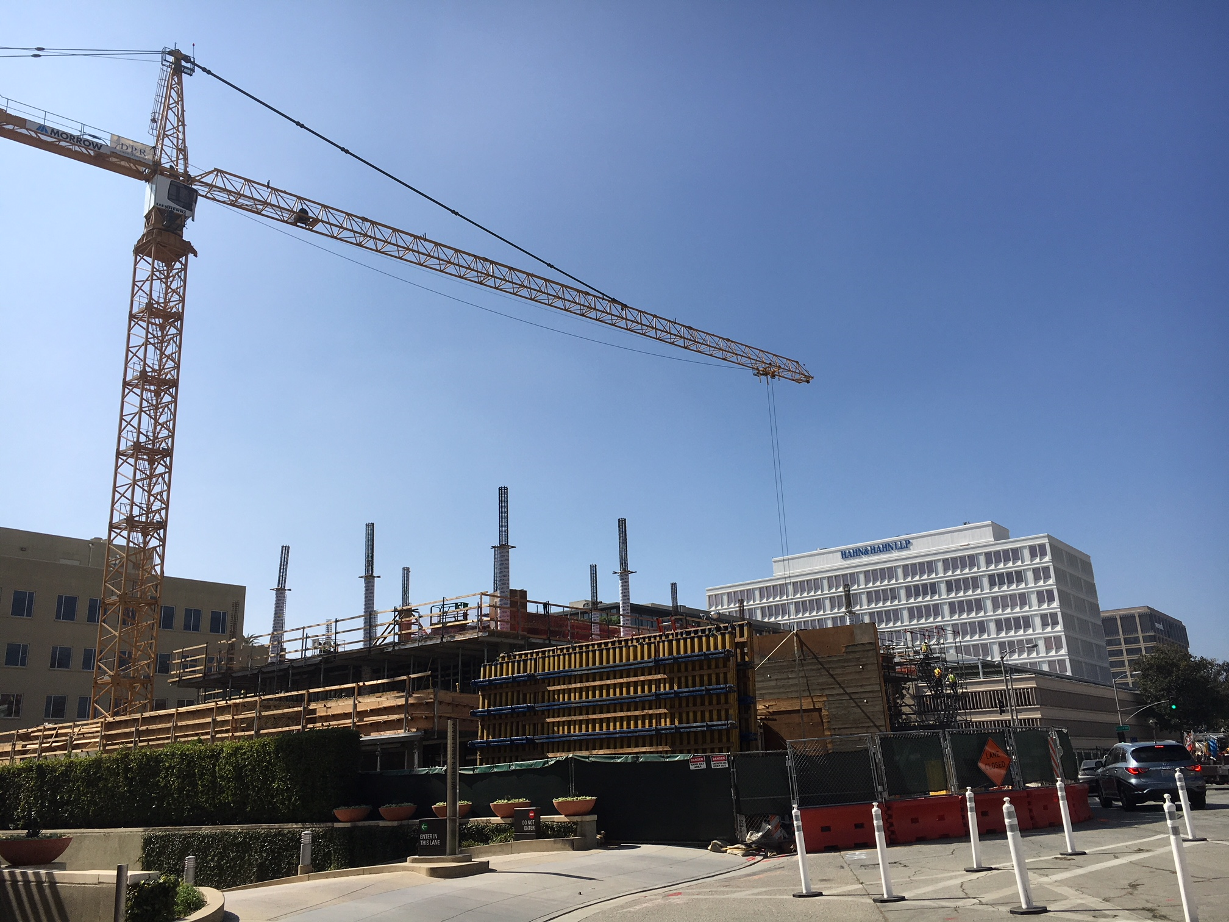
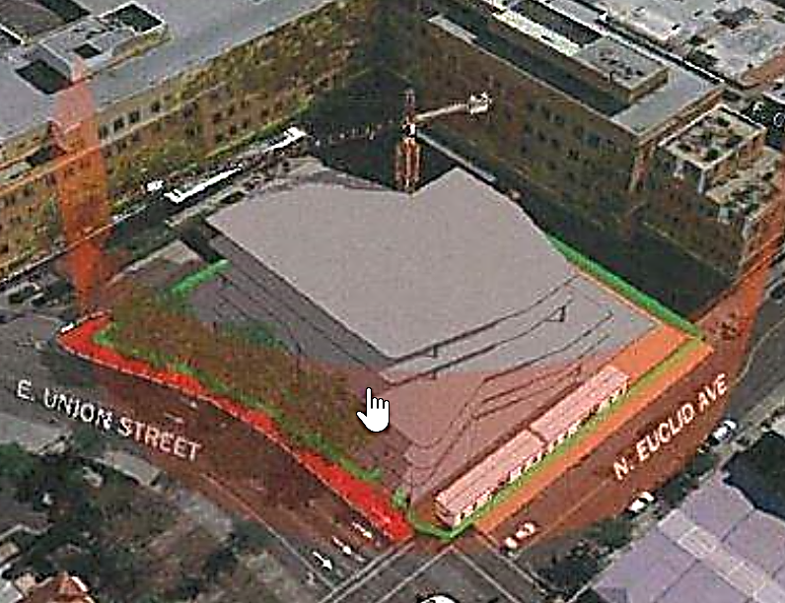
OFFICE
Alexandria RE -
Union/Euclid
Under Construction
2

Slide 3
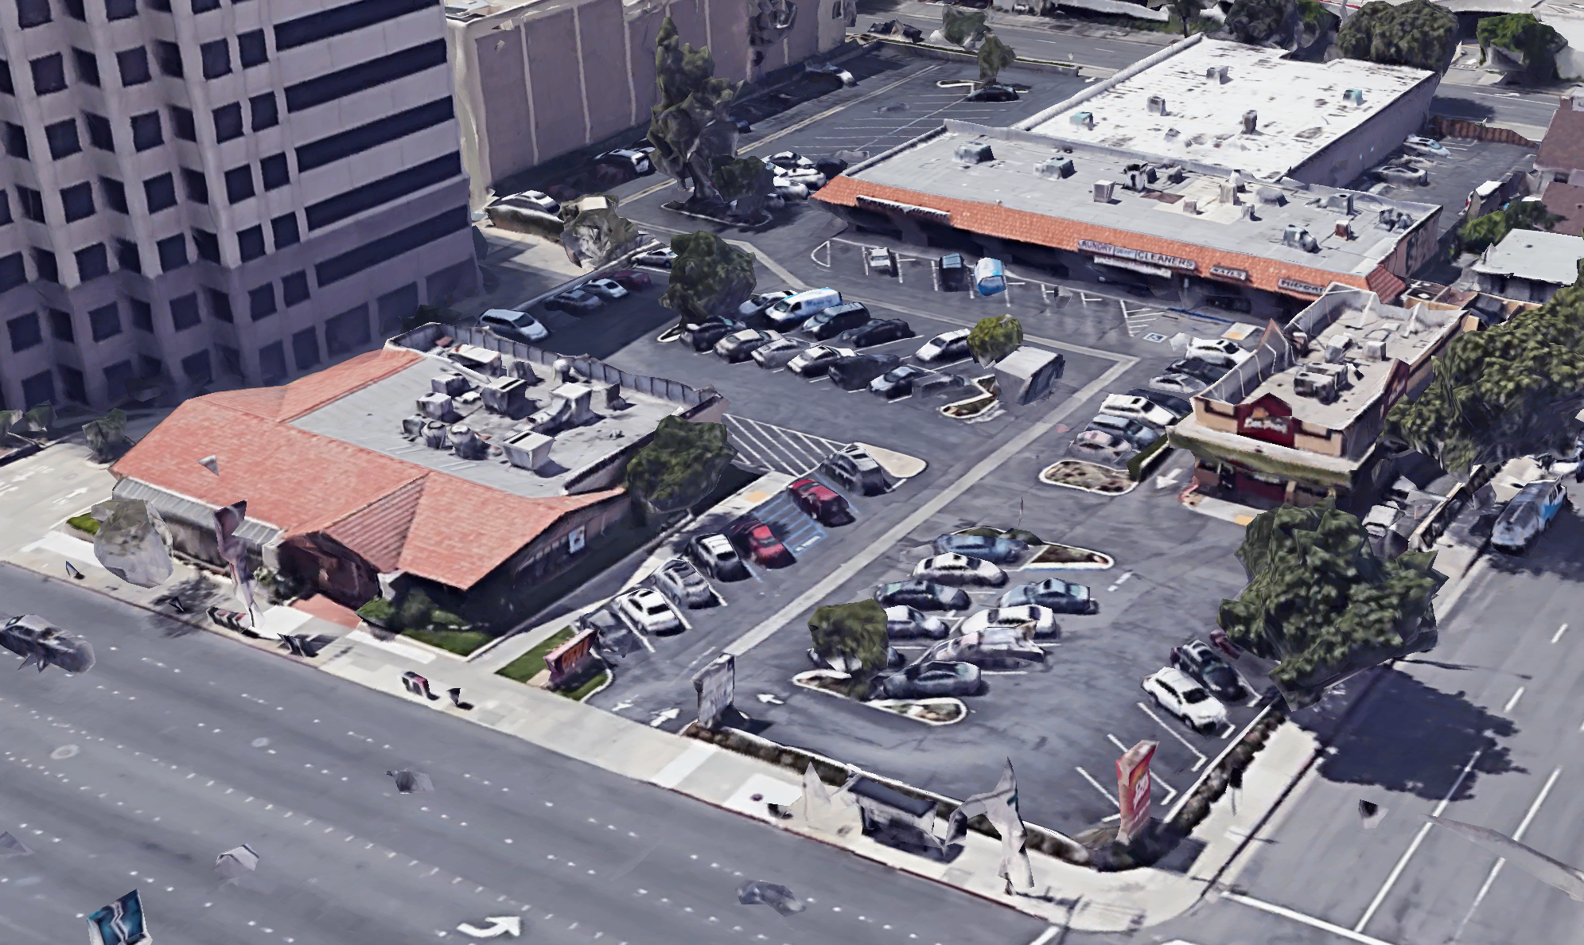
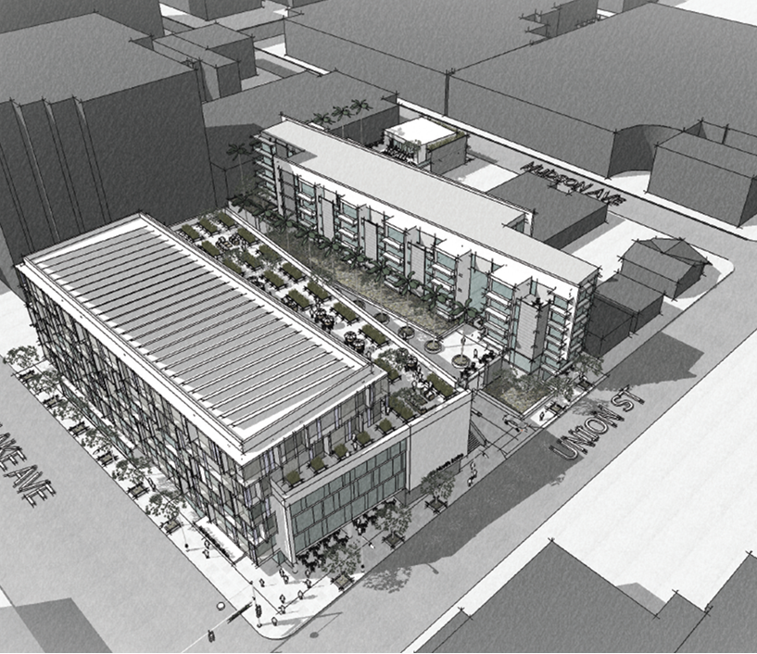
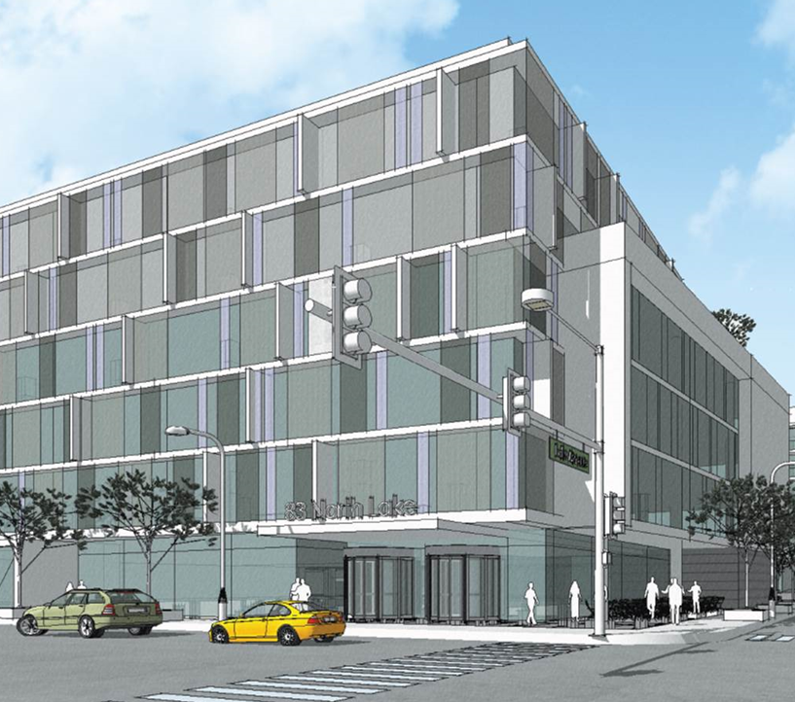
LAKE AND UNION - Office and Residential Project
OFFICE and RESIDENTIAL
In Design Review

Slide 4
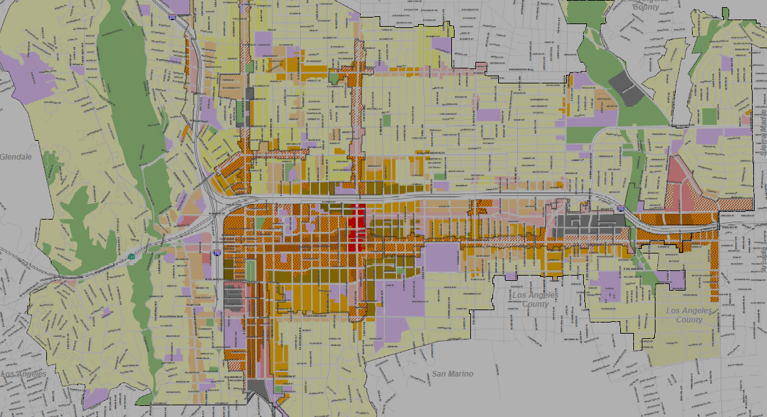
Development Activity near Transit
Larger Projects Completed 1994-2016
Larger Projects Construction/Planned
v

Slide 5
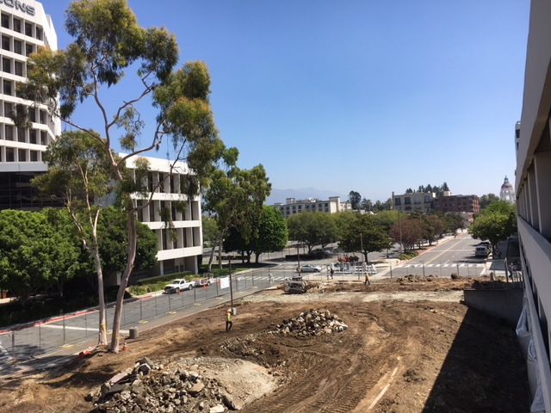
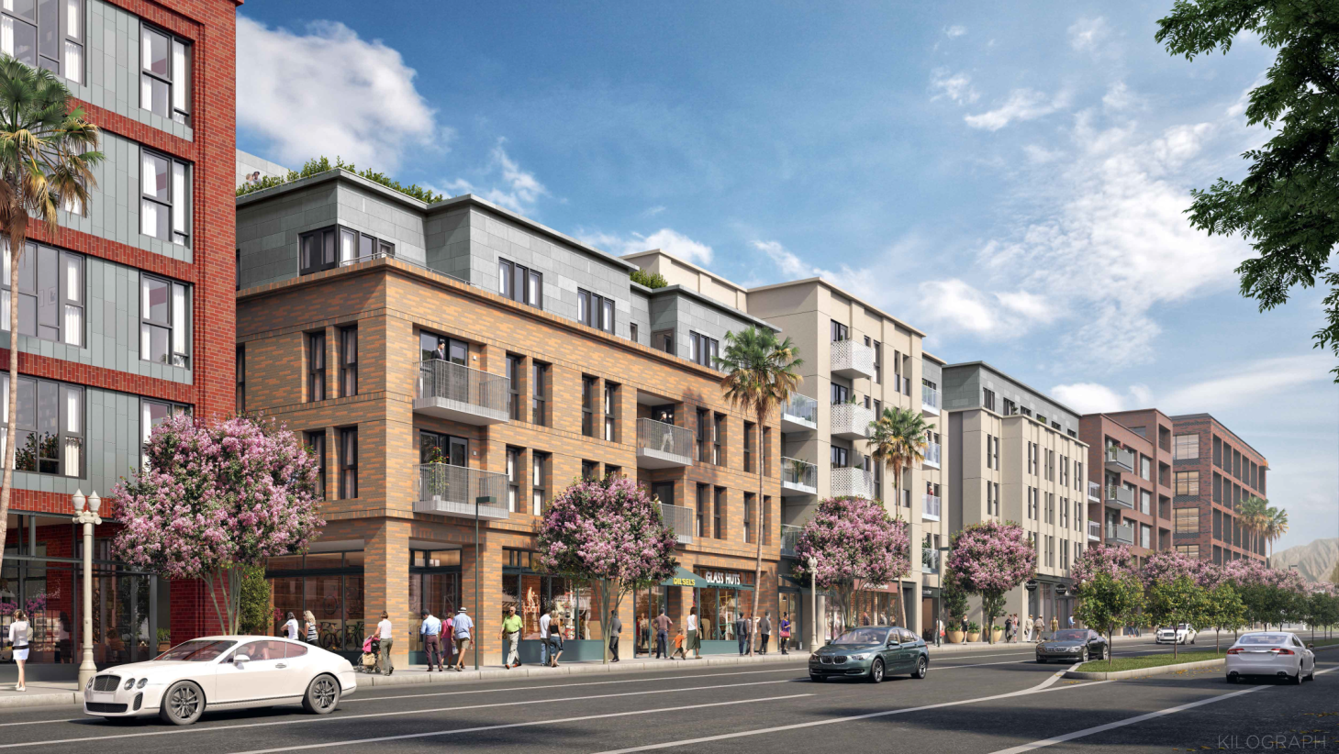
NEW HOUSING – Mixed Use
  Lincoln “ Parsons Block” (100 W. Walnut St.)
  Mixed Use Project: Construct a 5-story - 400 apartments and ground floor retail

