Slide 1
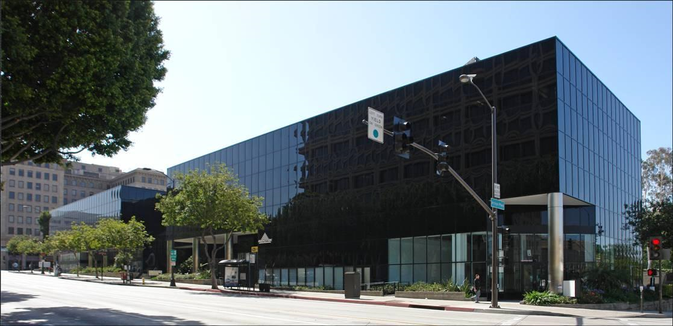
Marengo and Colorado
NEW HOUSING – Mixed Use
Housing with street level retail
In Design Review

Slide 2
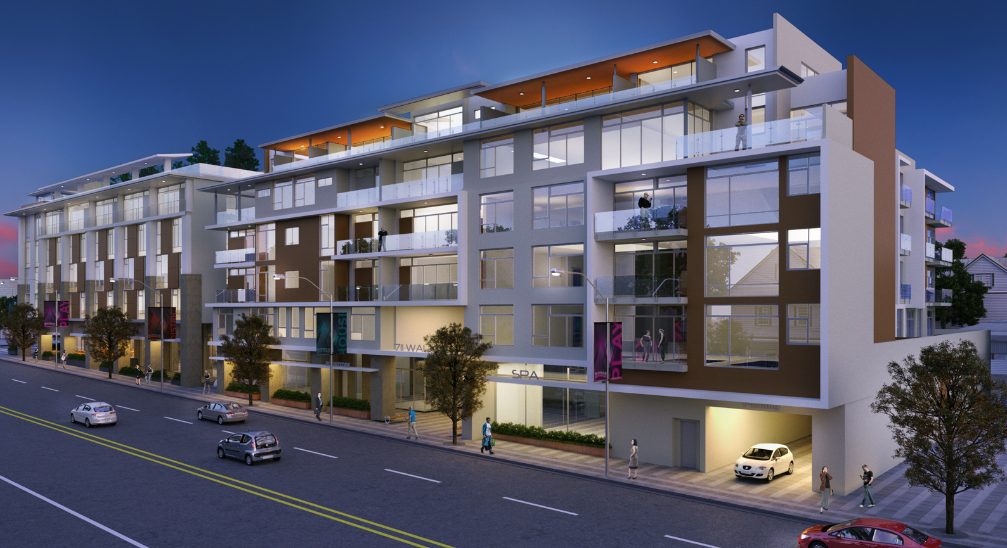
NEW HOUSING – Mixed Use
Los Robles and Colorado
In Plan Check
Walnut and El Molino
2

Slide 3
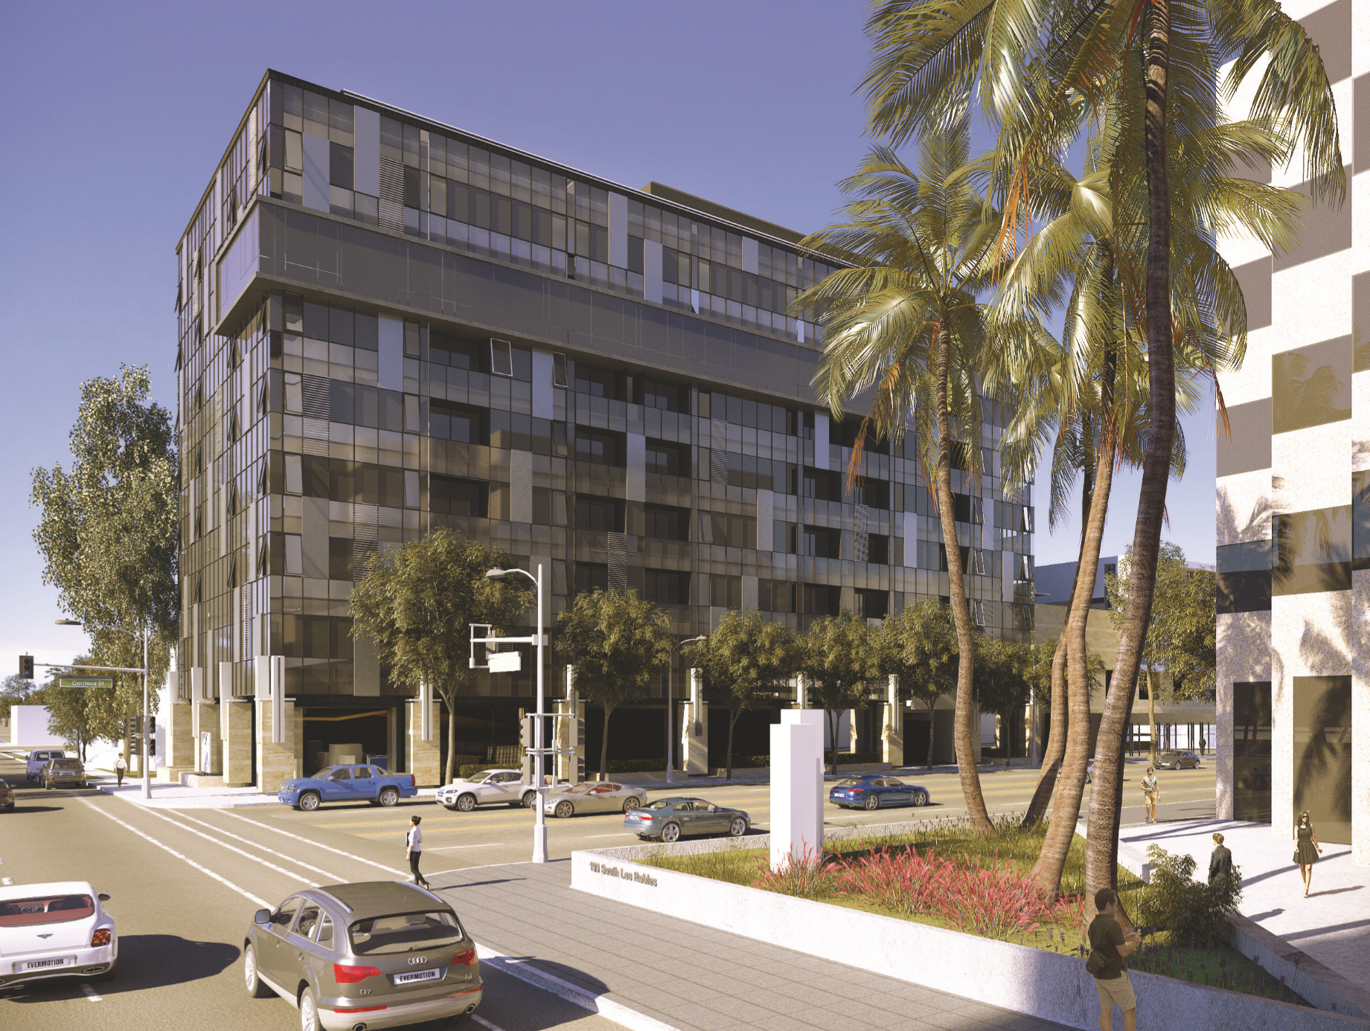
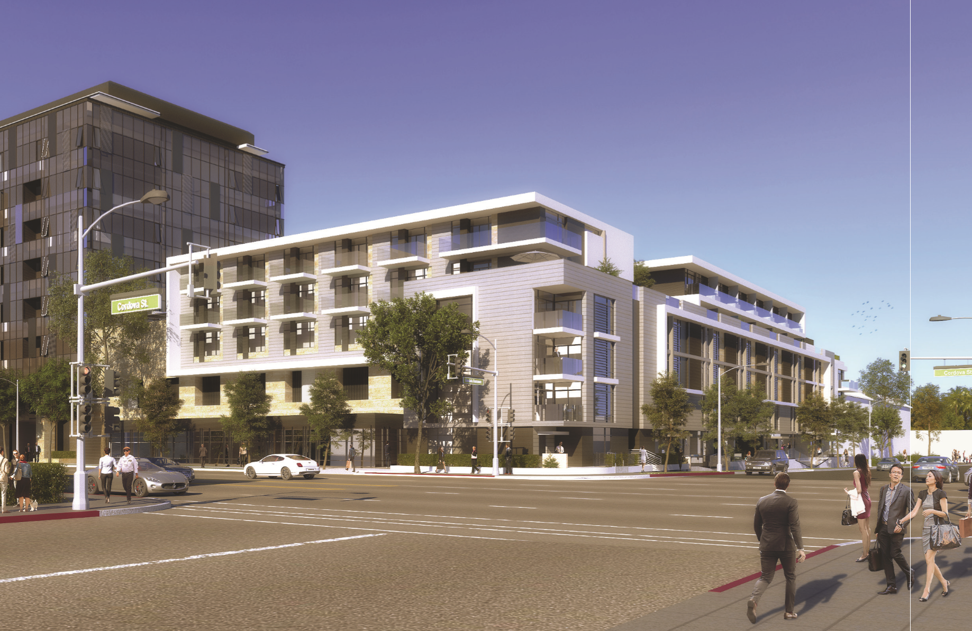
NEW HOUSING – Mixed Use
388 Cordova – Housing and Office
Under Construction

