Slide 1
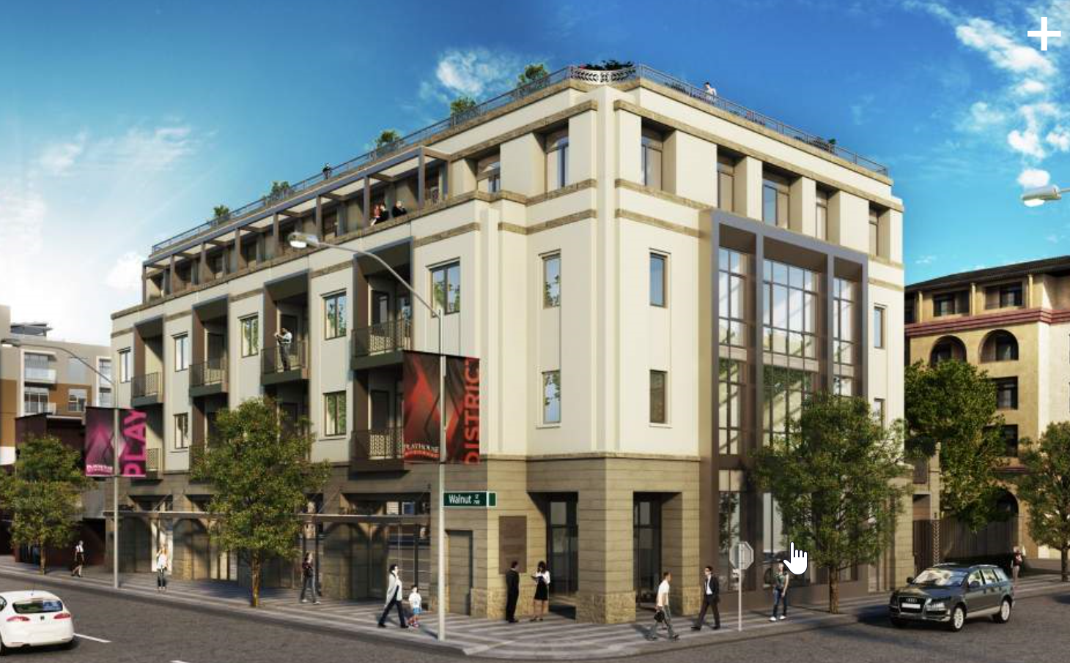
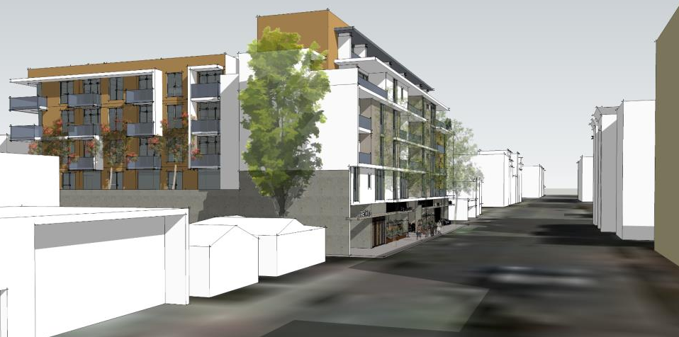
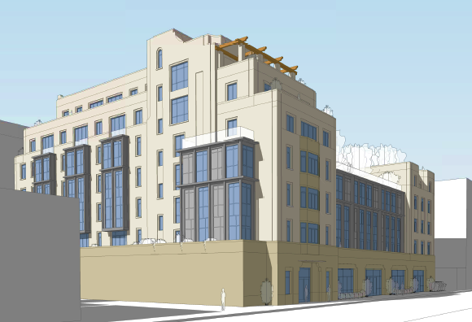
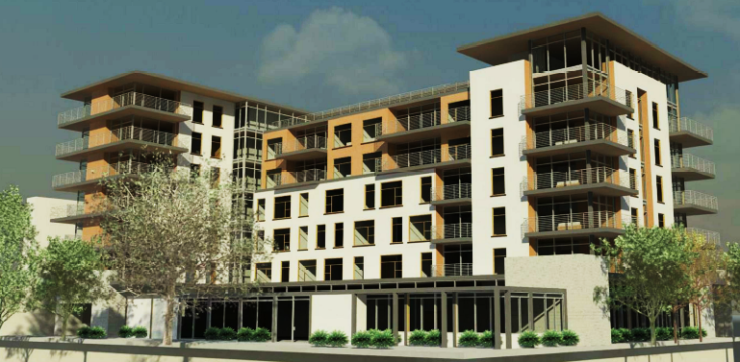
Downtown Housing
NEW HOUSING
– Mixed Use
Walnut and Hudson – 42 units
711 E. Walnut
450 S. Arroyo Parkway
747 E. Green St.

Slide 2
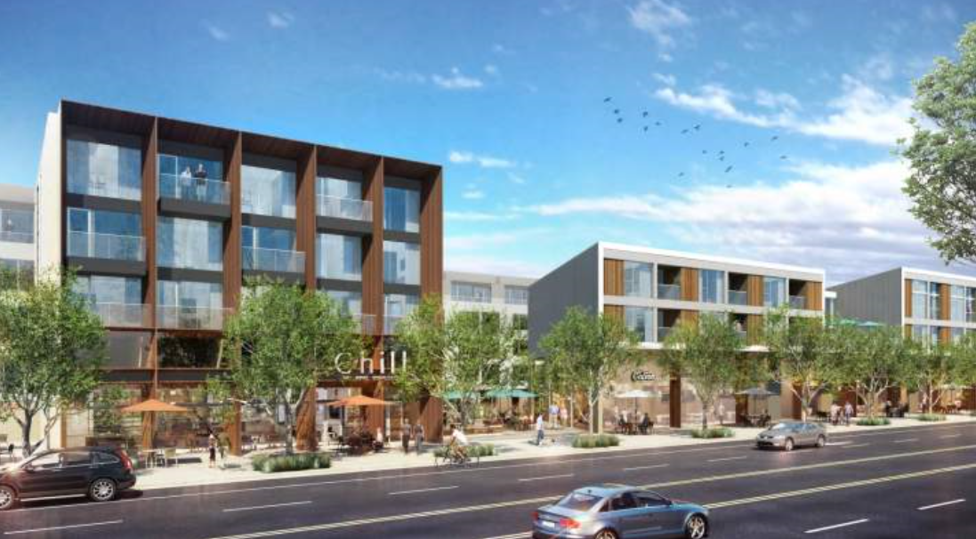
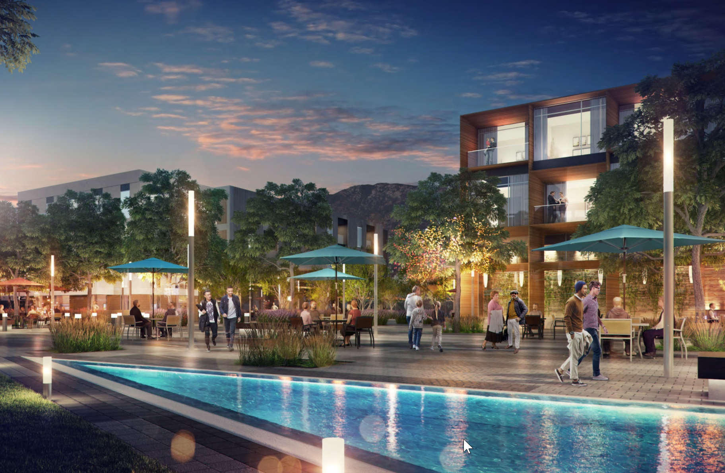
Space Bank Site – In Design Review
NEW HOUSING – Mixed Use

