Slide 1

Shriners Hospital for Children Medical Center - Pasadena
It Takes a Child to Build a Village
October 23,2018
October 23, 2018

Slide 2
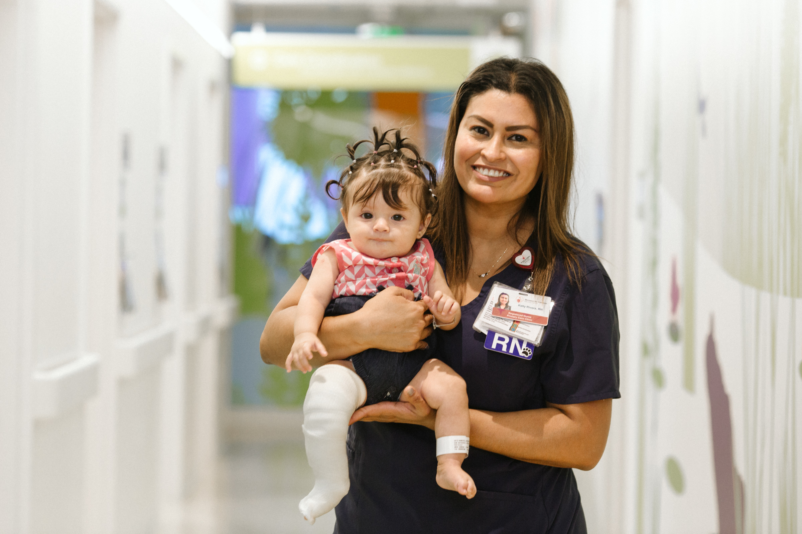
October 23, 2018
1

Slide 3

Shriners International
Shriners International, also commonly known as The Shriners, is a society established in 1870 and is headquartered in Tampa, Florida. It is an appendant body to Freemasonry.
The first hospital in the system opened in 1922 in Shreveport, Louisiana. It provided pediatric orthopaedic care.
October 23, 2018
2

Slide 4
Shriners for Children
Children at the center of what we do
Shriners a fraternity (fun, fellowship, brotherly love)
Today over 200 temples/clubs world wide
The Shriners charitable arm is the Shriners Hospital for Children –established 1922
22 locations worldwide
Have provide hope and healing to over 1 million children worldwide
October 23, 2018
3

Slide 5
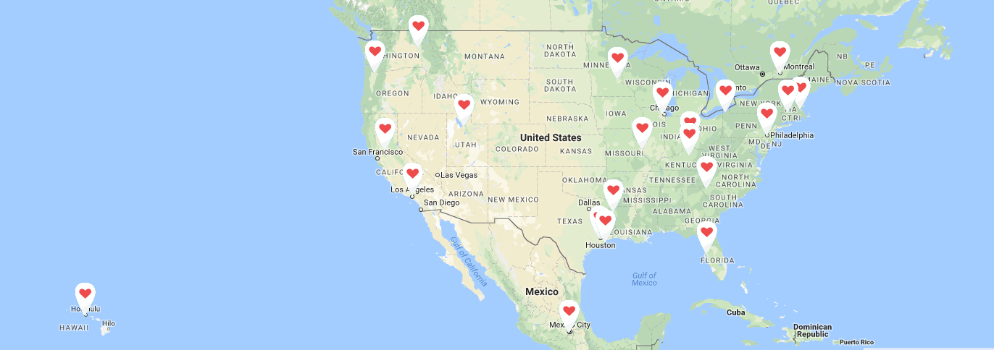
22 Locations
Orthopaedics Cleft Lip and Palate Burn Care
October 23, 2018
4

Slide 6
Mission
•Provide the highest quality care to children with neuromusculoskeletal conditions, burn injuries and other special healthcare needs within a compassionate, family-centered and collaborative care environment.
•Provide for the education of physicians and other healthcare professionals.
•Conduct research to discover new knowledge that improves the quality of care and quality of life of children and families.
This mission is carried out without regard to race, color, creed, sex or sect, disability, national origin, or ability of a patient or family to pay.
Vision
Become the best at transforming children’s lives by providing exceptional healthcare through innovative research, in a patient and family-centered environment.
Orthopaedics Cleft Lip and Palate Burn Care
October 23, 2018
5

Slide 7
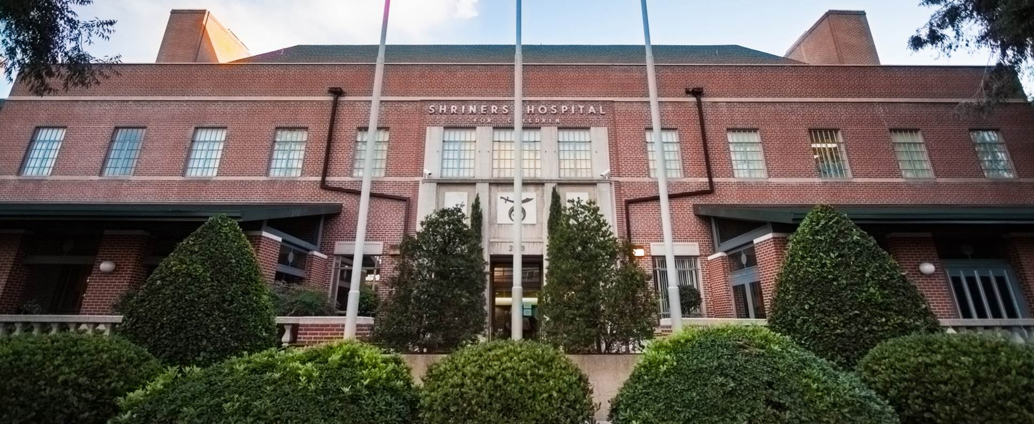
Our Hospital in Los Angeles
October 23, 2018
6

Slide 8
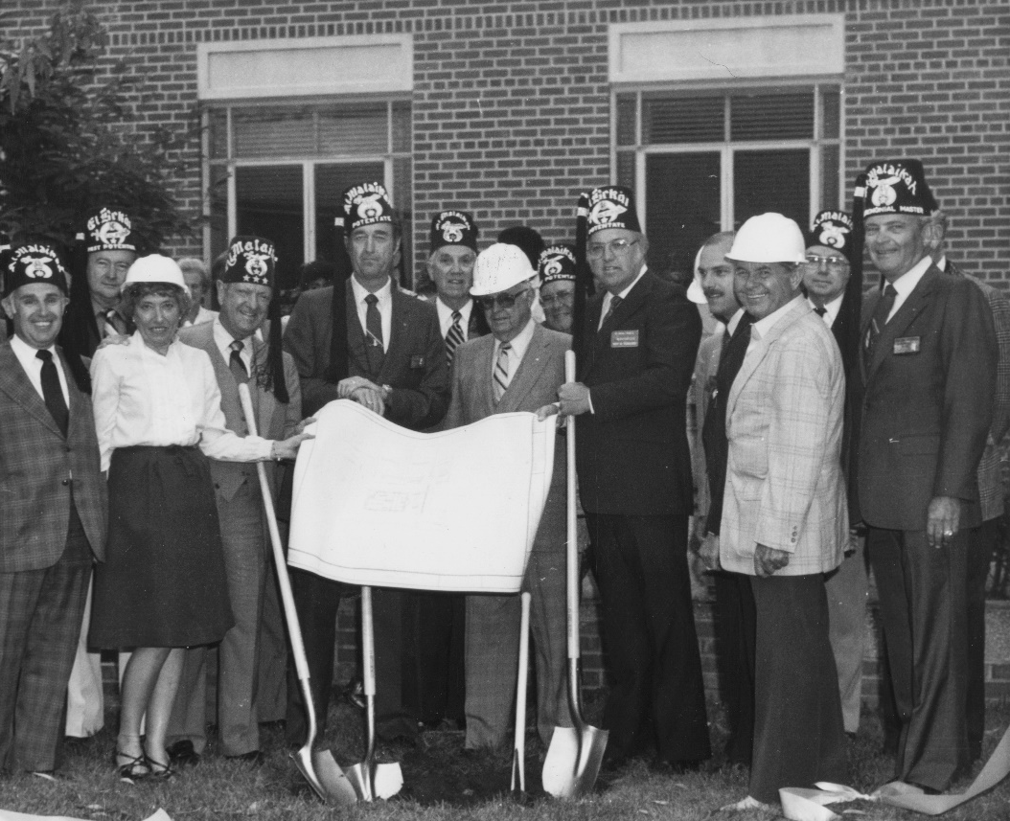
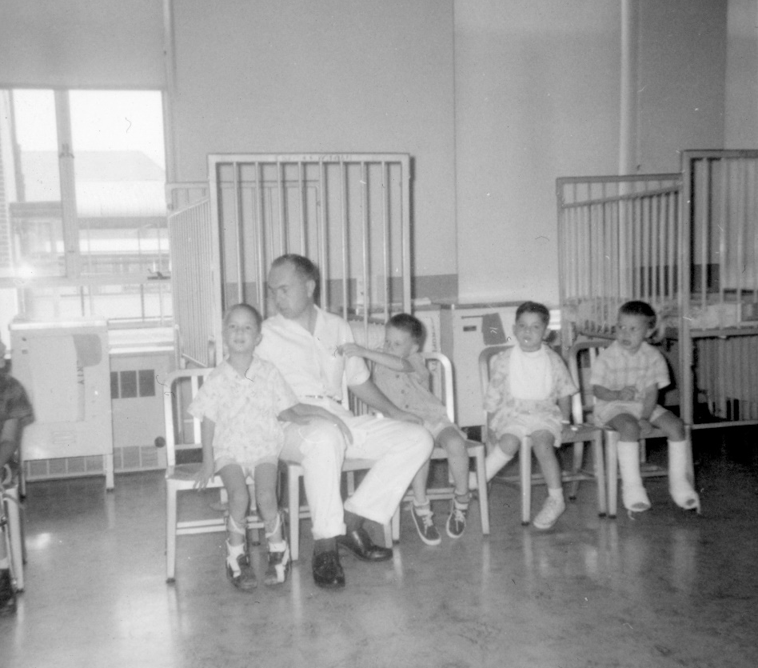
Our History in LA
From Concept to Expansion
1944 The idea for the hospital is first introduced
1945 Al Malaikah Temple receives approval for the hospital
1950 Al Malaikah Temple holds cornerstone ceremony
1952 Shriners Hospitals for Children Los Angeles opens
1983 Hospital is renovated and expanded
1988 Hospital is further expanded and CAPP is added
October 23, 2018
7

Slide 9
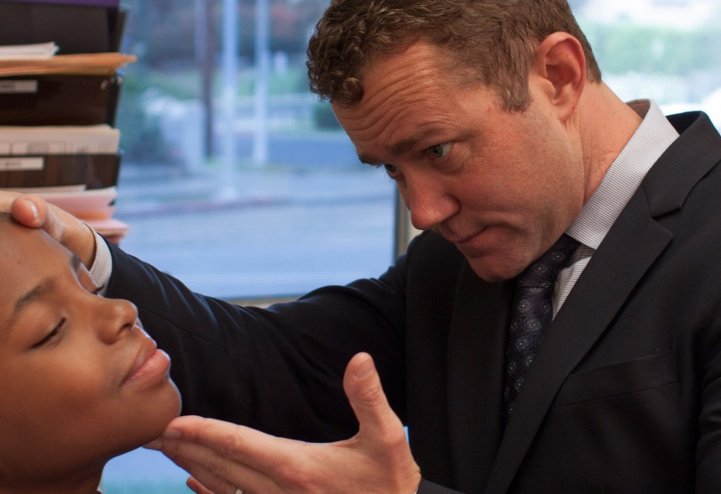
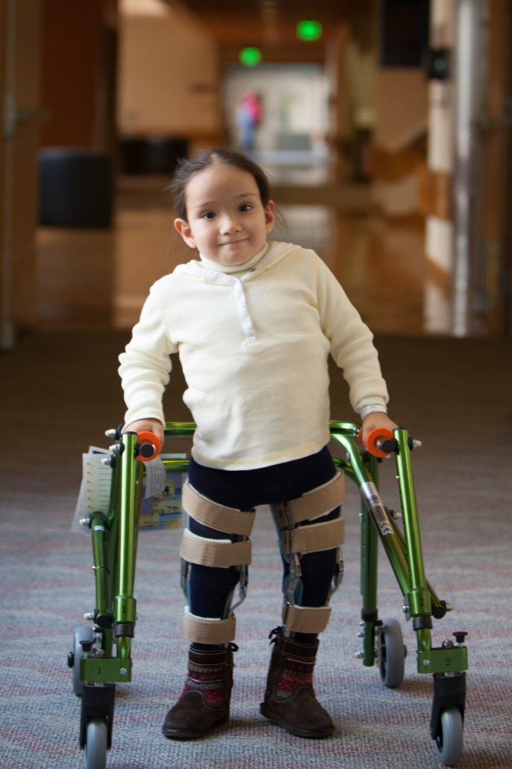
Our History in LA
From Concept to Expansion
Services
  Orthopaedics
  Cleft Lip and Palate
  Burns
  CAPP (POPS)
Academic Affiliations
  UCLA | UCLA Harbor | USC
Outreach Clinics
  LA | SD | PHX | TUS | LV | ABQ | MEX
October 23, 2018
8

Slide 10
Challenges with the LA Hospital
Hospital was not compliant with seismic safety law
Running an ADC of about 4.5 very inefficient
High cost of being a 24/7 facility
Shift from inpatient to outpatient (ambulatory) care
October 23, 2018
9

Slide 11
Favorite Einstein Quote
“Nothing happens until something moves.”
      Albert Einstein
October 23, 2018
10

Slide 12
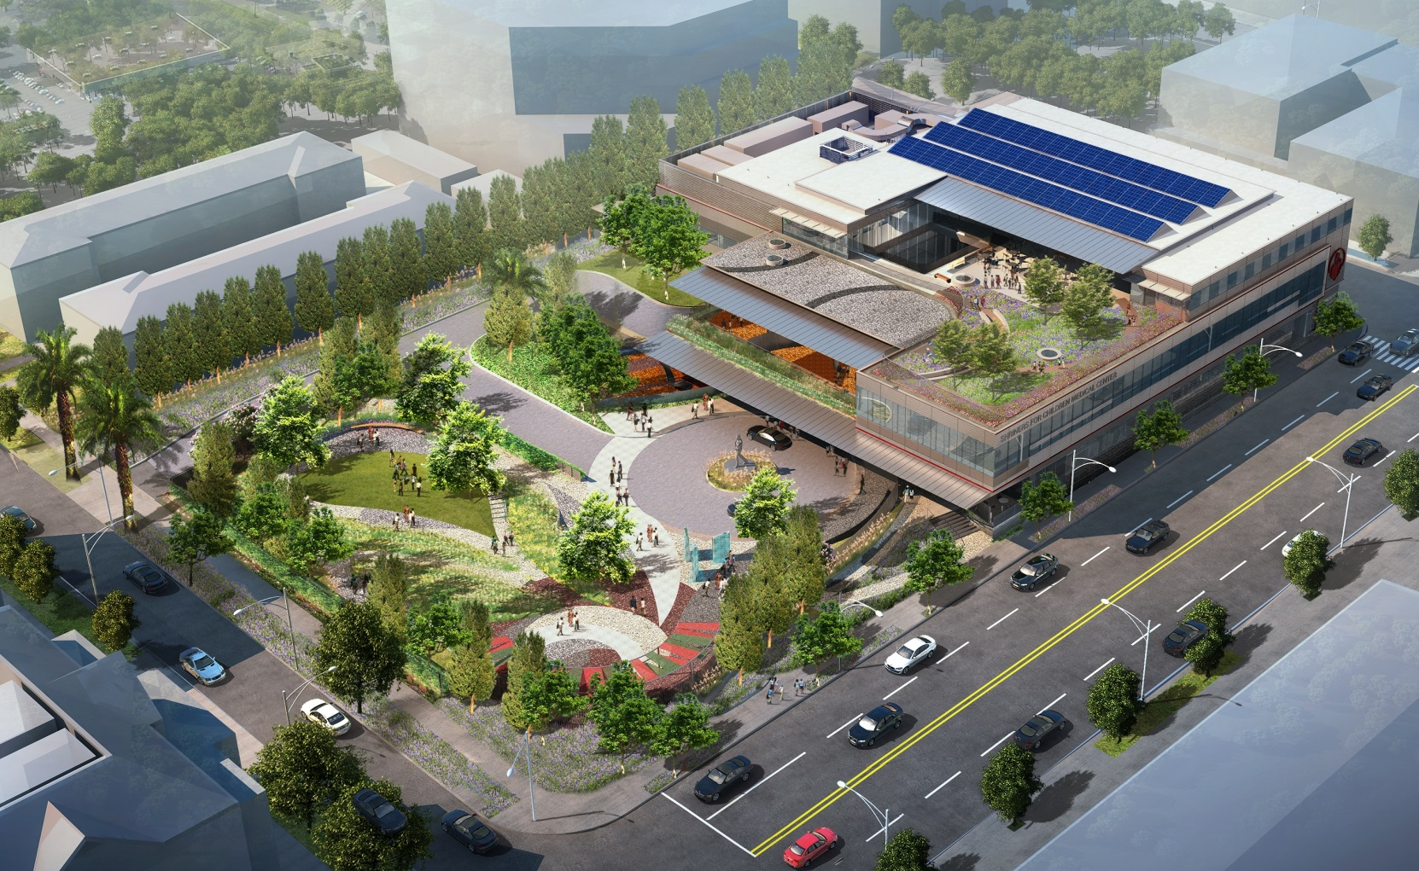
Our Medical Center in Pasadena
October 23, 2018
11

Slide 13
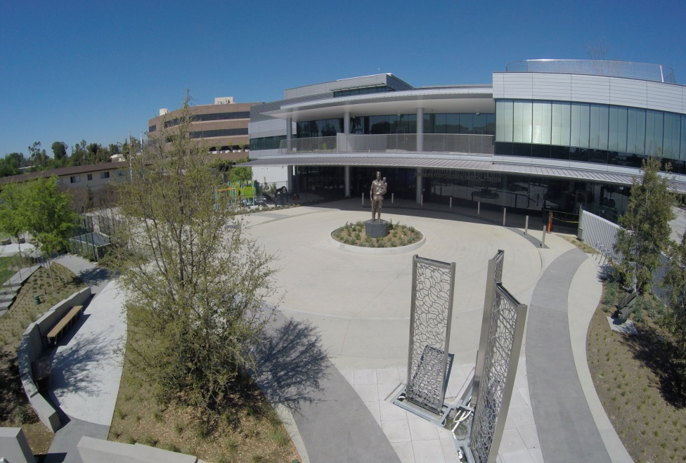
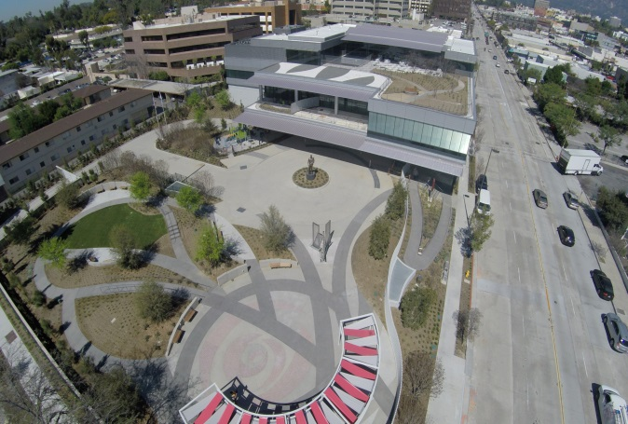
Shriners for Children Medical Center
Shriners for Children Medical Center - Pasadena, previously known as Shriners Hospitals for Children — Los Angeles, is a specialty medical center providing comprehensive medical, surgical and rehabilitative care to children up to age 18 with orthopaedic conditions, burn scars, and cleft lip and palate.
Orthopaedics Cleft Lip and Palate Burn Care
October 23, 2018
12

Slide 14
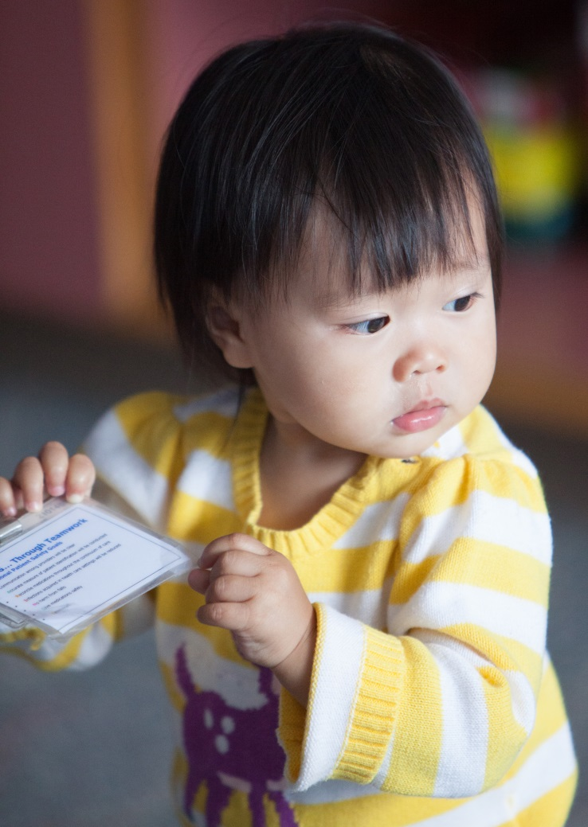
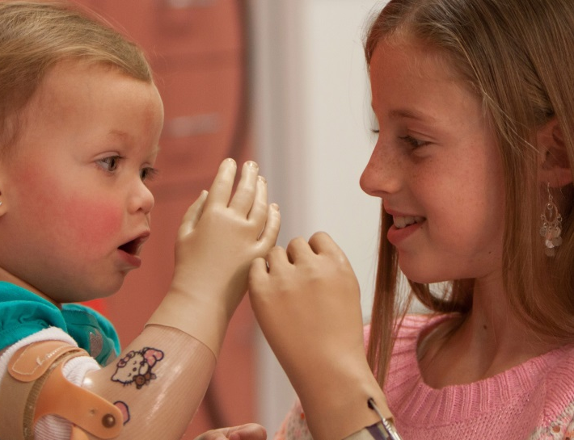
Our Medical Center
In Pasadena
Adapting to The New Marketplace
Enhanced Quality of Service With Our Partnership With Huntington Hospital
Medical Center Licensed as ASC, Rehabilitation Services, and Pediatric Clinic
Become networked with major payors in market
October 23, 2018
13

Slide 15

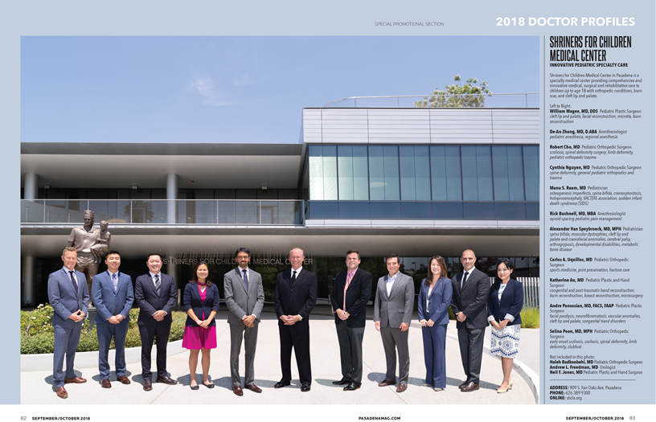
Orthopaedics Cleft Lip and Palate Burn Care
October 23, 2018
14

Slide 16
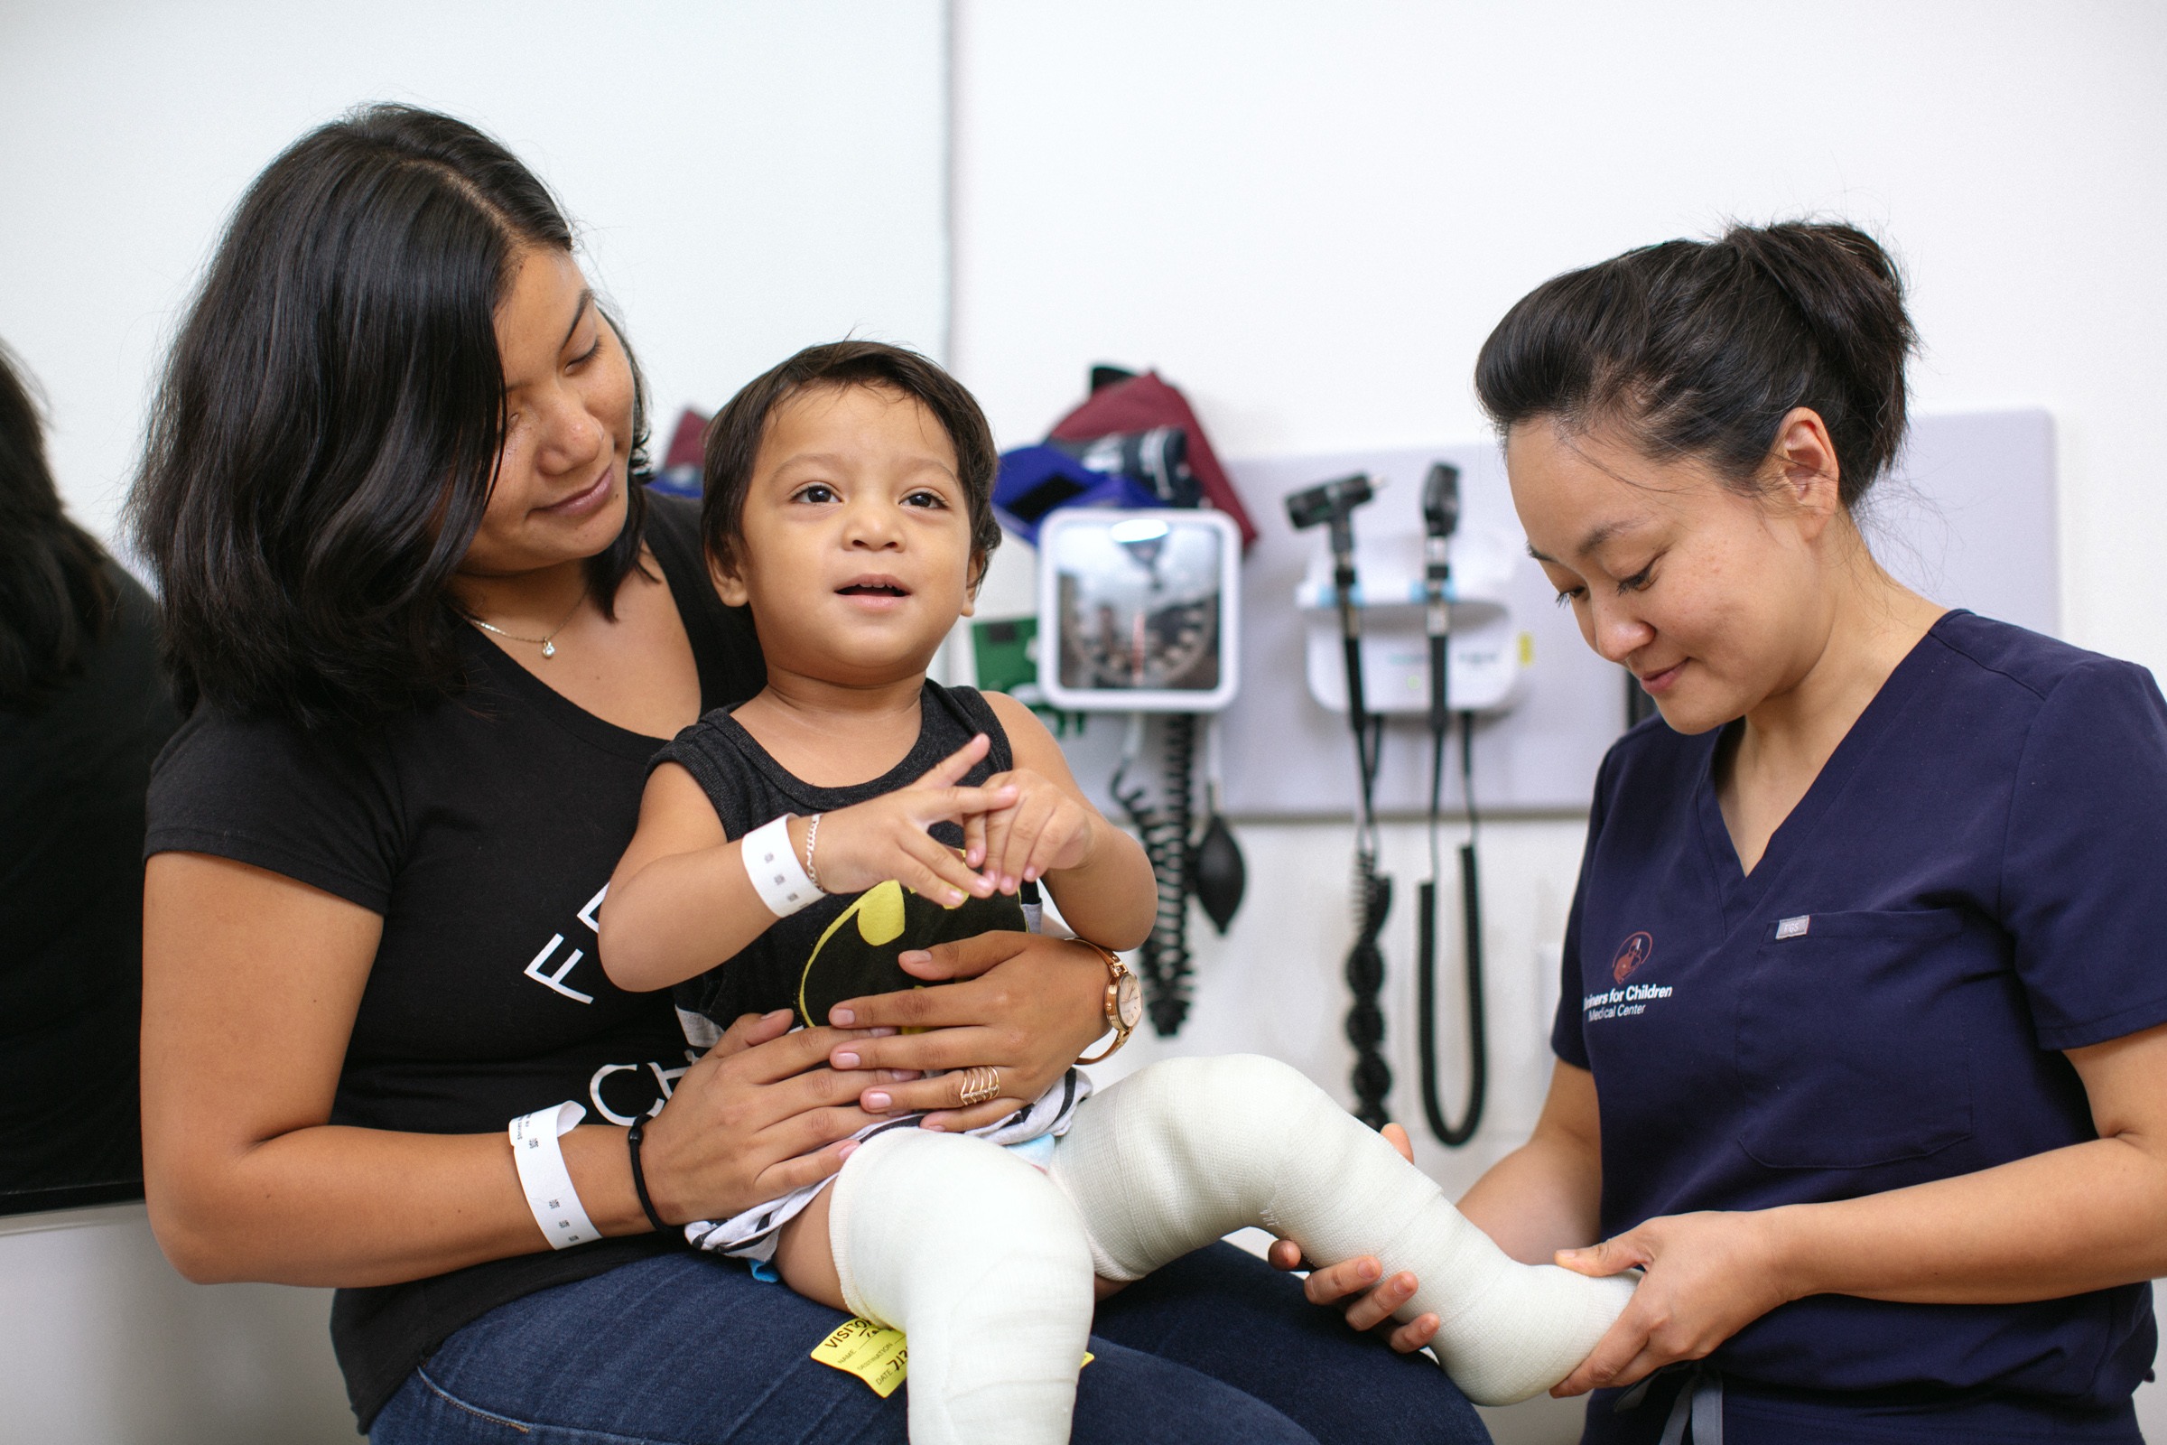
October 23, 2018
15

Slide 17
Current Challenges/Opportunities
Children are always cared for best as close to home as possible
Promoting desirable growth – must cast a wide net
Zero harm
Recruiting/retaining/developing phenomenal people
Exquisite patient and family experiences
Financial stewardship
Improve the future of pediatric health through research/teaching and education
October 23, 2018
16

Slide 18
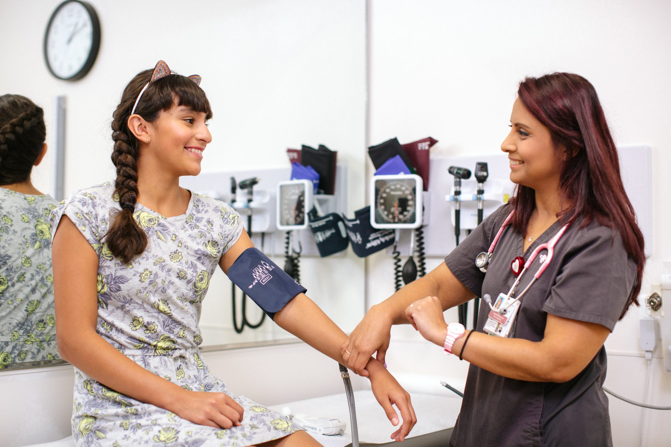
October 23, 2018
17

Slide 19
Coming Together As A Village
“We live in a world in which we need to share responsibility. It’s easy to say ‘it’s not my child, not my community, not my problem.’ Then there are those who see the need to respond. I consider those people my heroes.”
  - Fred Rogers
October 23, 2018
18

Slide 20
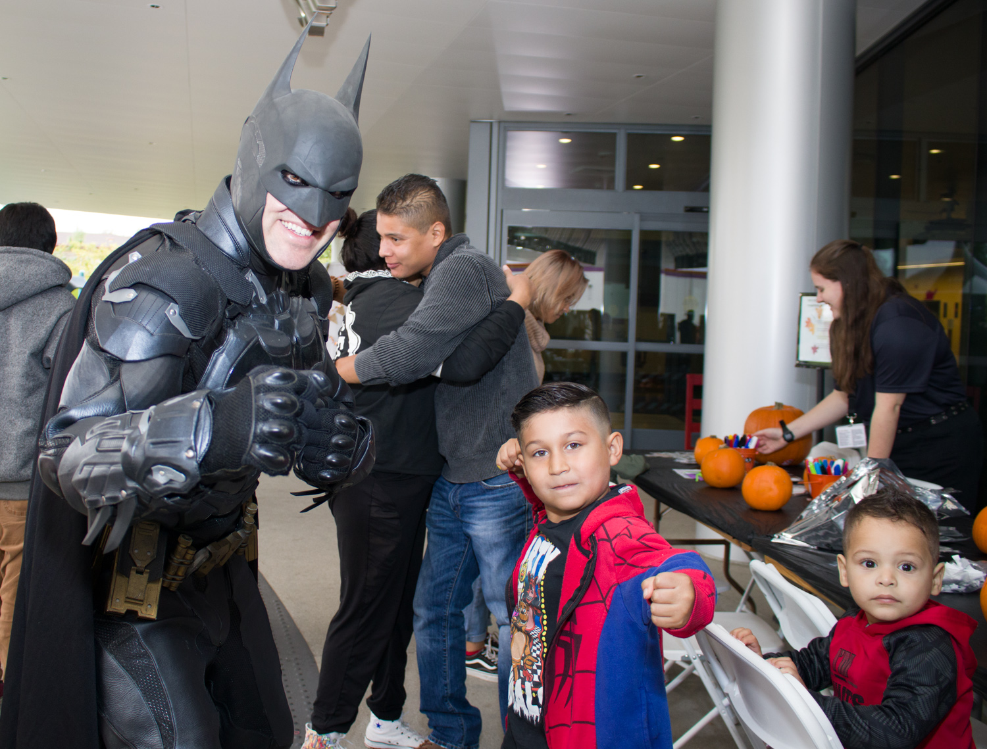
October 23, 2018
19

Slide 21
Our Journey Continues
Adapting to The New Marketplace
Telemedicine/Telehealth
Expand Service In NW Mexico with expansion of Tijuana presence. Add Hermosillo Clinic and Telemedicine in Sinaloa and Baja
Increase Market Penetration In PHX, TUC, LV, ABQ,
Explore more partnerships and build off the partnerships we currently have
October 23, 2018
20

Slide 22
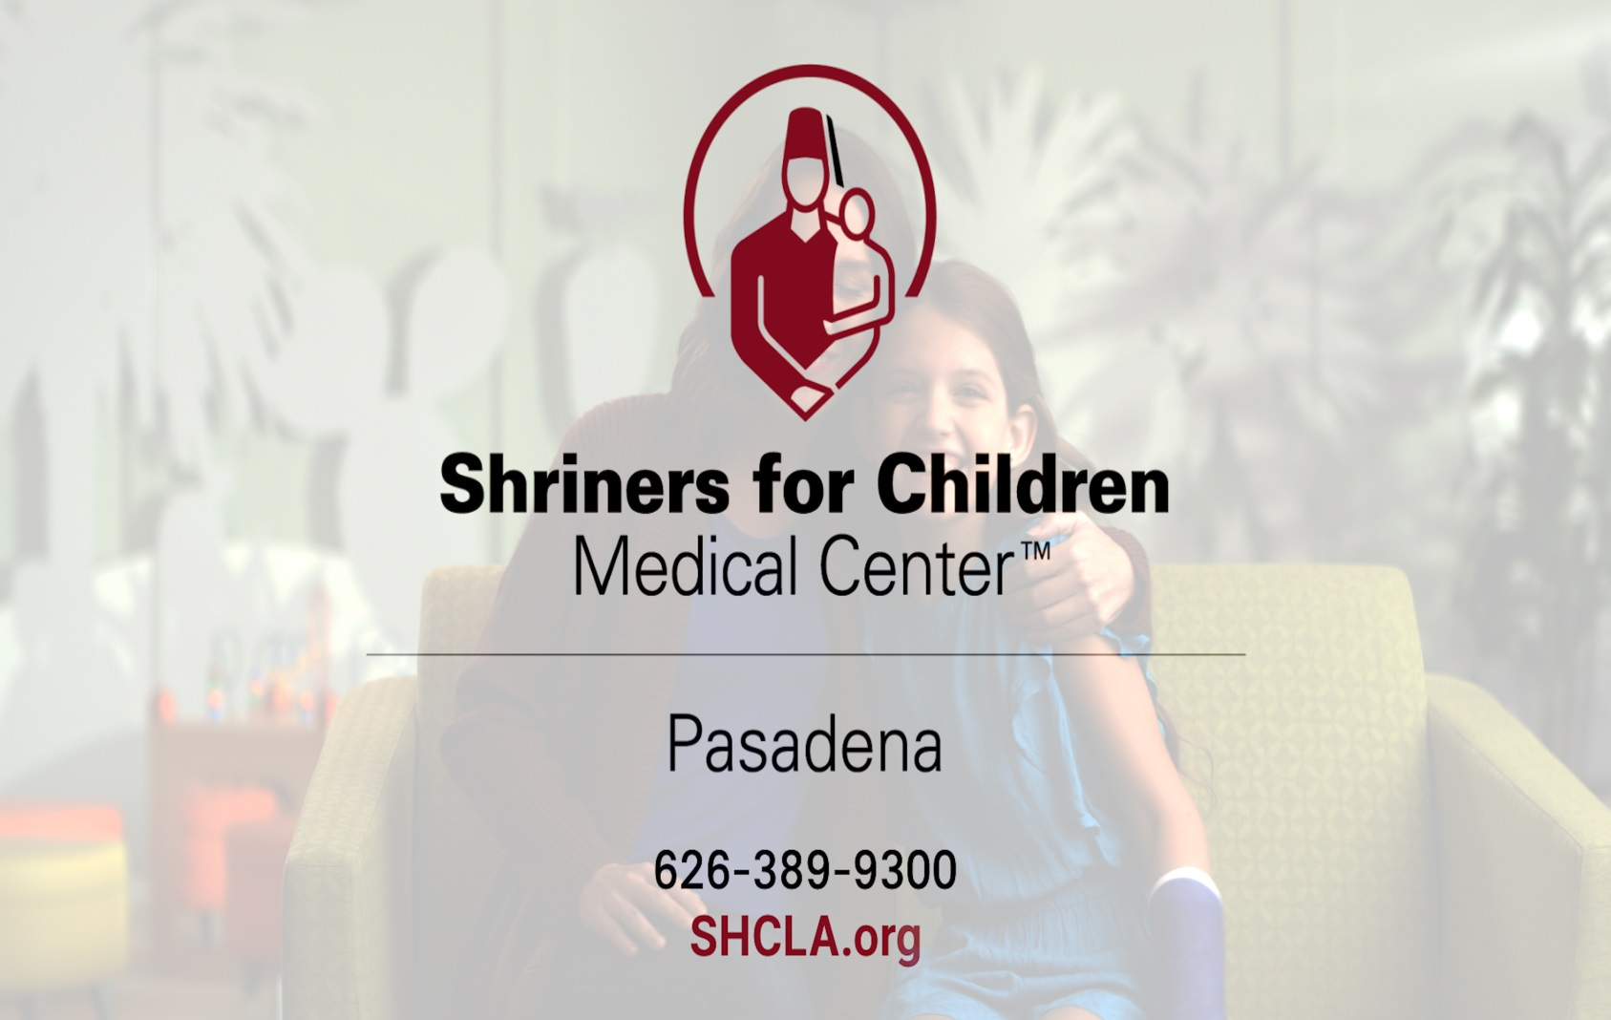
Orthopaedics Cleft Lip and Palate Burn Care
October 23, 2018
21

