Slide 1
BUSINESS AND ECONOMIC SUMMIT 2018
Dr. Somjita Mitra
Director, Institute for Applied Economics
LAEDC
October 23, 2018

Slide 2
CALIFORNIA INDICATORS
GDP Growth Unemployment Job Growth
2.5%
4.3%
1.8%
Institute for applied economics

Slide 3
GDP RANKING
1 | United States | $ 18,624
2 | China | 11,199
3 | Japan | 4,940
4 | Germany | 3,478
5 | United Kingdom | 2,648
v | California | $2,623
6 | France | 2,465
7 | India | 2,264
8 | Italy | 1,859
9 | Brazil | 1,796
10 | Canada | 1,529
….
15 | SoCal 5 | $ 1,243
….
19 | Los Angeles County | $ 760
GDP ($US billion) 2016
Institute for applied economics

Slide 4
GDP GROWTH
Institute for applied economics

Slide 5
UNEMPLOYMENT RATE
California
Institute for applied economics

Slide 6
STEADY GROWTH PATH
Expected job growth:
1.8%
Annual average 2018-2019
California will add about 636,500 jobs through 2019
Institute for applied economics

Slide 7
REAL GDP GROWTH LOS ANGELES
Los Angeles County Economic Development Corporation

Slide 8
UNEMPLOYMENT RATE LOS ANGELES
2010
12.5%
Forecast 2019
4.1%
Los Angeles County Economic Development Corporation

Slide 9
STEADY GROWTH PATH LOS ANGELES COUNTY
Expected job growth:
2.3%
Annual average
2018-2019
Los Angeles will add about 82,100 jobs through 2019
Los Angeles County Economic Development Corporation

Slide 10
JOBS FORECAST
Los Angeles County
(thousands of jobs)
Los Angeles County Economic Development Corporation

Slide 11
PaSADENA
2018 Population: 145,181
2023 Population: 58,454
2018 Households: 149,616
2023 Households: 60,151
Institute for applied economics

Slide 12
Race / ethnicity
LA County
City of Pasadena
Institute for applied economics

Slide 13
Educational attainment

Slide 14
income

Slide 15
HOUSEHOLDS BY INCOME

Slide 16
Top industries by NUMBER OF BUSINESSES

Slide 17
Top industries by EMLOYMENT

Slide 18
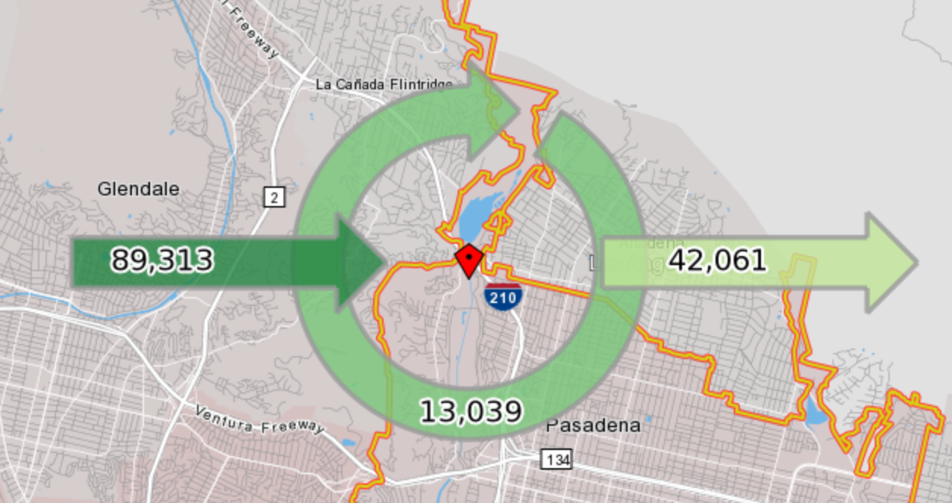
PASADENA COMMUTING PATTERNS

Slide 19
Housing

Slide 20
What Does Our Future Hold?

Slide 21
SINCE 2007…LOS ANGELES COUNTY
68,000
29,000
Fewer jobs in finance
Ave Wage: $119K
More social assistance
Ave Wage: $18K
Los Angeles County Economic Development Corporation

Slide 22
SINCE 2007…LOS ANGELES COUNTY
86,000
111,000
Fewer manufacturing jobs
Ave Wage: $68K
More jobs in food services
Ave Wage: $22K
Los Angeles County Economic Development Corporation

Slide 23
TOP 5 OCCUPATIONS
Retail salespersons
General office clerks
Cashiers
Laborers and freight handlers
Combined food preparation and serving
Los Angeles County Economic Development Corporation

Slide 24
ENTRY LEVEL REQUIREMENTS
Los Angeles County Economic Development Corporation

Slide 25
WAGE RANGE OF OCCUPATIONS
Los Angeles County Economic Development Corporation

Slide 26
CONCLUSION
Economic growth continues
Moderate wage growth expected
Job gains solid with “full employment” continuing
Consumer momentum
Real estate/construction outlook good
But.....
Geopolitical risks/future of trade policy
Political gridlock/policy uncertainty in U.S.
Rising energy prices and inflation risks
Housing shortage in California

Slide 27
Thank You!
somjita.mitra@laedc.org
(213) 236-4881

